Slide 1


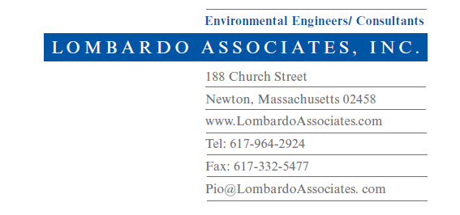
Nitrex Wastewater Treatment & Nitrogen Removal System
25 Years of Achieving TN < 3 mg/L
Pio Lombardo, P.E.
^{Yankee Conference}
Massachusetts Environmental Health Association
^{September 12, 2025}

Slide 2
Wastewater Quality
Total Nitrogen ~ 65 mg/L - Residential
(Organic N + ammonia) 15 g/day – person
12 lbs/year -person
~ 150 mg/L – Schools/Office/Retail
~ 80 mg/L – Restaurants
Nitrogen Removal Mechanisms
Organic Nitrogen → Ammonia - NH₄⁺
Ammonia NH₄⁺ → Nitrite -NO₂⁻ + H⁺→ Nitrate NO₃⁻ Nitrification
Nitrate NO₃⁻ → Nitrogen Gas (N₂) Denitrification

Slide 3

Nitrex™ Technology for Nitrogen Removal – since 2000
Simplified Process Flow Diagram
  *Operating Projects of Nitrex technology for Nitrogen removal in MA, CT, NY, RI, MD, VA, NC, FL, AZ, CA, OR, UT & MT–since 2000
  Very low energy use. No aeration. Treatment system cannot be shut off. Oxygen provided by spraying water over media.
  Can be completely gravity at sites with sufficient slope and land area
  Sludge (in addition to Septic Tank) – no need for removal for 20++ years
  Electricity solely for periodic pump use – 110 kwhr/year
  Professional Engineer Guaranteed to achieve TN < 10 mg/L, Averaging 3 mg/L

Slide 4
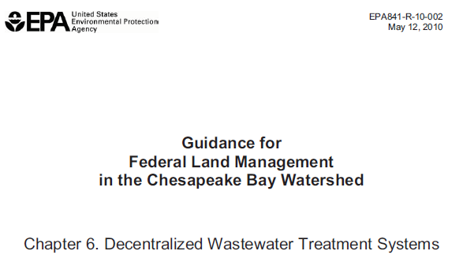
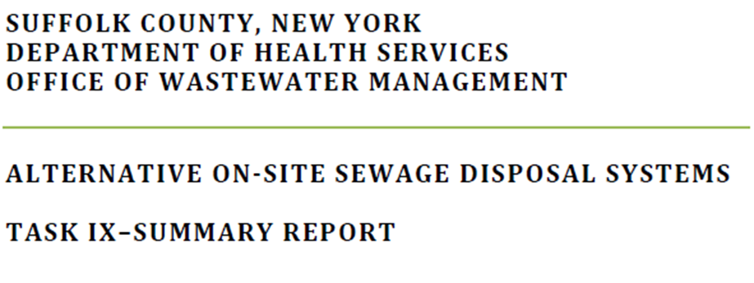
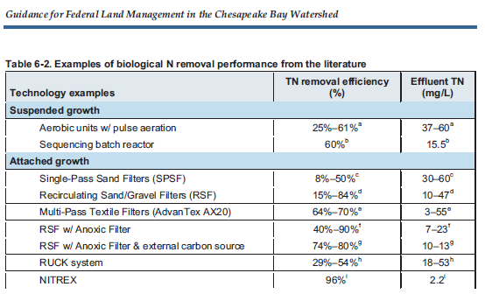
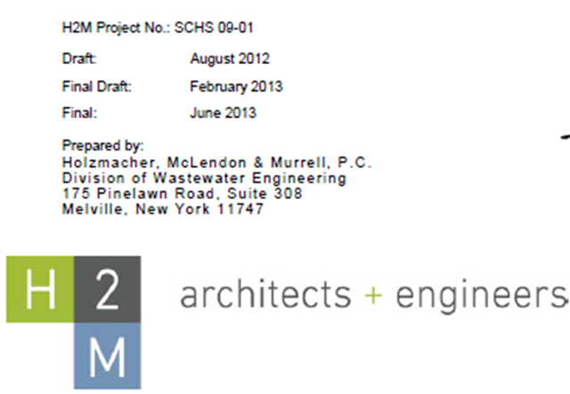
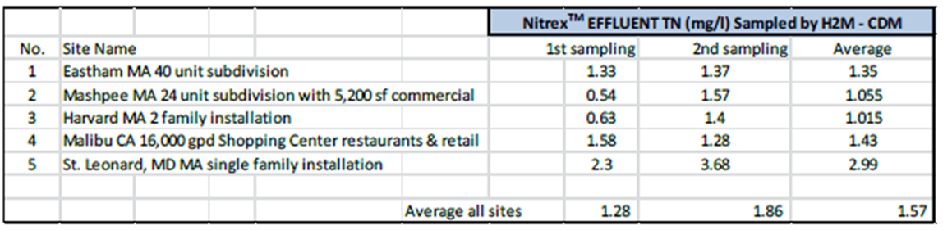

Slide 5
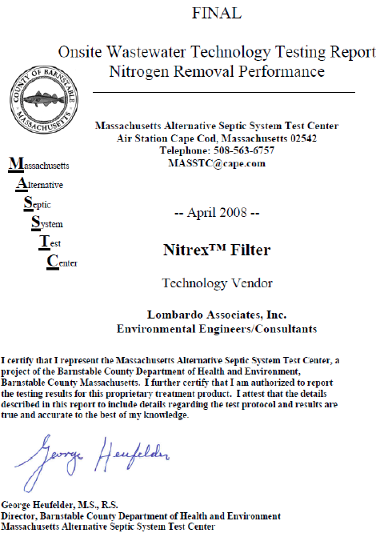
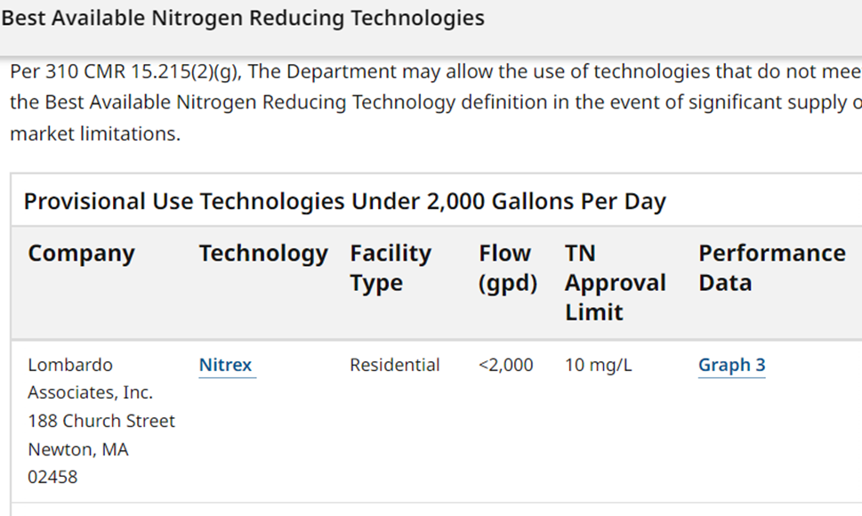
MassDEP - Best Available Nitrogen Reducing Technologies

Slide 6
O&M Requirements & Costs
Consistent performance even with seasonal use – tested at MASSTC in 2002
Min. Operator visits - 1 year
Costs – Single family, 3-4 bedroom
  Equipment costs $21,900 - $24,000
  Installed costs – site specific
  O&M
    Electricity (110 kwhr/yr) $ 30 – 50+/yr
    Total O&M Costs w/o sampling $250/yr
    Mass DEP required O&M sampling with O&M
        Years 1 – 3 $1,950
        Year 4+ $ 650

Slide 7
Nitrogen Removal for larger Title 5 and Groundwater Discharge Systems
SCADA - Treatment system managed by a Programmable Logic Controller (PLC) with internet connection to Engineer + Operator
Daily reports electronically issued on system wastewater flows and process unit status.
Alarm conditions are instantaneously sent to the facility operator and engineer with identification of alarm cause

Slide 8
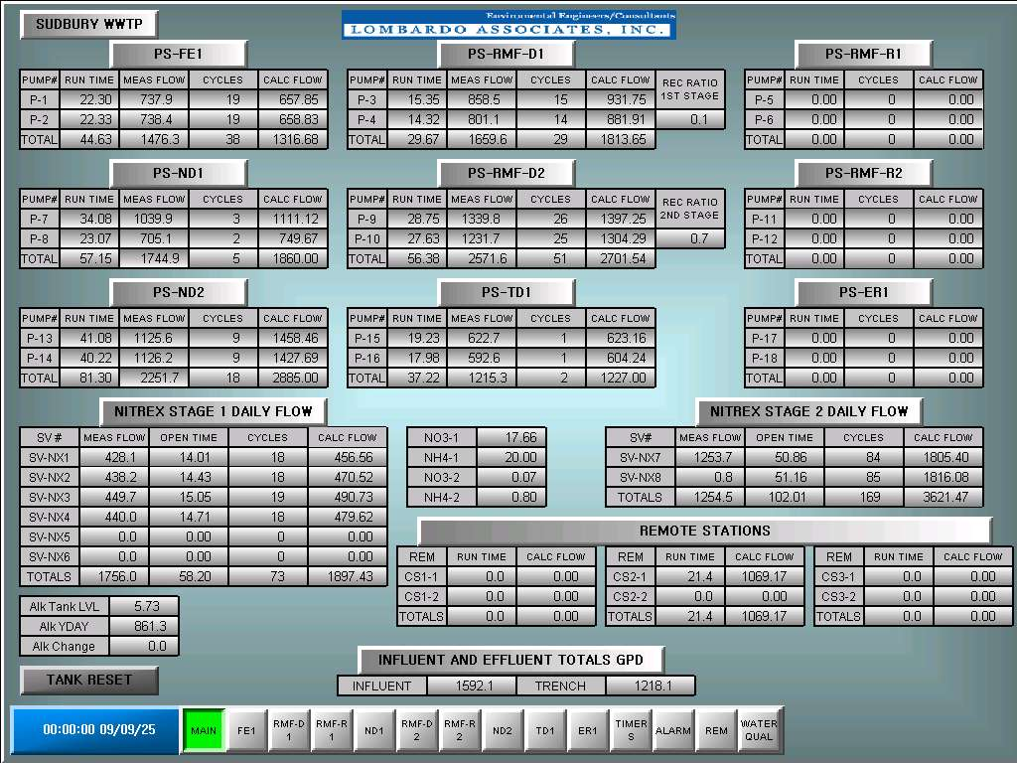

Slide 9
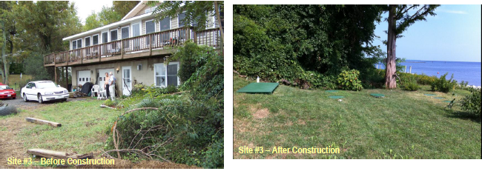
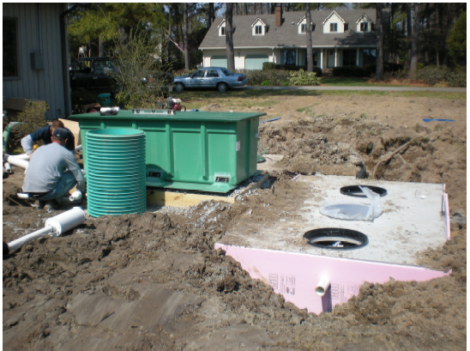
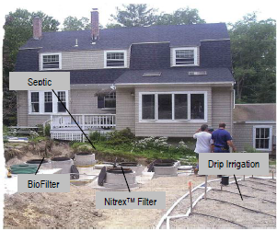
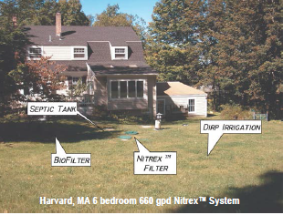
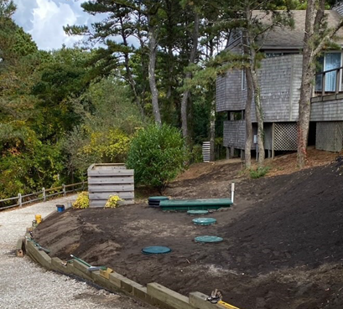
Representative Installations - Single Family
Nitrex RMF
Septic Tank
NitrexTM

Slide 10
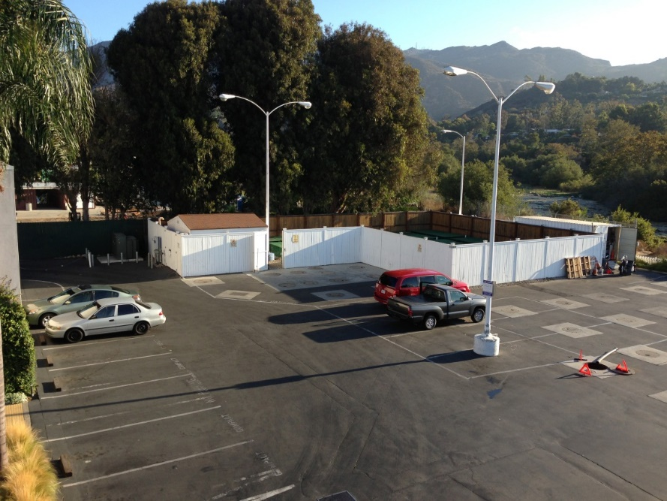
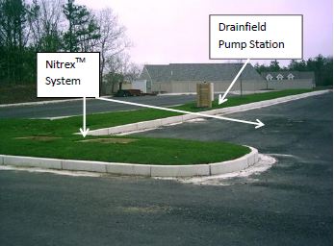
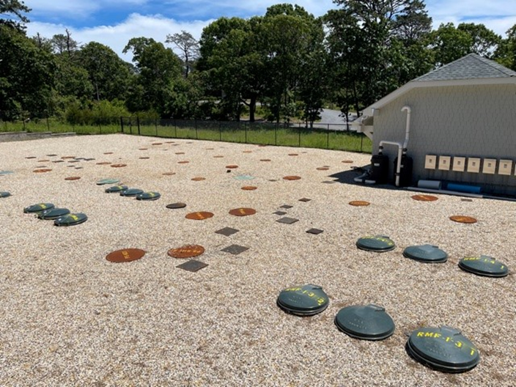
Larger Flows- Neighborhood Systems + PRB Representative Installations
5,625 gpd – Mashpee – TN 3 mg/L - 2006
45,000 gpd – Malibu, CA TN 3 mg/L - 2007
11,000 gpd serving 37 Townhouses TN < 2 mg/L – Southampton NY 2020

Slide 11
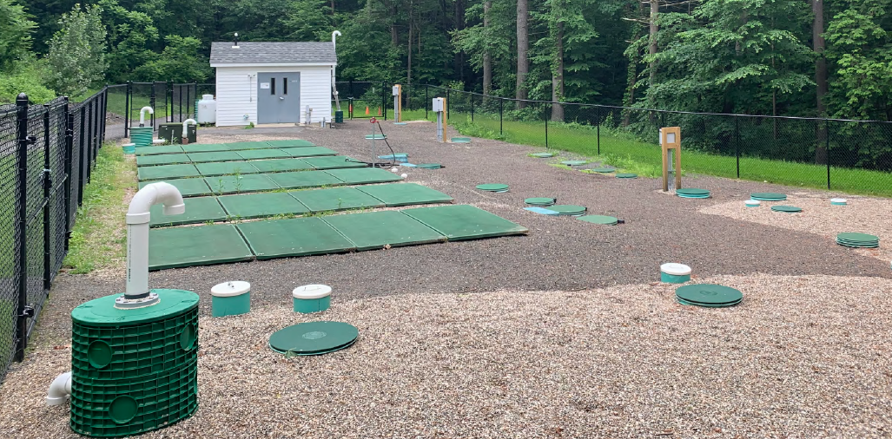
Sudbury Crossing – 9,600 gpd
Southampton NY
Condominiums – 11,900 gpd
Granby, MA – 17,700 gpd

Slide 12
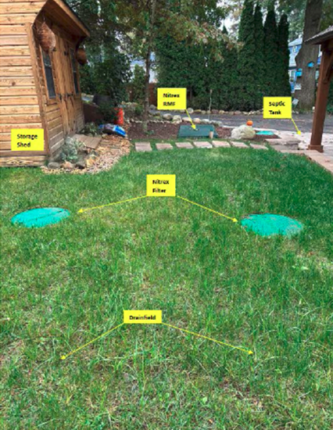
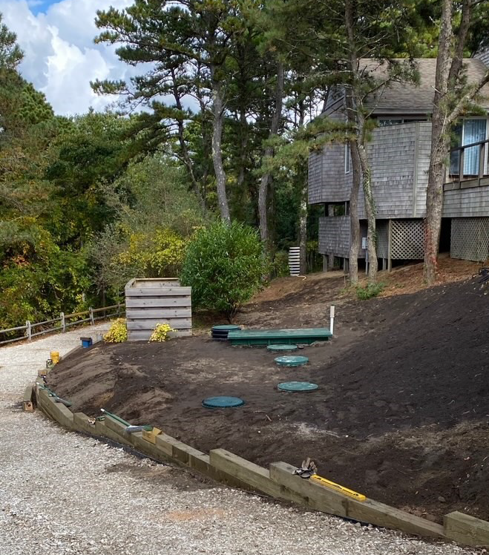
Harvard, MA
Westfield, MA
Wellfleet, MA

Slide 13

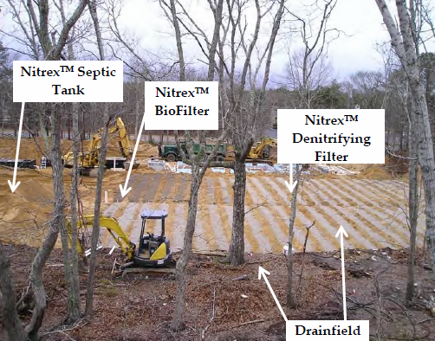
Malibu, CA
Mashpee, MA
Eastham, MA

Slide 14
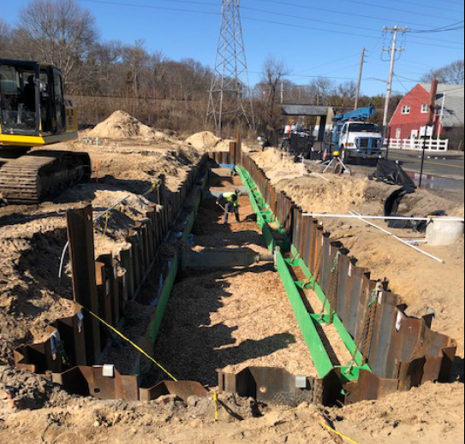
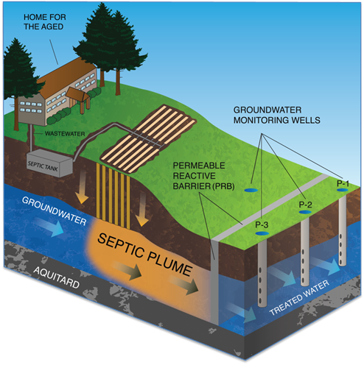
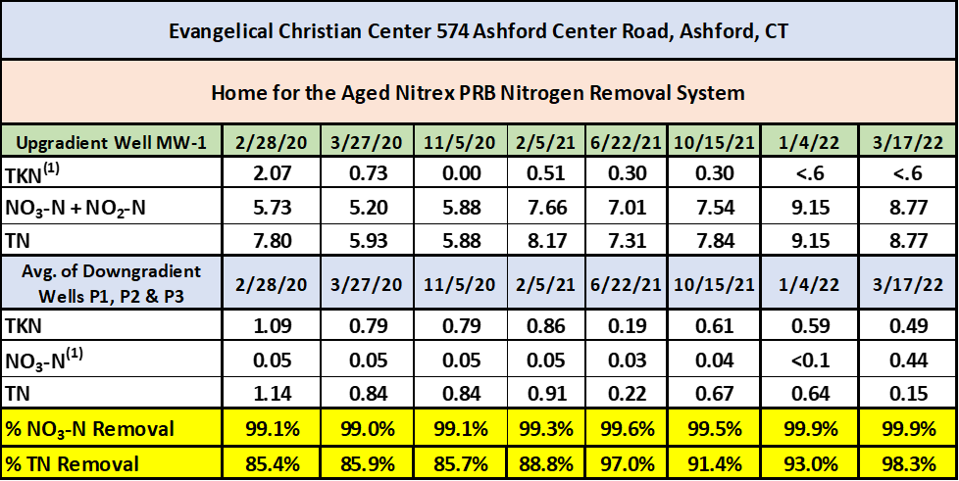
PRB Installations
Southampton NY – Projects Net Positive N Removal
Ashford CT – 99+% NO₃-N Removal

Slide 15
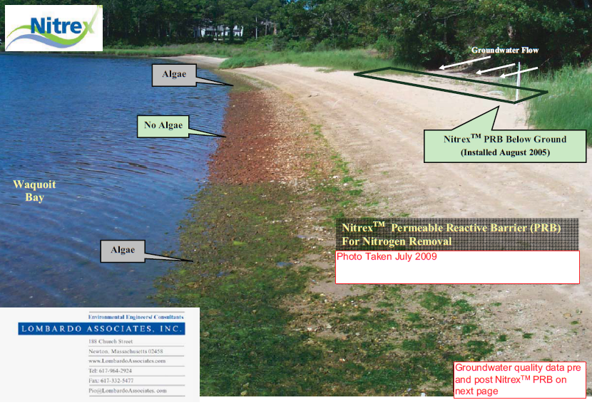
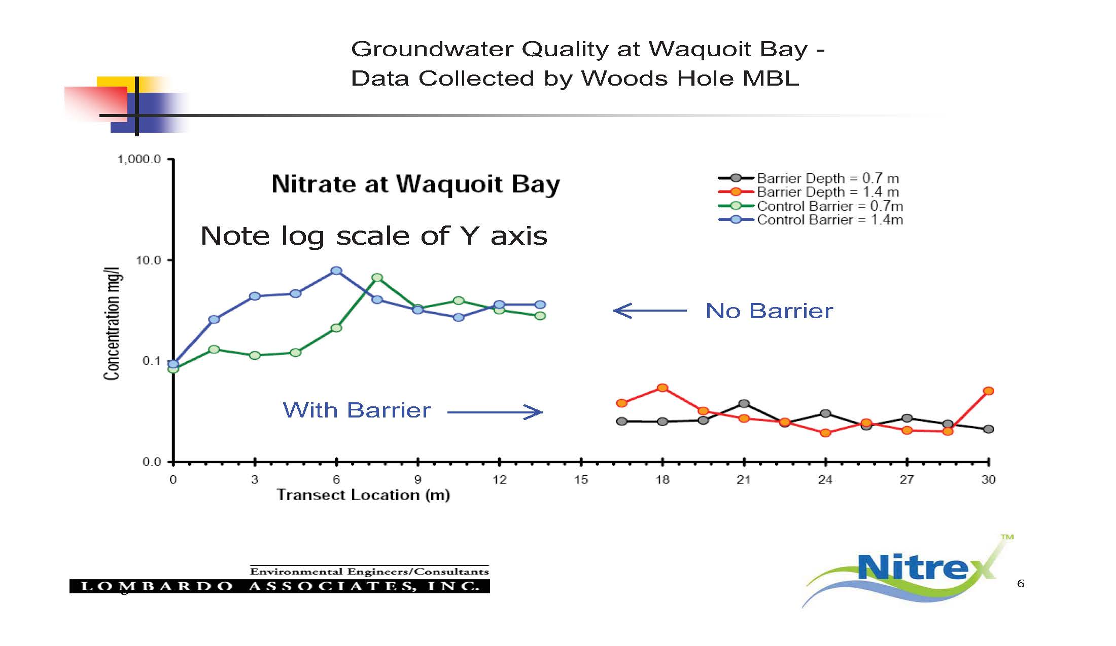
PRB Installation
Waquoit Bay – Falmouth - 2005
Where viable, PRBs can be significantly less expensive than wastewater treatment for N removal.

Slide 16
Questions / Discussion
Thank you for your attention
Pio Lombardo, P.E.

