Slide 1



Nitrogen
The Good the Bad
and the Ugly….
and how it relates to Nitrogen Sensitive Areas and the “new” Title 5
George Heufelder M.S., R.S.
Gheufelder@capecod.gov

Slide 2

Outline
Nitrogen – what’s the big deal and why are we so concerned ?
What changed in the “new” 310:CMR 15.000 (Title 5)
What has occurred to help address the new challenges

Slide 3

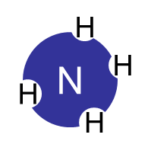
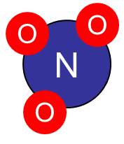
Nitrogen – what’s the big deal and why are we so concerned ?
In a nutshell ….
Wastewater disposal practices like septic systems break down complex nitrogen into smaller molecules that pose both public health and environmental threats.

Slide 4


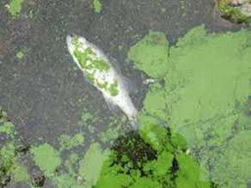
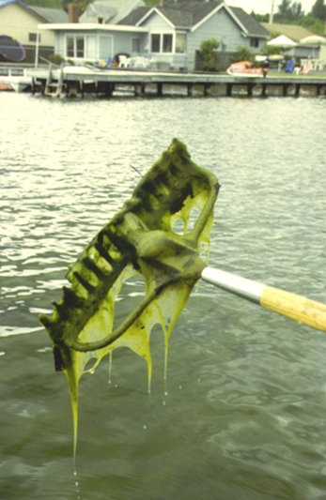
Good
Blue Skies
Food
NO “1992 molecule of the year”**
DNA
Protein
NITROGEN
Bad
Ugly
Nitrates in Drinking Water
Eutrophication of marine environments
Methemoglobinemia
Cancer risks
Toxic algae blooms
Anoxic Zones
Impaired water uses
**Research has proven the crucial role the gas plays in such fundamental biological processes as regulation of blood pressure, functioning and malfunctioning of the immune system, and activation of mechanisms in the central nervous system affecting everything from gastric motility to memory to behavior. https://www.ahajournals.org/doi/10.1161/01.cir.98.22.2365#:~:text=Nitric%20oxide%20was%20named%20%E2%80%9CMolecule,1998%2C%20in%20Stockholm%2C%20Sweden.

Slide 5













Thinking globally about reactive nitrogen
Fertilizer
Lightning
6.6 x 10 ⁹ -
2.2 x 10 ¹⁰ lbs
Crop management
2.2 x 10 ¹¹ lbs
N₂
8.8 x 10 ¹⁰ lbs
?
Haber-Bosch
2.6 x 10 ⁸ lbs
NO_{x}
6.6 x 10 ¹⁰ lbs
Environmental Health Perspectives
Volume 112(10), 2004
4.4 x 10 ¹⁰ lbs
Burning – marsh clearing etc.

Slide 6
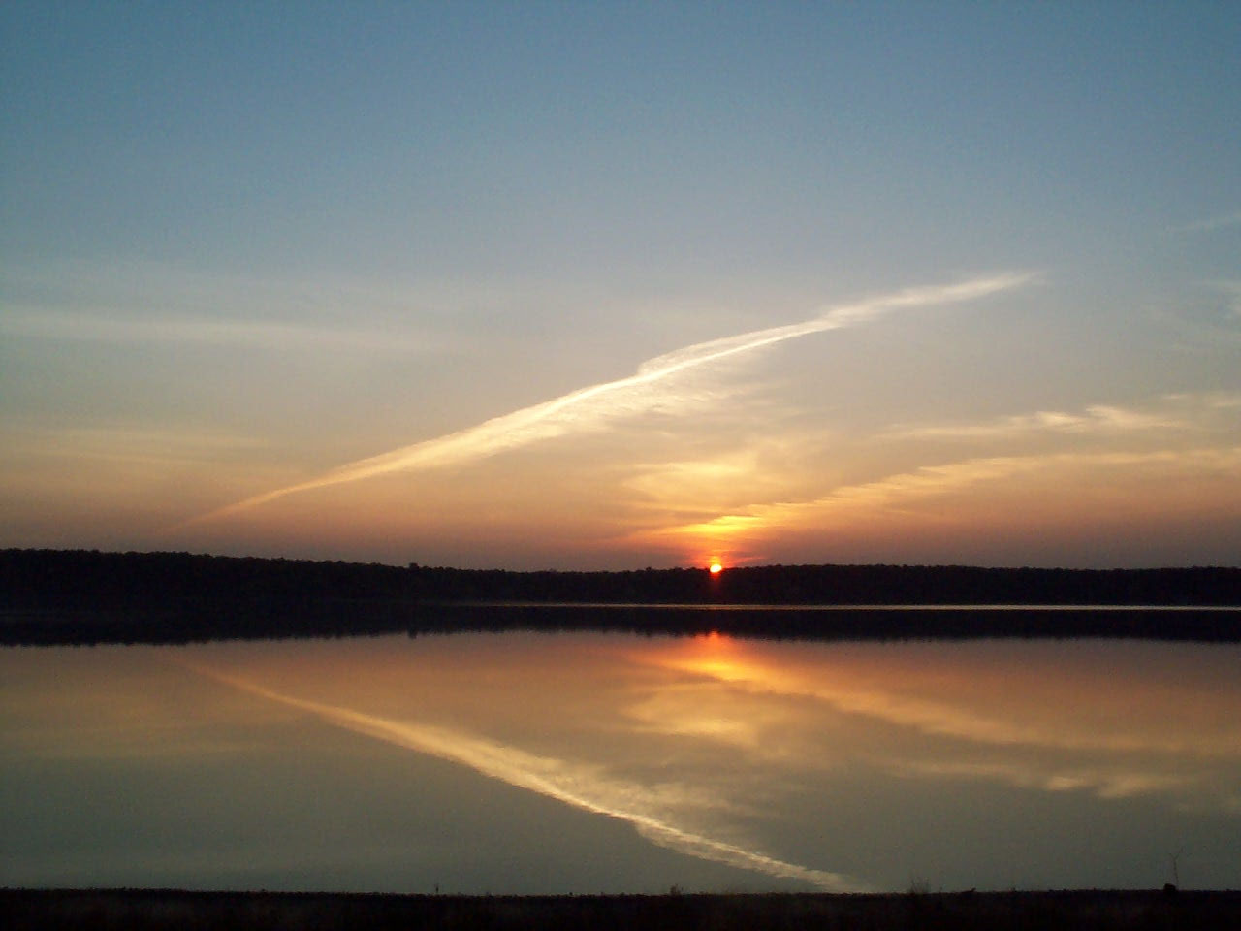

Nitrogen Cycle
The Big Picture
The Zen of N
WE are part of the nitrogen cycle. We take in nitrogenous nutrients that ultimately came from organisms that fixed atmospheric nitrogen gas (or plants that got their nitrogen from commercial fertilizers). We excrete what nitrogen we don’t need, primarily as urea, into our septic tanks. Bacteria in the septic tank anaerobically ammonify the nitrogen. Other bacteria aerobically nitrify the ammonia in the soil as wastes pass through the leachfield. If we introduce nitrified waste to the right anoxic setting, we can denitrify the wastewater or turn the nitrate into nitrogen gas. And the cycle continues…..

Slide 7

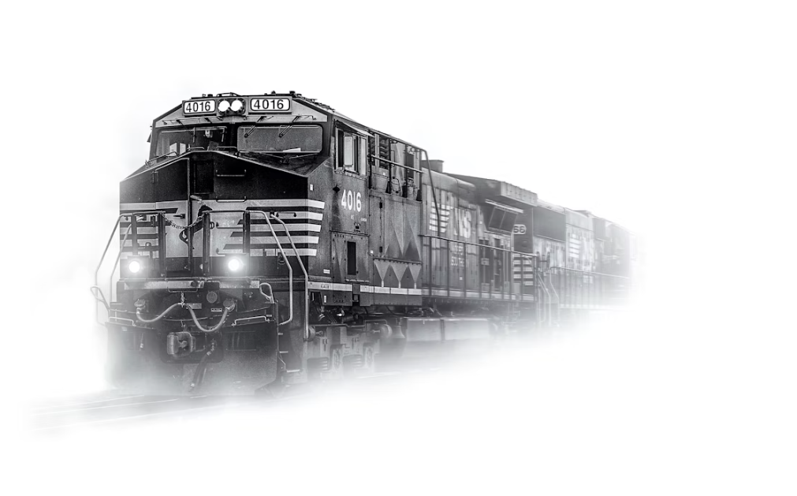
For the most part
Microbes drive the train

Slide 8
So, what’s new ?

Slide 9
Nitrogen
So, what’s new ?
Sensitive
Areas
It’s not just about drinking water resources anymore

Slide 10

Prequel Review
Title 5 - 1995
NSA
Focus on drinking water
NSA
Title 5 - 2023
Focus on drinking water
and additionally identified sensitive surface water receptors

Slide 11


Review - NSAs prior to recent code changes
1995
4 BEDROOMS PER ACRE
Title 5 circa 1995 introduced the ability to increase the density to six bedrooms per acre using approved innovative/alternative septic systems that could meet a 19mg/L Total Nitrogen discharge limit
Why?
Drinking water protection
At 440 gallons per day, the total nitrogen (primarily nitrate) could meet an acceptable level of nitrogen in the groundwater (combined with other sources) as to not present a public health risk at the property line (5 mg/L?)

Slide 12
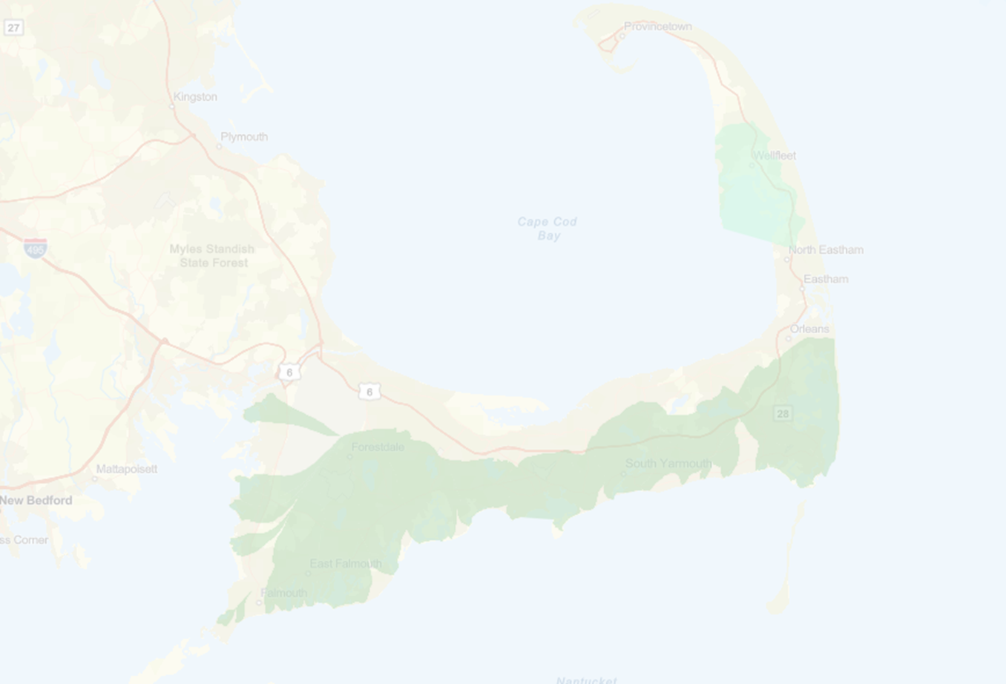
The “new” NSAs
It’s all about watersheds
Watershed - Any region or area measured in a horizontal topographic divide which directs water runoff from precipitation, normally by gravity, into a stream, a body of impounded surface water, or a coastal embayment, or any region or area measured by a groundwater divide which directs groundwater into a stream, a body of impounded surface water, or a coastal embayment.
15.215: Designation of Nitrogen Sensitive Areas (emphasis added)

Slide 13
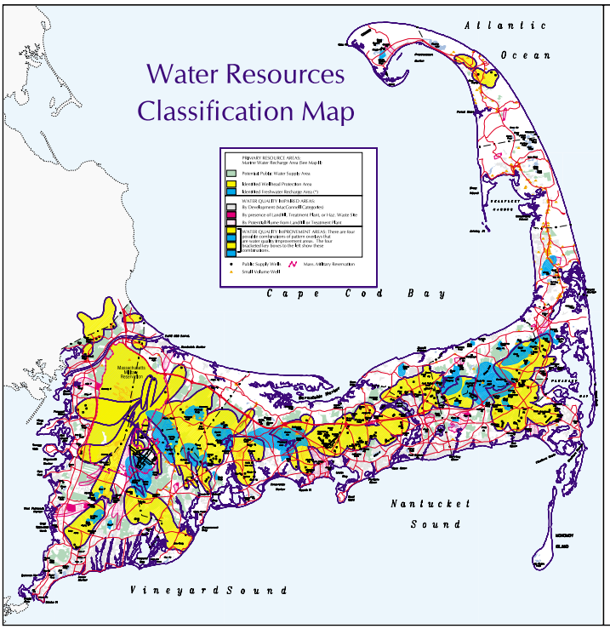
Watersheds
are
analogous to
Zones of Contribution
(wellhead protection areas)
Both define the land areas that contribute/direct/influence groundwater or surface runoff toward a feature of concern.
Source: Cape Cod Commission - Water Resources Classification Map

Slide 14

Coming soon to a theatre or watershed near you (if it’s not already there)
– the NEW Nitrogen Sensitive Areas -

Slide 15
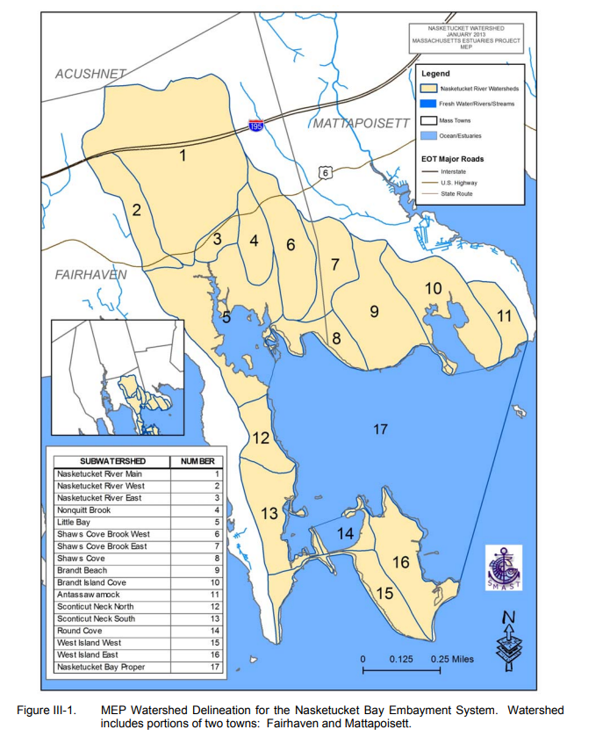
ACUSHNET
MATTAPOISETT
Sub watershed
FAIRHAVEN
Groundwater divide

Slide 16

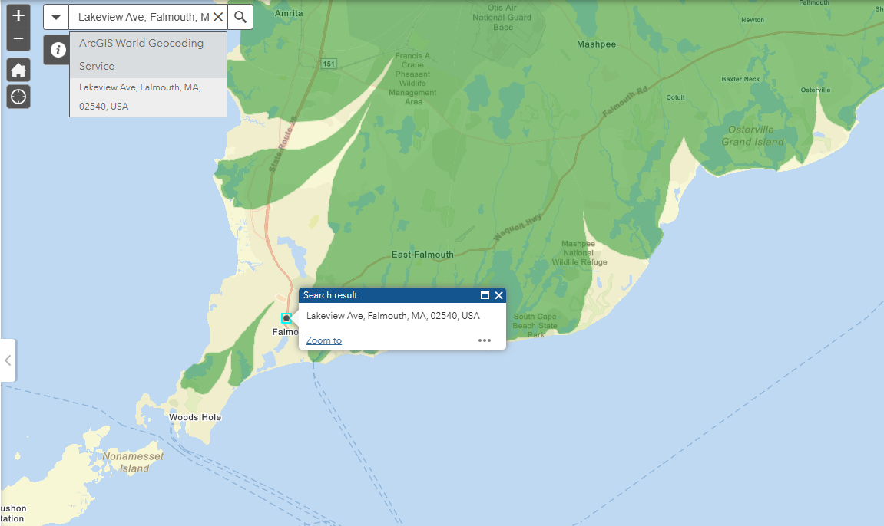
https://mass-eoeea.maps.arcgis.com/apps/webappviewer/index.html?id=96035fe034044e2596b49168b0e35d8e
MassDEP has provided a lookup interactive map to determine whether a property in is a new NSA
MassDEP Designated Natural Resource Area Nitrogen Sensitive Areas

Slide 17
WATERSHEDS - THE NEW NITROGEN SENSITIVE AREAS
Nitrogen removal performance requirements need to be determined by the carrying capacity of the receiving waterbody (usually determined in process of compiling a watershed wastewater management plan).
Generally higher levels of performance and management will be required compared to drinking water NSAs

Slide 18
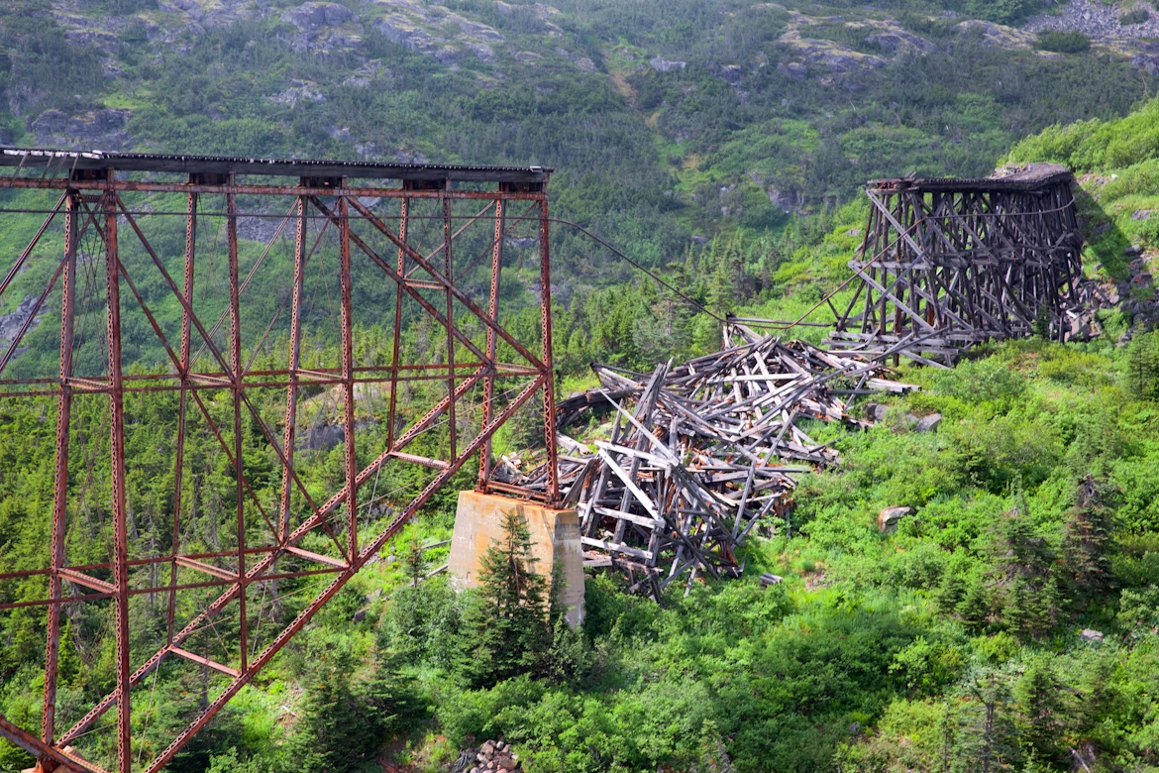
Total
Maximum
Daily
Load
How much of a contaminant can you load on a contributing area without getting an undesired result at the point of interest ?
Or…

Slide 19

Total Maximum Daily Load
How much of this ?
Before you get this
Or…

Slide 20


Total Maximum Daily Load
How many of these ?
Before you get this

Slide 21
Total Maximum Daily Load
Once you have these
How do you fix
this?

Slide 22
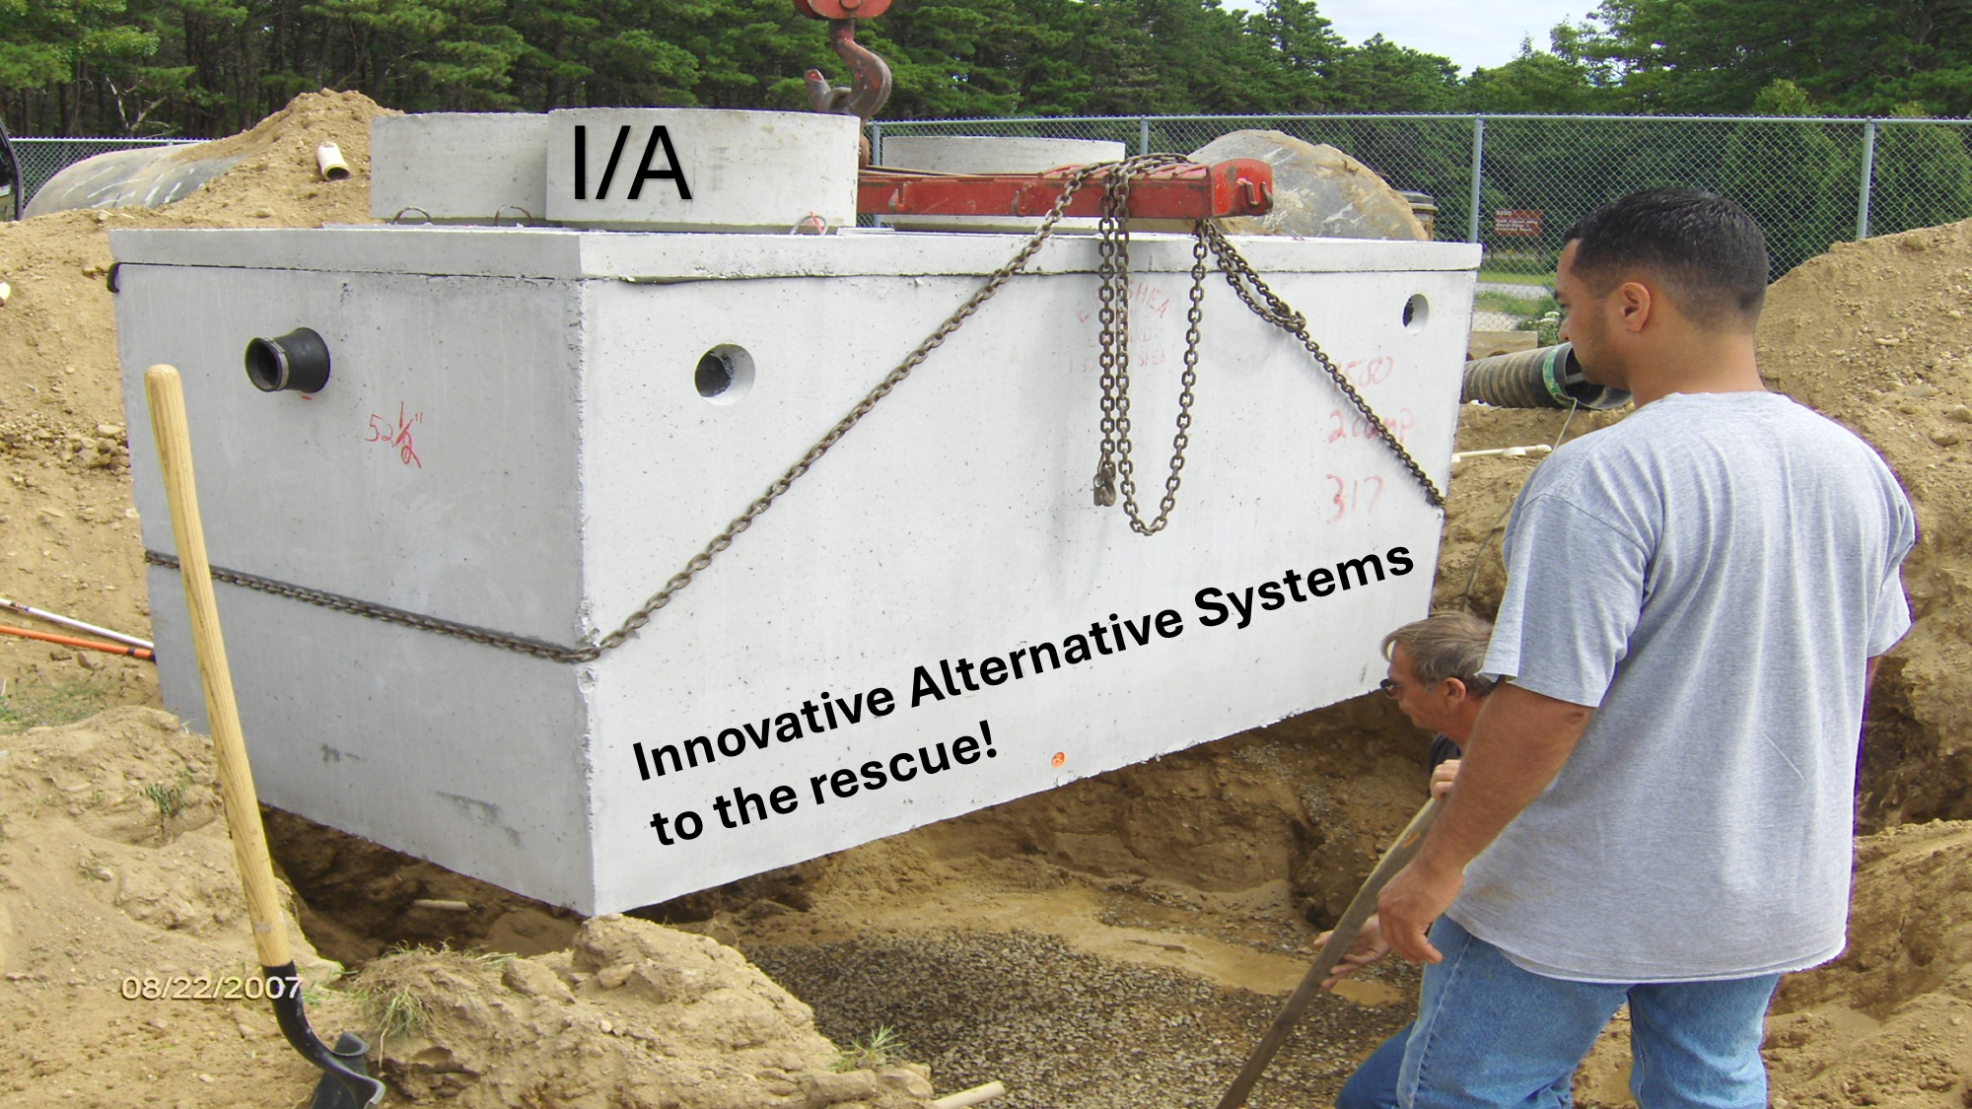
I/A Septic Systems
One of many ways to reduce
nitrogen loading
ONE WAY

Slide 23

How do Innovative/Alternative (I/A) septic systems reduce nitrogen loading?

Slide 24


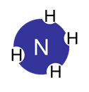
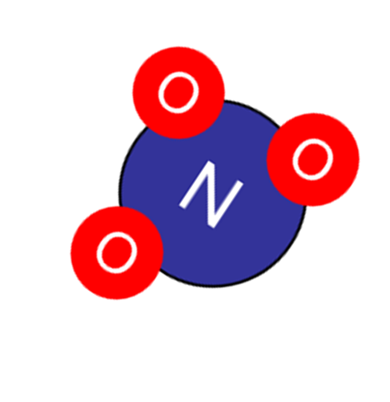



In a nutshell… Innovative Alternative Septic Systems (I/A) manipulate the nitrogen cycle in contained units to first oxidize reduced nitrogen (ammonium) to nitrate and then reducing nitrate to nitrogen gas.

Slide 25
Types or broad classes of alternative onsite septic systems that remove nitrogen.
Trickling filters (various media)
Mixed liquor systems with some fixed film growth
Sequencing Batch Reactors
Membrane bioreactors
Woodchip Bioreactors
The mention or showing of any product does not represent and endorsement for its use by the Barnstable County Department of Health and the Environment

Slide 26
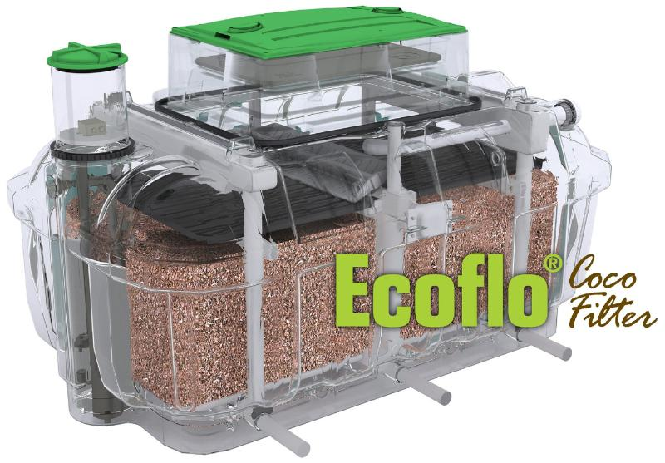
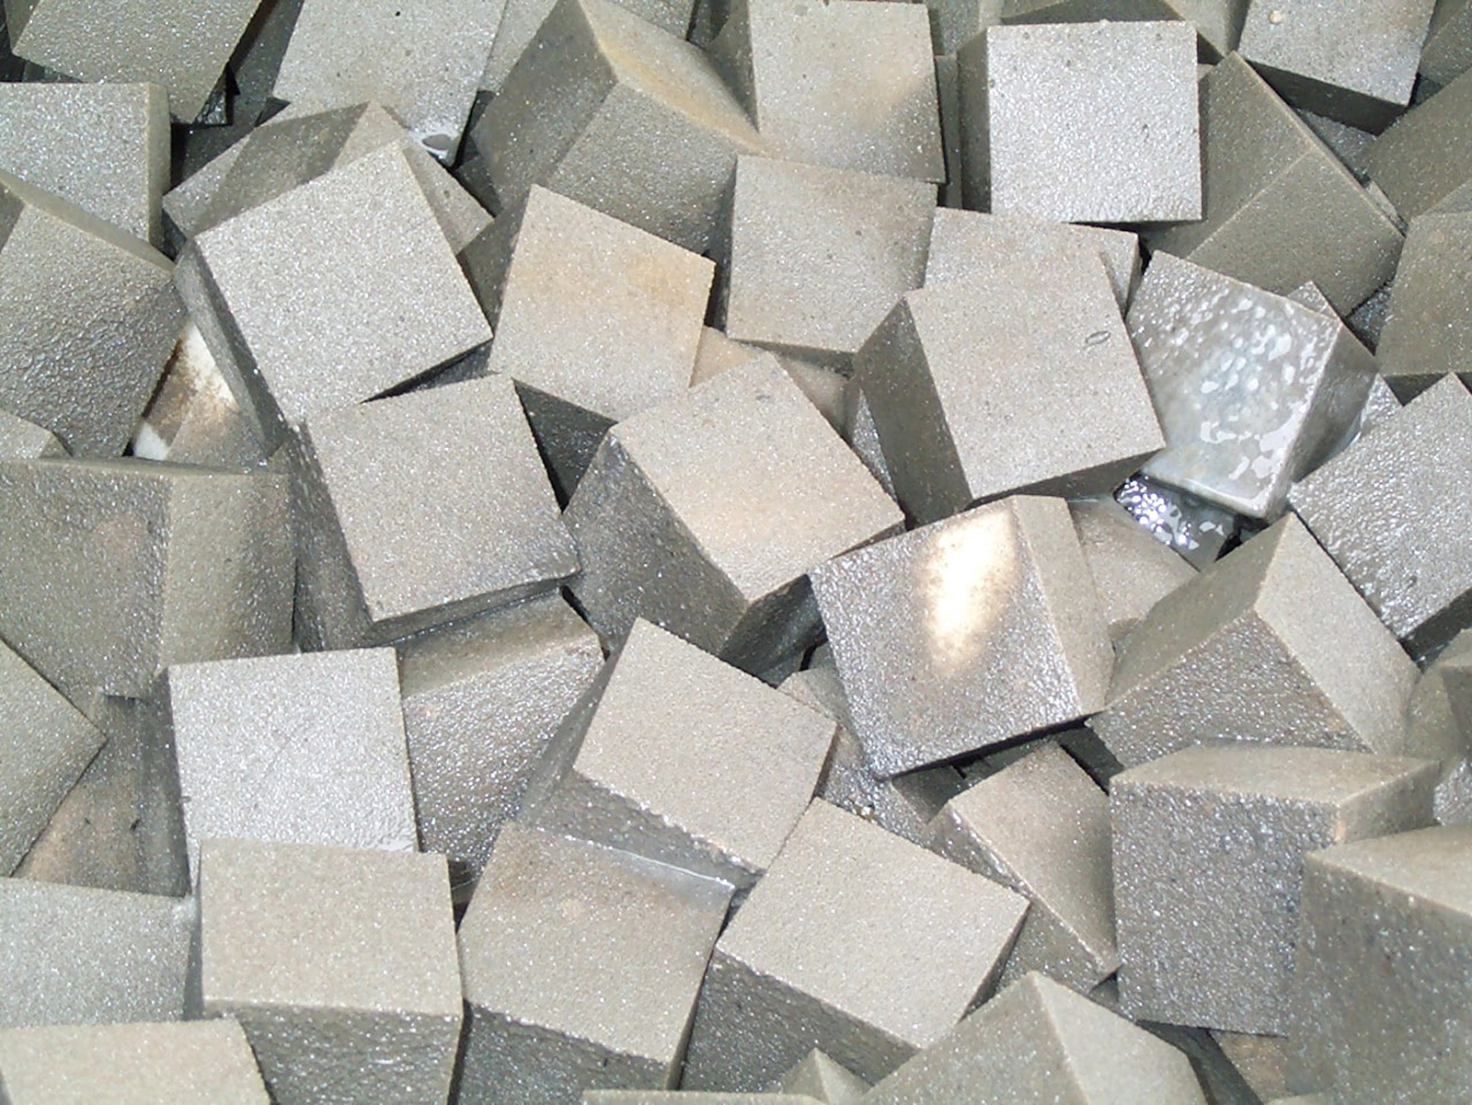
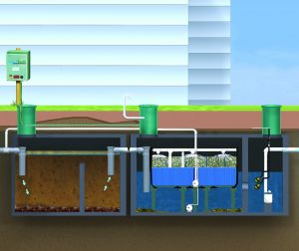
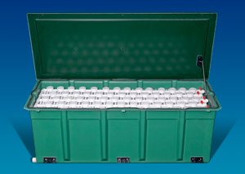
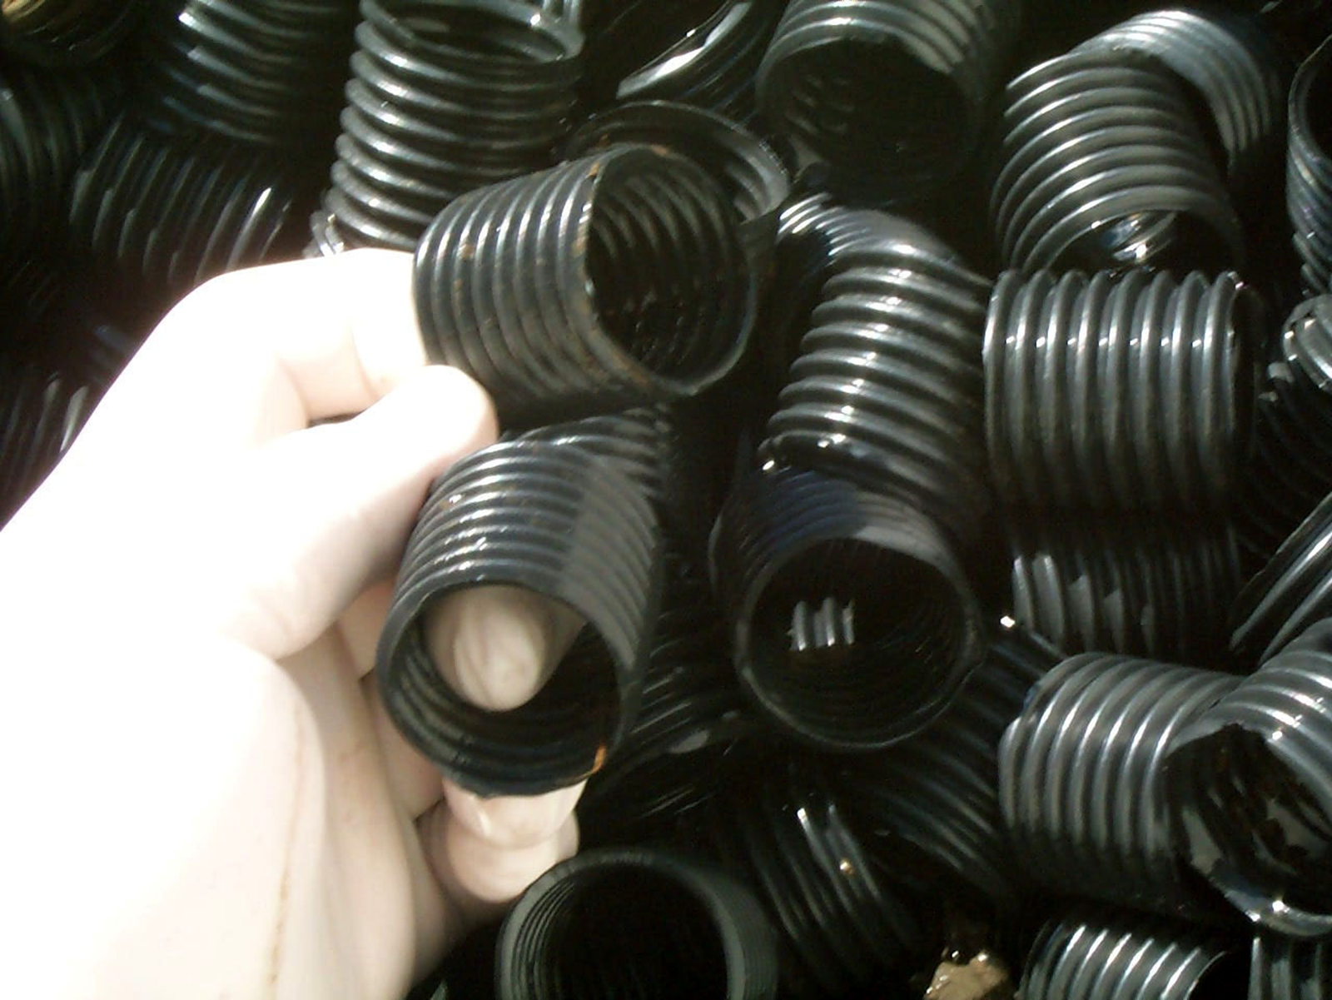
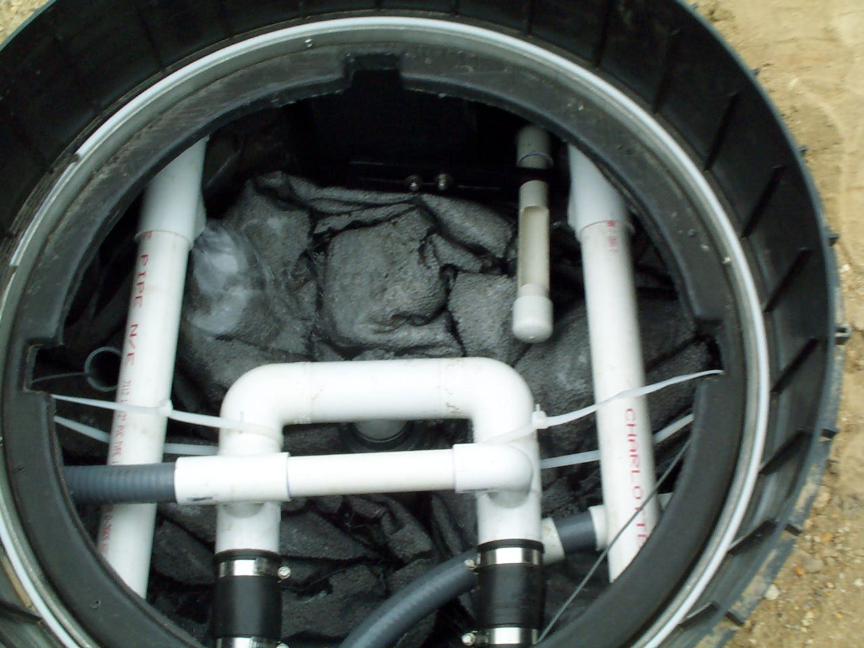
Media Filters
with recirculation

Slide 27
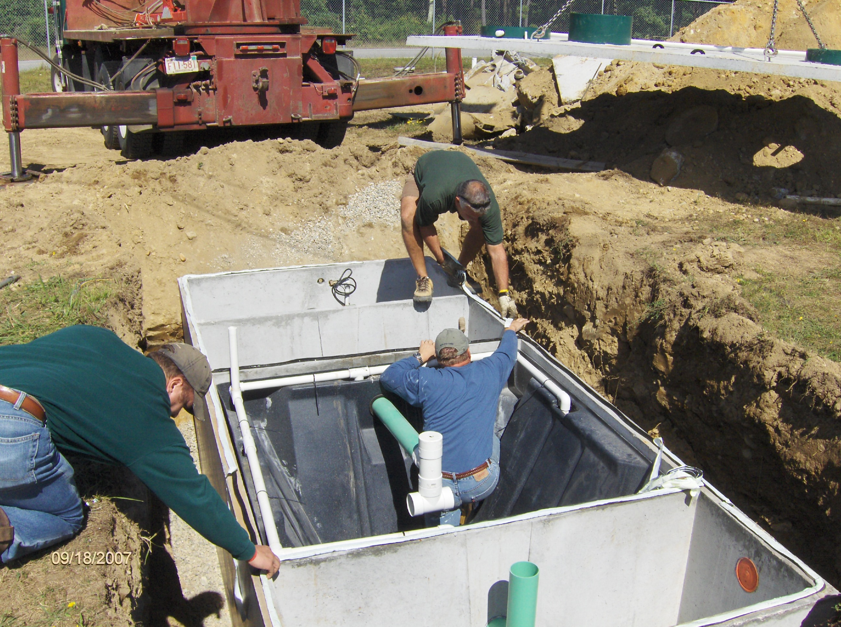
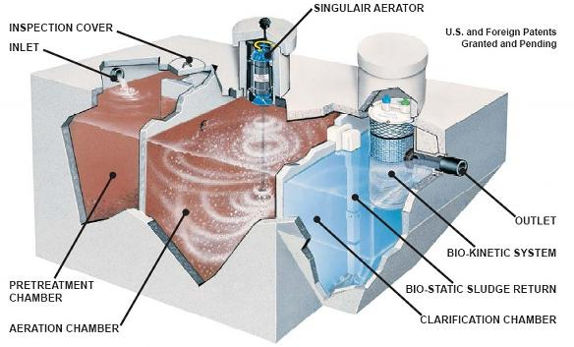
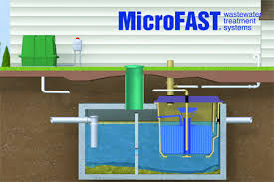
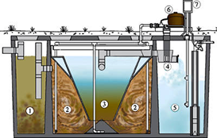
Mixed Liquor
and fixed film
some with recirculation
HOOT®

Slide 28
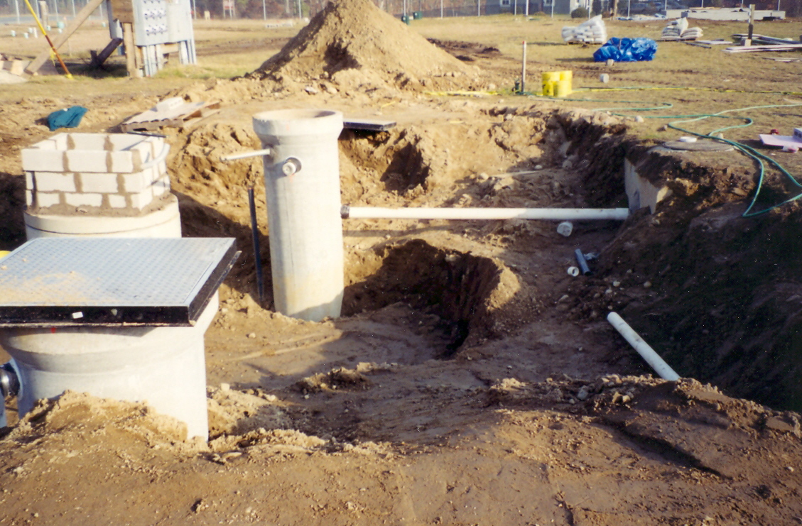
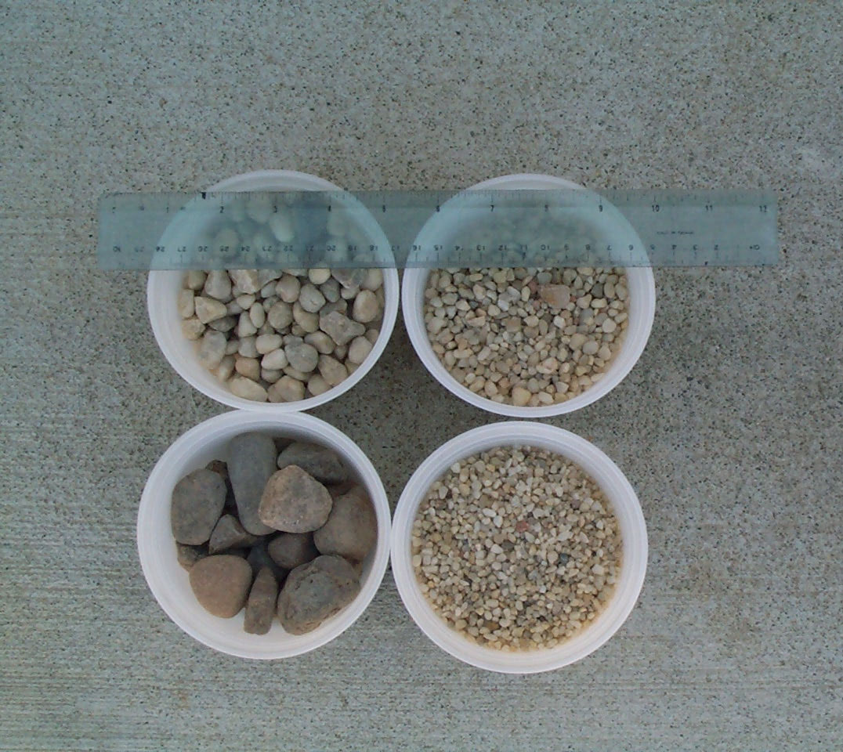
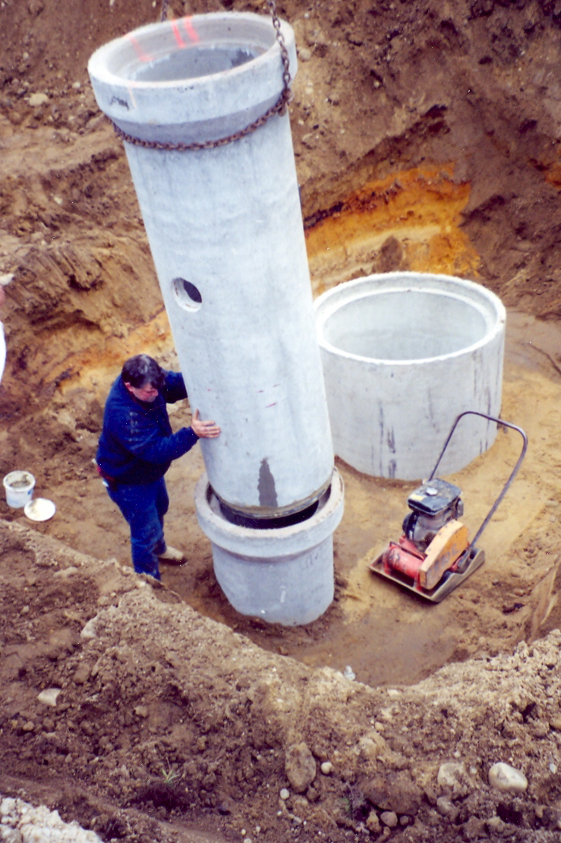
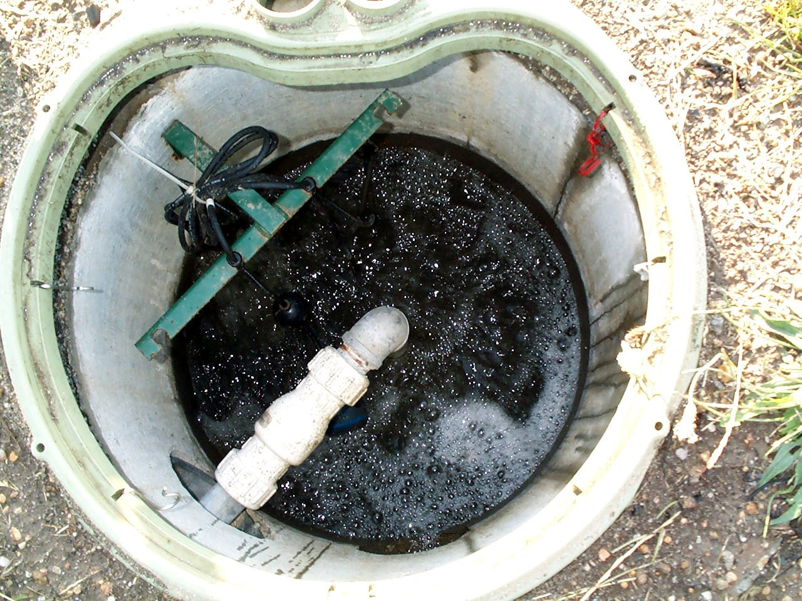
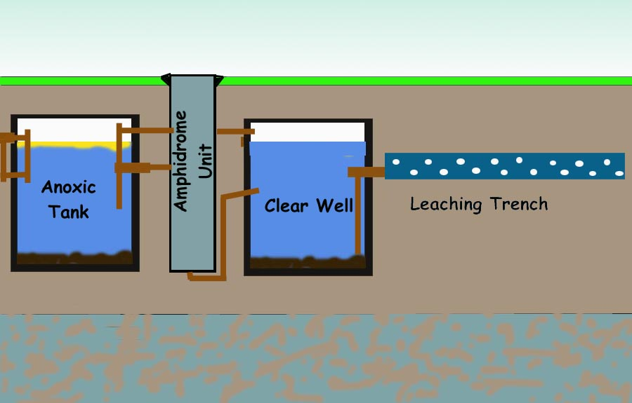
Sequencing Batch Reactors

Slide 29
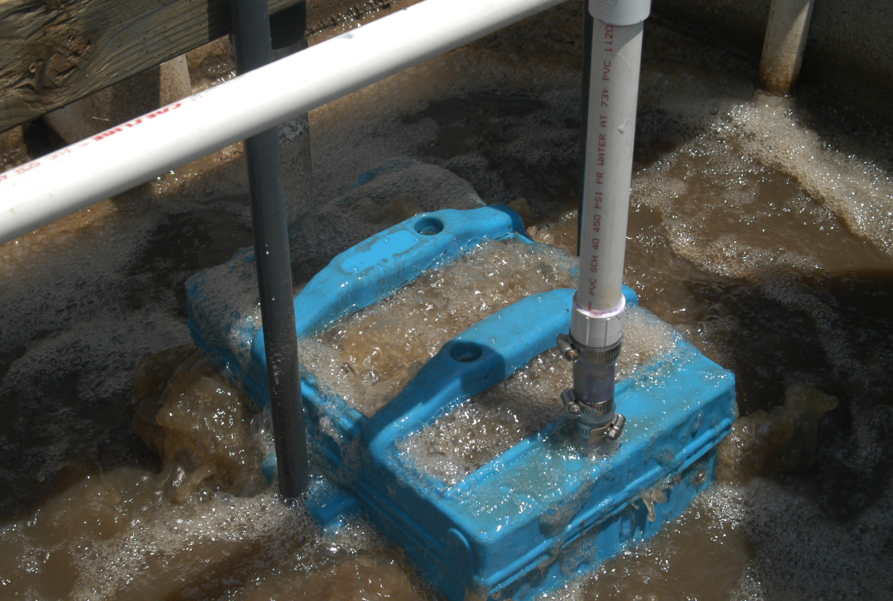
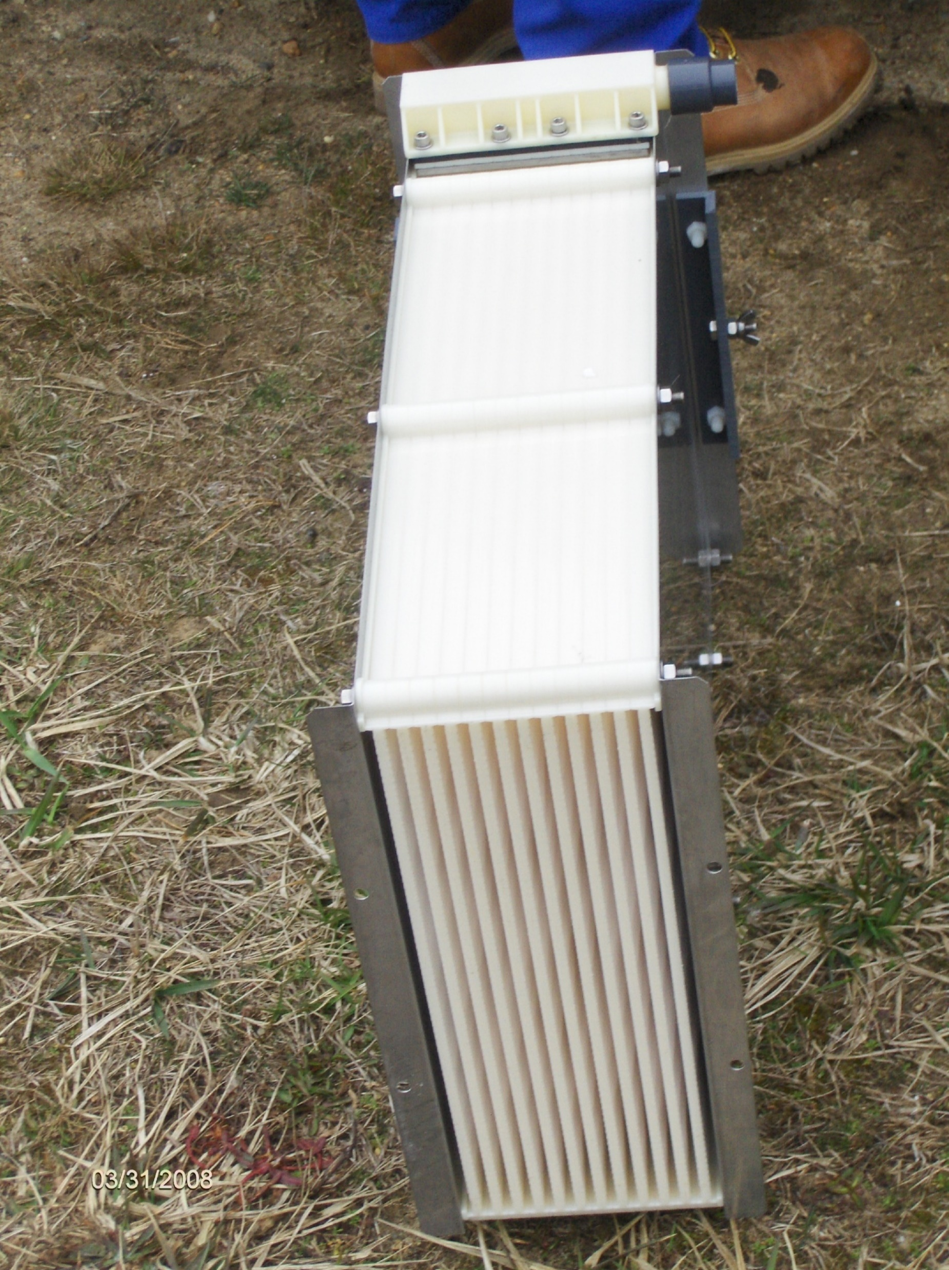
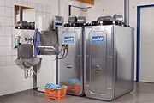
Membrane
Bioreactors
some with recirculation

Slide 30
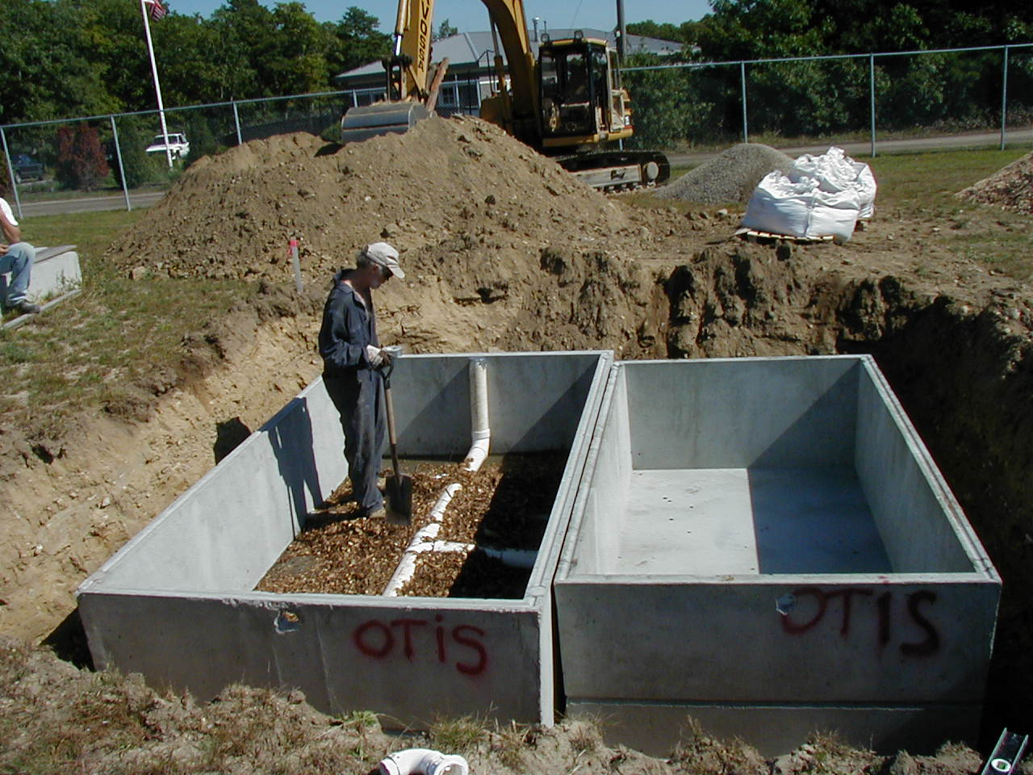
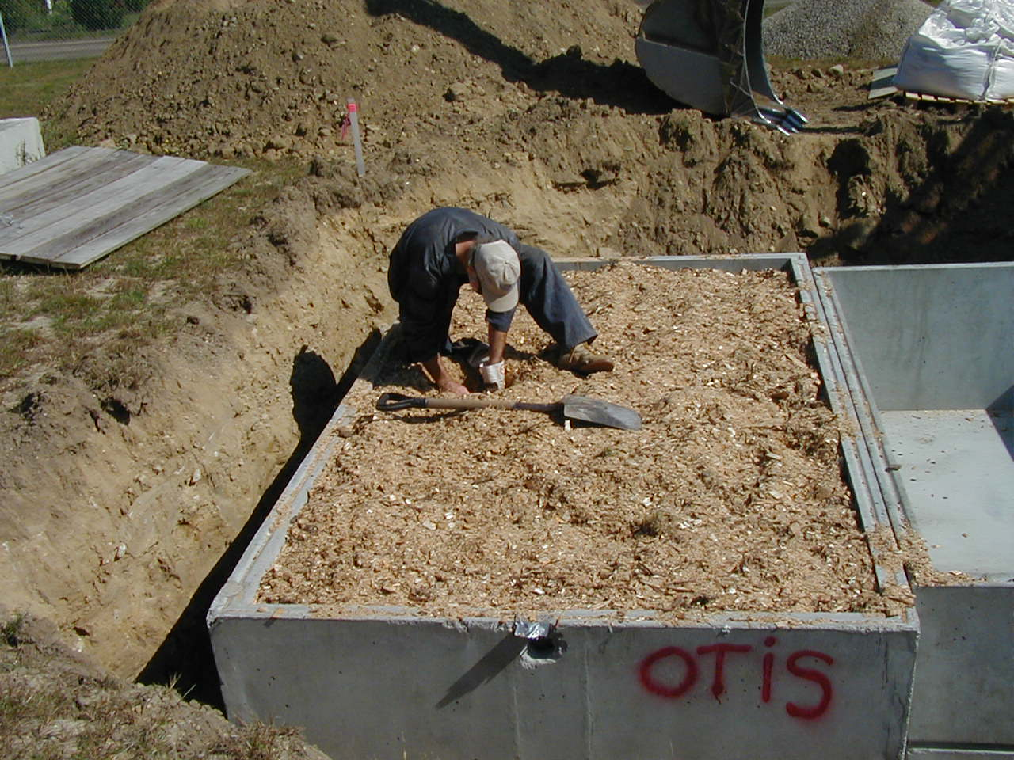
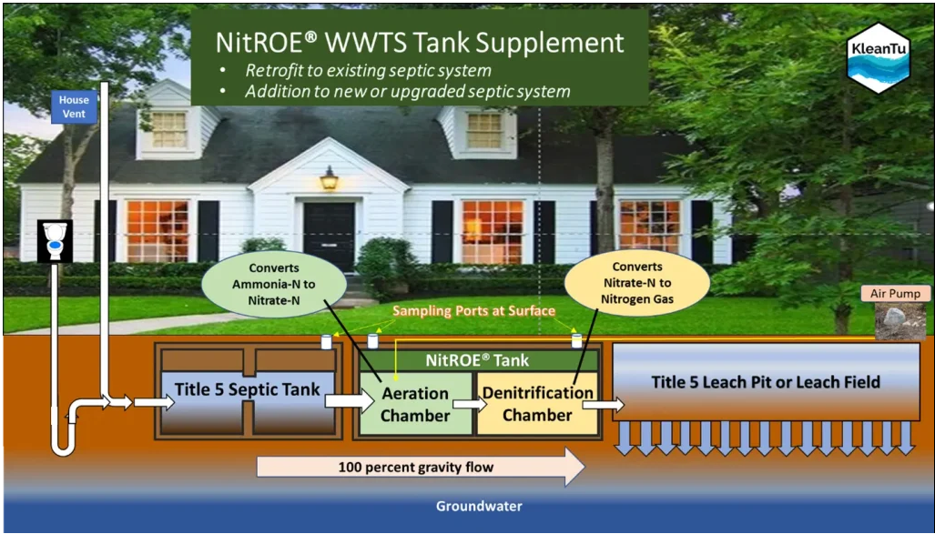
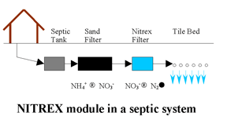
Woodchip Bioreactors
https://www.lombardoassociates.com/nitrex.php

Slide 31
The challenge of determining the true performance of Innovative/Alternative (I/A) septic systems

Slide 32
Nitrogen Concentrations
Vs
Nitrogen Loads
Tale of two methods

Slide 33
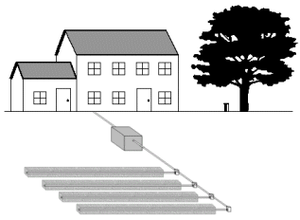
Bottom line – concentration is not the whole story but it’s the easiest measure of performance
330 GPD
130 GPD
130 GPD
I/A System
I/A System
I/A System
19 mg/L
19 mg/L
48 mg/L
19 Lbs/Year
7.5 Lbs/Year
19 Lbs/Year

Slide 34
What about varying INFLUENT numbers ?
Assume 130 gal/day usage two houses
Influent 40 mg/L
Influent 90 mg/L
I/A System
I/A System
19 mg/L
System discharge 19mg/L
System discharge 19mg/L
Mass Load Reduction
79%
Mass Load Reduction
53 %

Slide 35
Take Home Message
Without influent concentrations and water usage to determine the pre-treatment loads you can not calculate a true load reduction affected by any I/A system.

Slide 36

Best
Better
Good
MassDEP provides information on the performance of Innovative/Alternative septic Systems and has established a list of Best Available Nitrogen Removal Technology
Data extracted from MassDEP website current 25-09-01

Slide 37
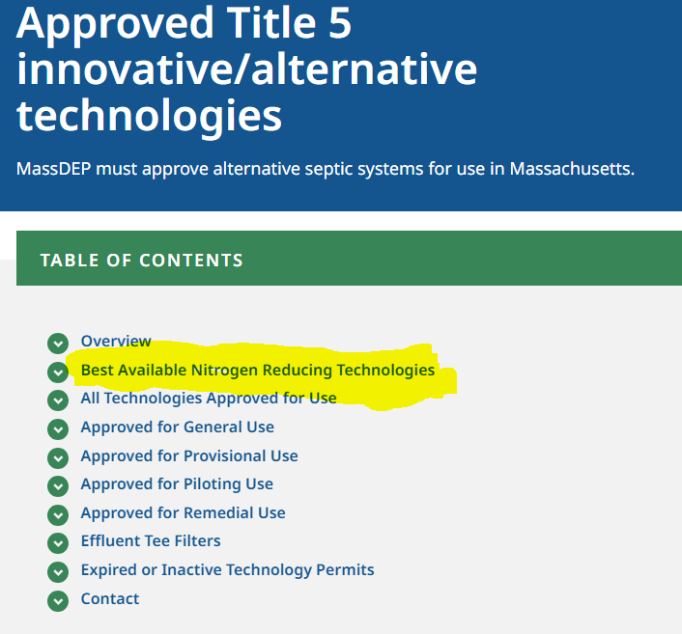
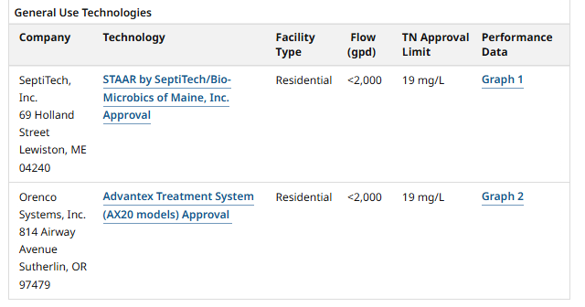
https://www.mass.gov/info-details/approved-title-5-innovativealternative-technologies
GENERAL USE

Slide 38
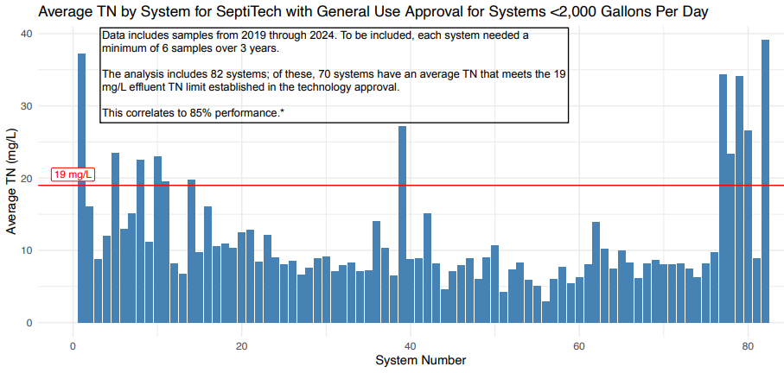
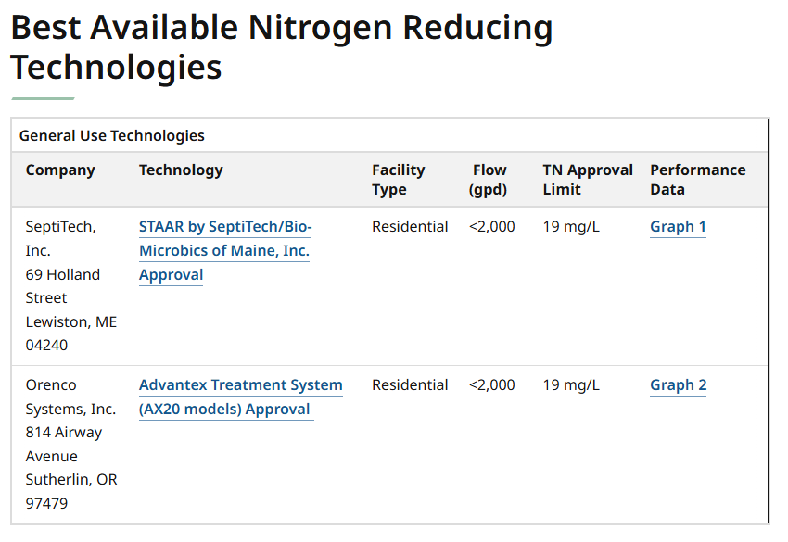
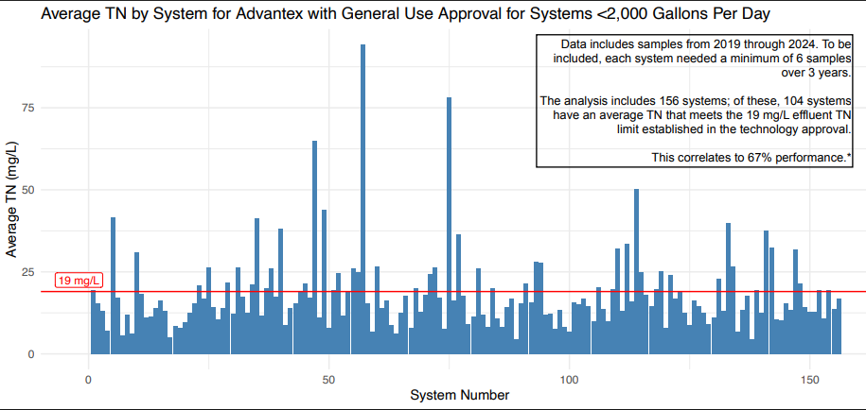
Data to support the classification as BANRT
Data extracted from MassDEP website current 25-09-01

Slide 39
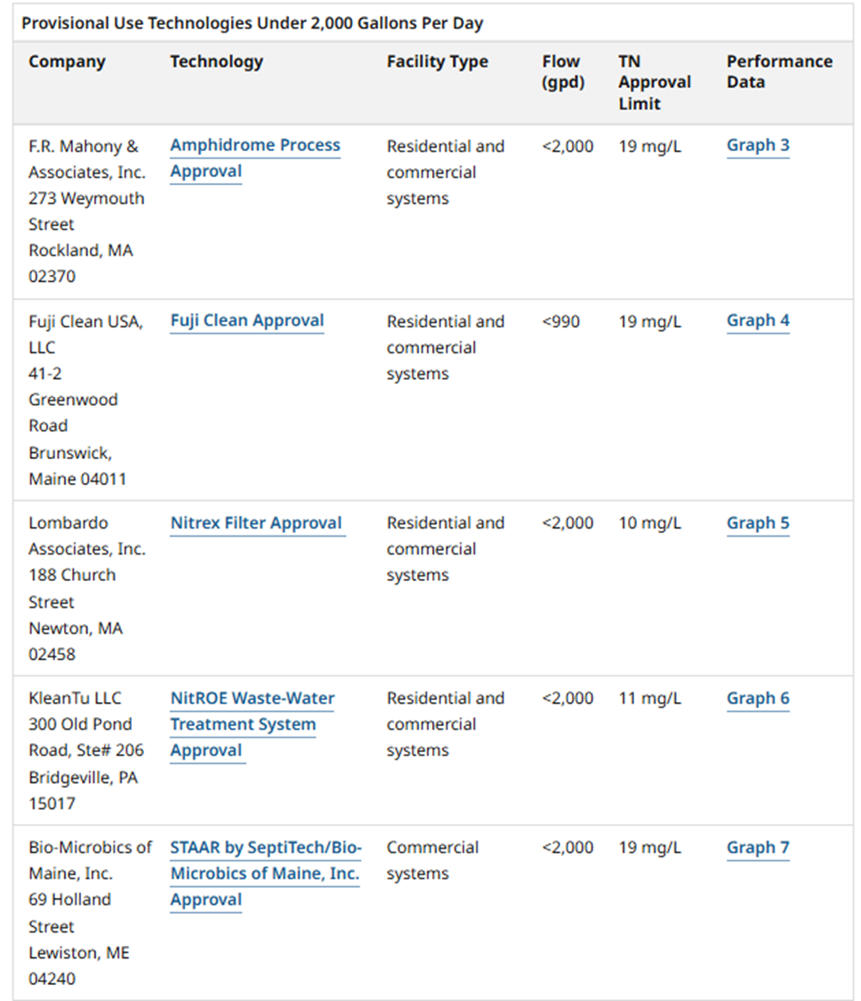
PROVISIONAL USE
https://www.mass.gov/info-details/approved-title-5-innovativealternative-technologies
Data extracted from MassDEP website current 25-09-01

Slide 40
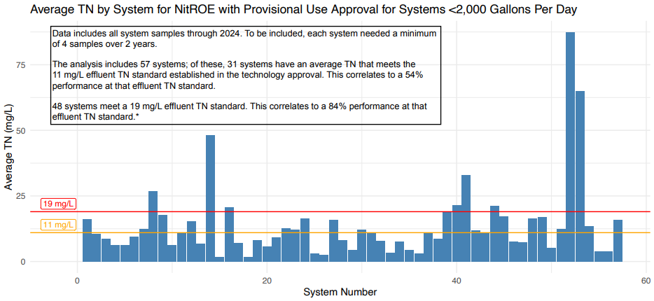
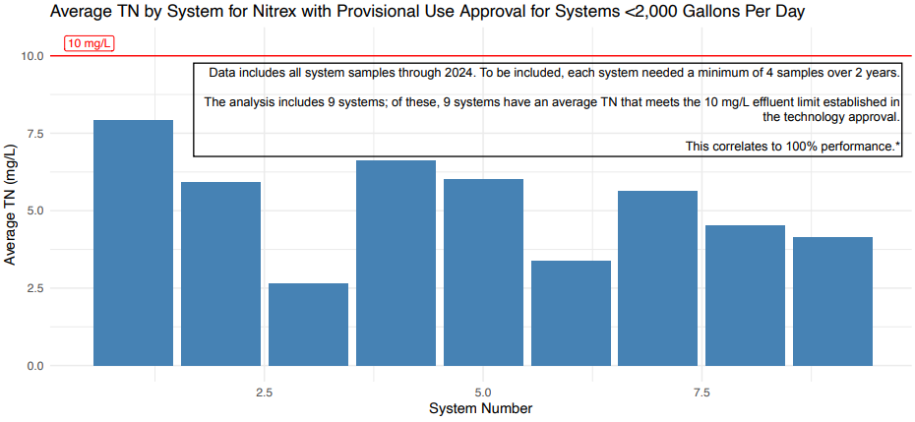
PROVISIONAL USE
NitROETM
NitrexTM
Data extracted from MassDEP website current 25-09-01

Slide 41
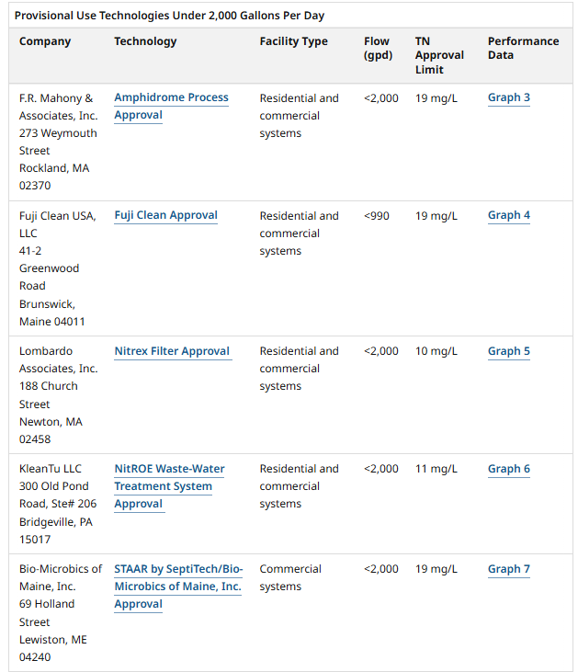

Slide 42
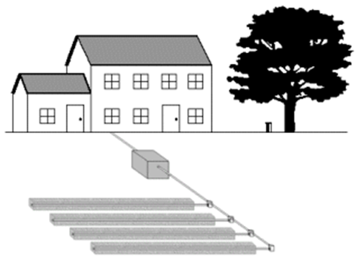
Take Home
Nitrogen becomes a problem when our wastewater practices deposit reactive nitrogen where it intercepts drinking water wells or surface waters sensitive to reactive nitrogen inputs.
Title 5 included in its 2023 revisions a new class of Nitrogen Sensitive Areas (NSA), expanding the definition to include selected marine embayments (those designated by MassDEP based on established Total Maximum Daily Load Estimates).
Also included in the revised regulation is a definition of Best Available Nitrogen Reducing Technology and their application in certain areas.
MassDEP has established a series of web pages that help you lookup whether you are in a “new” NSA, and what septic system technologies can use in those areas.
Upgrade of septic systems in marine NSA is mandatory unless your town obtains a watershed permit.

Slide 43

Questions?

