Slide 1

Empowering Food Businesses: Practical Training Tools for Sanitation, Safety, and Risk Reduction
Christina Allingham, PhD
University of Massachusetts Amherst
Notes:
Regarding the Yankee Conference, I have always enjoyed attending that program. I am not sure if my current work aligns directly with the interest of attendees, but we have a variety of training programs and training tools related to good manufacturing practices. The content discusses basic food handling for processors, although I think it applies to retail. One thing we find is that owners/managers are open to offering training, but do not always have the resources to do it themselves. These projects aim to help provide the support they need. I could discuss these resources with attendees to provide them as resources to facilities they see that need support in the field.
iTIPS: Interactive tools to improve Food Safety practices —In collaboration with UNM and Iowa State, we developed a training tool: https://itipsfoodsafety.com/. By the end of the summer, we will also have a learning management system with training modules that can help provide training support for businesses.
Sanitation Control Practitioner Program - https://www.ifpti.org/sanitation-control-practitioner-program-scpp?srsltid=AfmBOoqtuLu811Usa_yigWAIdZID9B-2BrAECLkO859Nry-JJGBCON_A
This hybrid sanitation program utilizes self-paced online training modules, an in-person hands-on workshop, and a series of coaching webinars. These materials are based on job tasks associated with sanitation practitioners' roles. The program is designed to make information regarding cleaning and sanitation accessible and practical for smaller-scale and new processors to implement and manage a sanitation program confidently.
Risky Business? Conducting a risk assessment of postharvest operations using washing machines for leafy greens​​. The project investigated the risks associated with spin drying leafy green spinach using DIY spinners (made from washing machines). The work aims to offer guidance grounded in science, enabling farmers to make more informed decisions to improve best practices on their farms.

Slide 2
Sanitation Controls Practitioner Program (SCPP)
Interactive Tools to Improve the Practice of Food Safety
Agenda Overview
NECAFS: Processors’ Food Safety Toolkit
UMass – Current Research & Future Direction

Slide 3

Sanitation Controls Practitioner Program (SCPP)

Slide 4



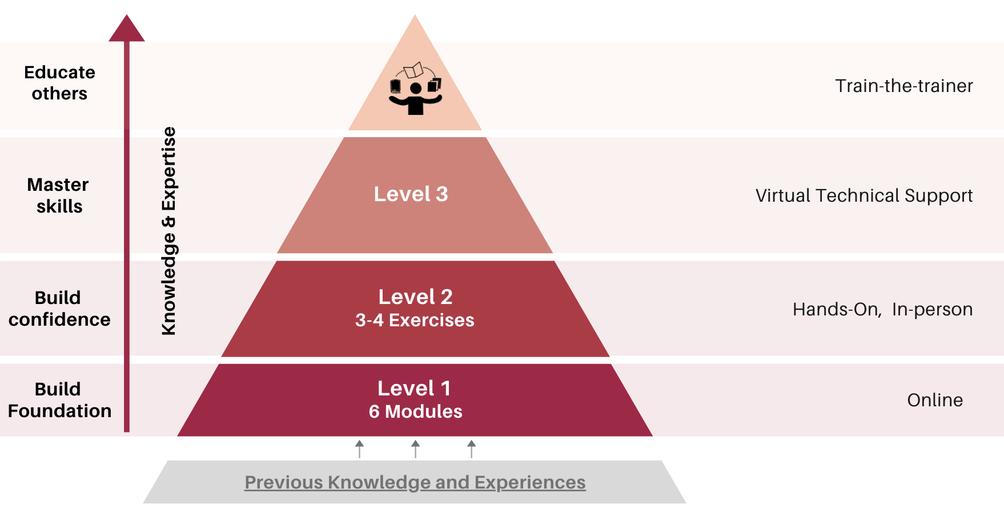
Sanitation Controls Practitioner Program (SCPP)
USDA FSOP, Project #2021-70020-35685
Problem Statement: Need for Sanitation Training Targeting Small Processors
Preliminary knowledge is present, but many lack the foundational knowledge needed to implement sanitation programs
Regulatory inspections report a lack of training records & lack of established sanitation programs as top deficiencies.
Notes:
Include pictures, figures, tables, or graphs of results. If applicable. (Feel free to add more than 1 image)

Slide 5
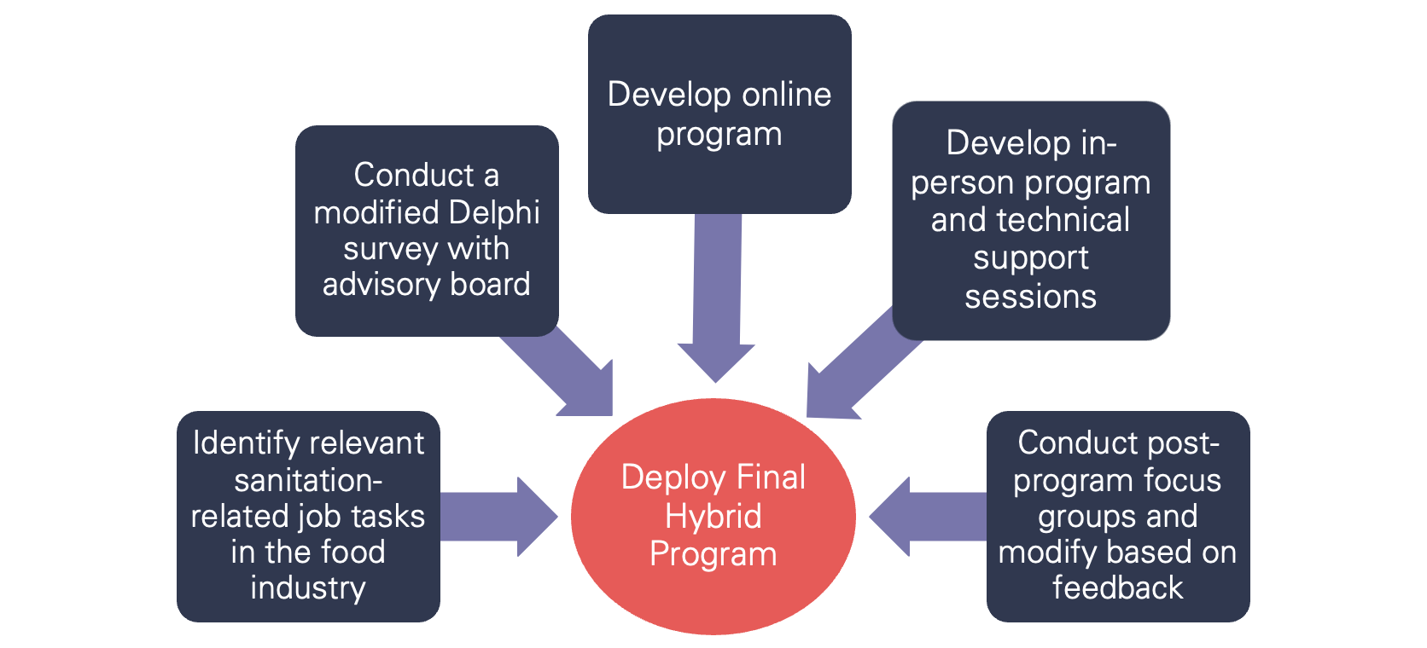
Sanitation Control Practitioner Program (SCPP)
USDA FSOP, Project #2021-70020-35685
APPROACH:
Notes:
{Describe your project results / outcomes, either projected / planned or actual, depending on the project status.}
Comply with an SSOP for cleaning a food contact surface (operator, manager, owner)
Identify and apply the appropriate utensils and/or equipment for cleaning a food contact surface and non-food contact surface (operator, manager, owner)
Perform cleaning and sanitation monitoring activities (operator, manager, owner)
Establish and maintain sanitation records (operator, manager, owner)
Inspecting preparation, processing, and food storage areas for cleanliness and hygiene (manager, owner)
Managing water sources that are in food preparation facilities for regulatory compliance (manager, owner)
Establish and deliver appropriate training for the staff of a food production facility (manager, owner)
Support and/or lead internal quality and safety investigations (manager, owner)
Evaluate the effectiveness of cleaning and sanitizing by performing verification activities as appropriate (manager, owner)
Evaluate results of tests and make appropriate decisions (manager, owner)
Manage sanitation chemical handling and inventory (operator, manager, owner)
Routinely assess cleaning and sanitizing data for trends to make informed decisions about corrective and preventive actions
Establish the roles and responsibilities of a cleaning and sanitation program (owner)
Write cleaning and sanitation responsibilities into job descriptions, as relevant (owner)

Slide 6
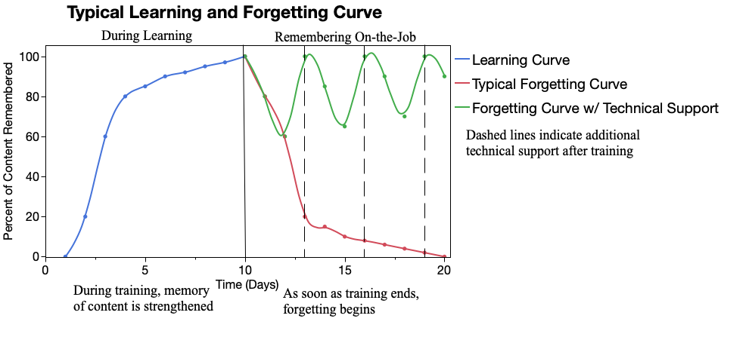
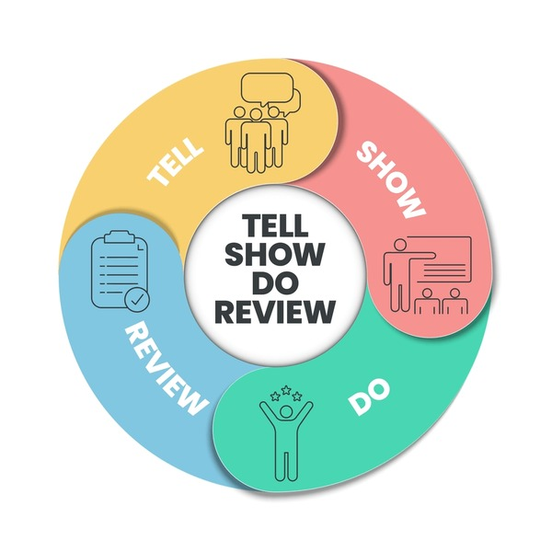
The Tell, Show, Do Model
Otherwise referred to as Know, Show, Go, or Tell, Show, Do, Review Model
Moves beyond lectures and traditional content delivery and establishes skill competencies.
Aims to help learners remember, understand, and apply what they have learned to their role.
https://www.atlas101.ca/pm/concepts/learning-and-forgetting-curves/
https://www.shutterstock.com/search/tell-show-do-review
26

Slide 7
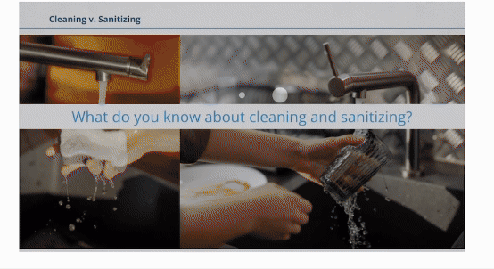

Sanitation Controls Practitioner Program (SCPP)
USDA FSOP, Project #2021-70020-35685
Results/Outcomes: Part 1 - Online Program Engagement Activities
Interactive Modules:
  Cleaning and Sanitation Basics
  Sanitation Tools and Supplies
  Water for Cleaning and Sanitation
  Chemicals for Cleaning and Sanitation
  Sanitation Documentation
  Sanitation Monitoring and Verification
Peer-review completed through the Northeast Center to Advance Food Safety (NECAFS) Clearinghouse
Notes:
{Describe your project results / outcomes, either projected / planned or actual, depending on the project status.}

Slide 8
Sanitation Controls Practitioner Program (SCPP)
FSOP, Project #2021-70020-35685
Results/Outcomes: Part 2 – In-Person Workshop
Cleaning and an SSOP activity
Monitoring activities
Sanitation activities
Focus-Group-Determined Hands-on Topics
How to physically clean and sanitize.
How to understand and follow SSOPs to effectively perform cleaning and sanitation tasks.
How to use ATP and protein monitoring
devices.
Photo credits (bottom to top):
NBC News
Common Sense Germ Defense
ServSafe
Notes:
{Describe your project results / outcomes, either projected / planned or actual, depending on the project status.}

Slide 9
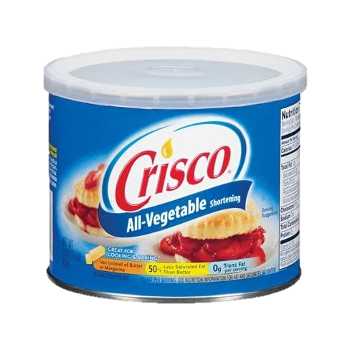
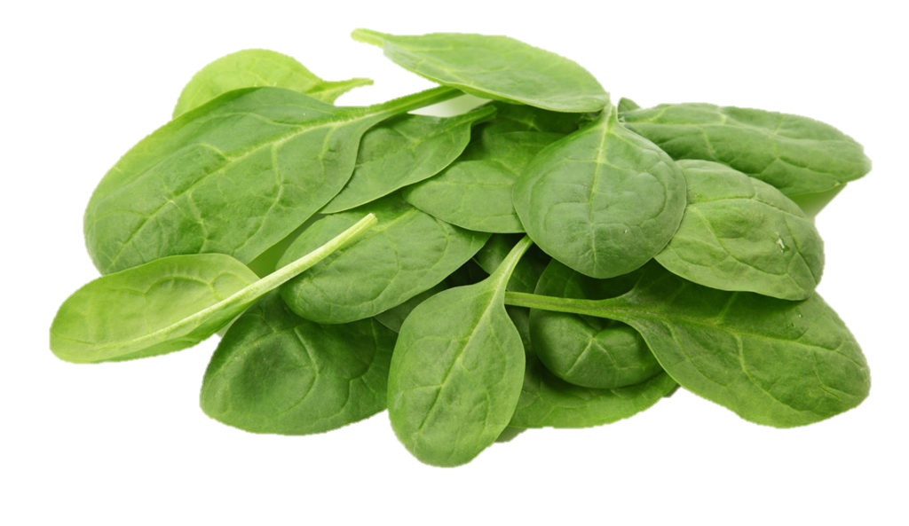
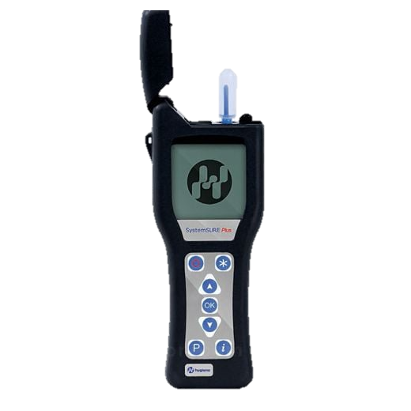
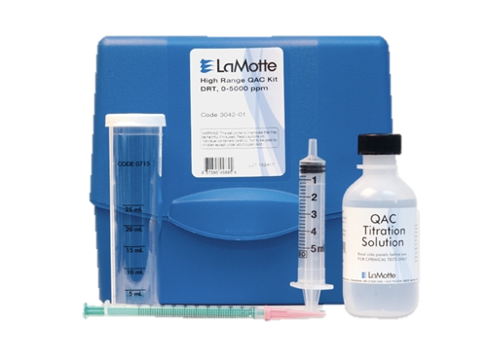
Part II: In-Person Program Practice Activities
Clean
Visual inspection
Verify
ATP Swab
Sanitize
Titrations
Protein Swab
Test Strips
3 different surfaces: wood, plastic, stainless steel, with 2 different organic contaminants
Sponge Swab
Chemical concentrations
SSOP exercise
Photo credits: Christina Allingham, UMass Amherst
Notes:
Different surfaces

Slide 10
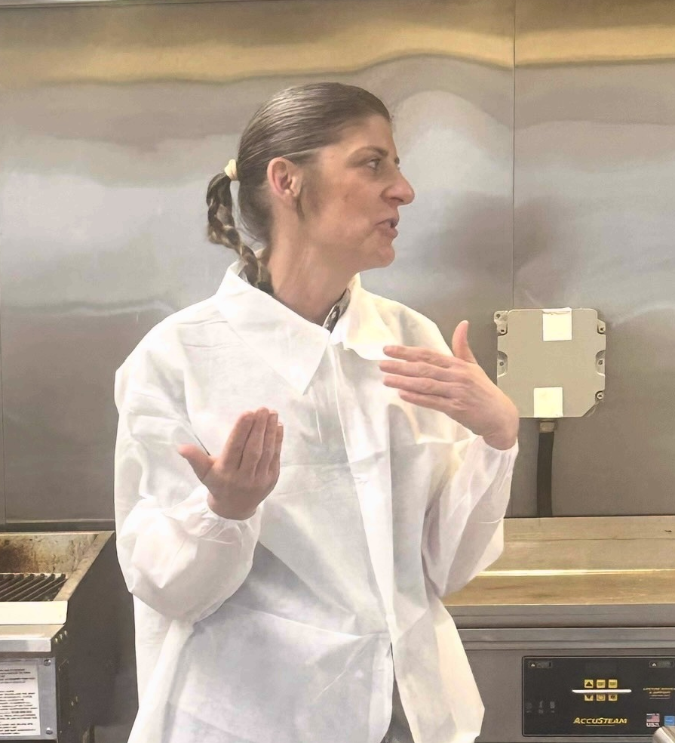
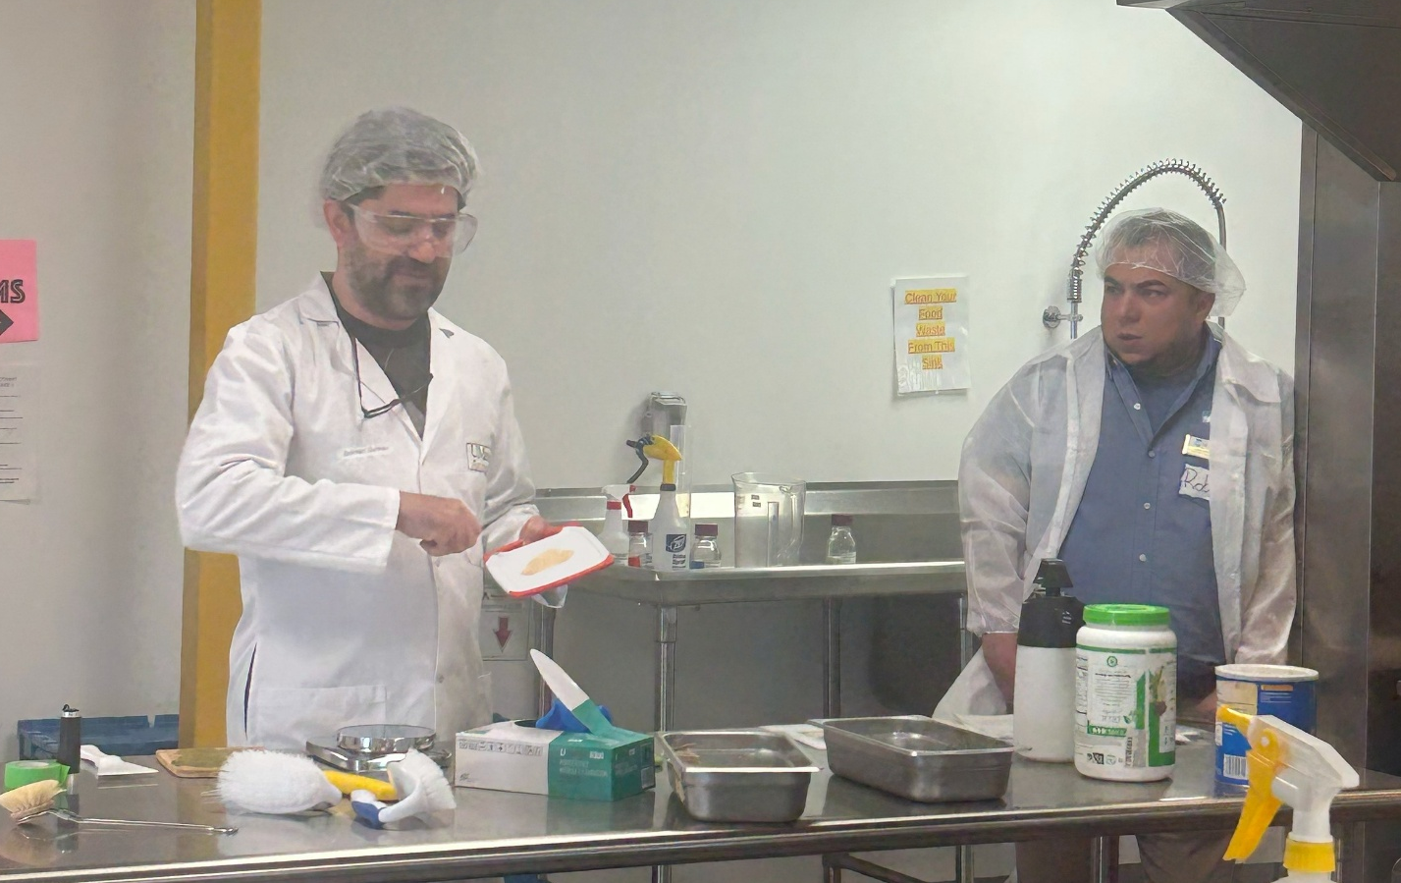
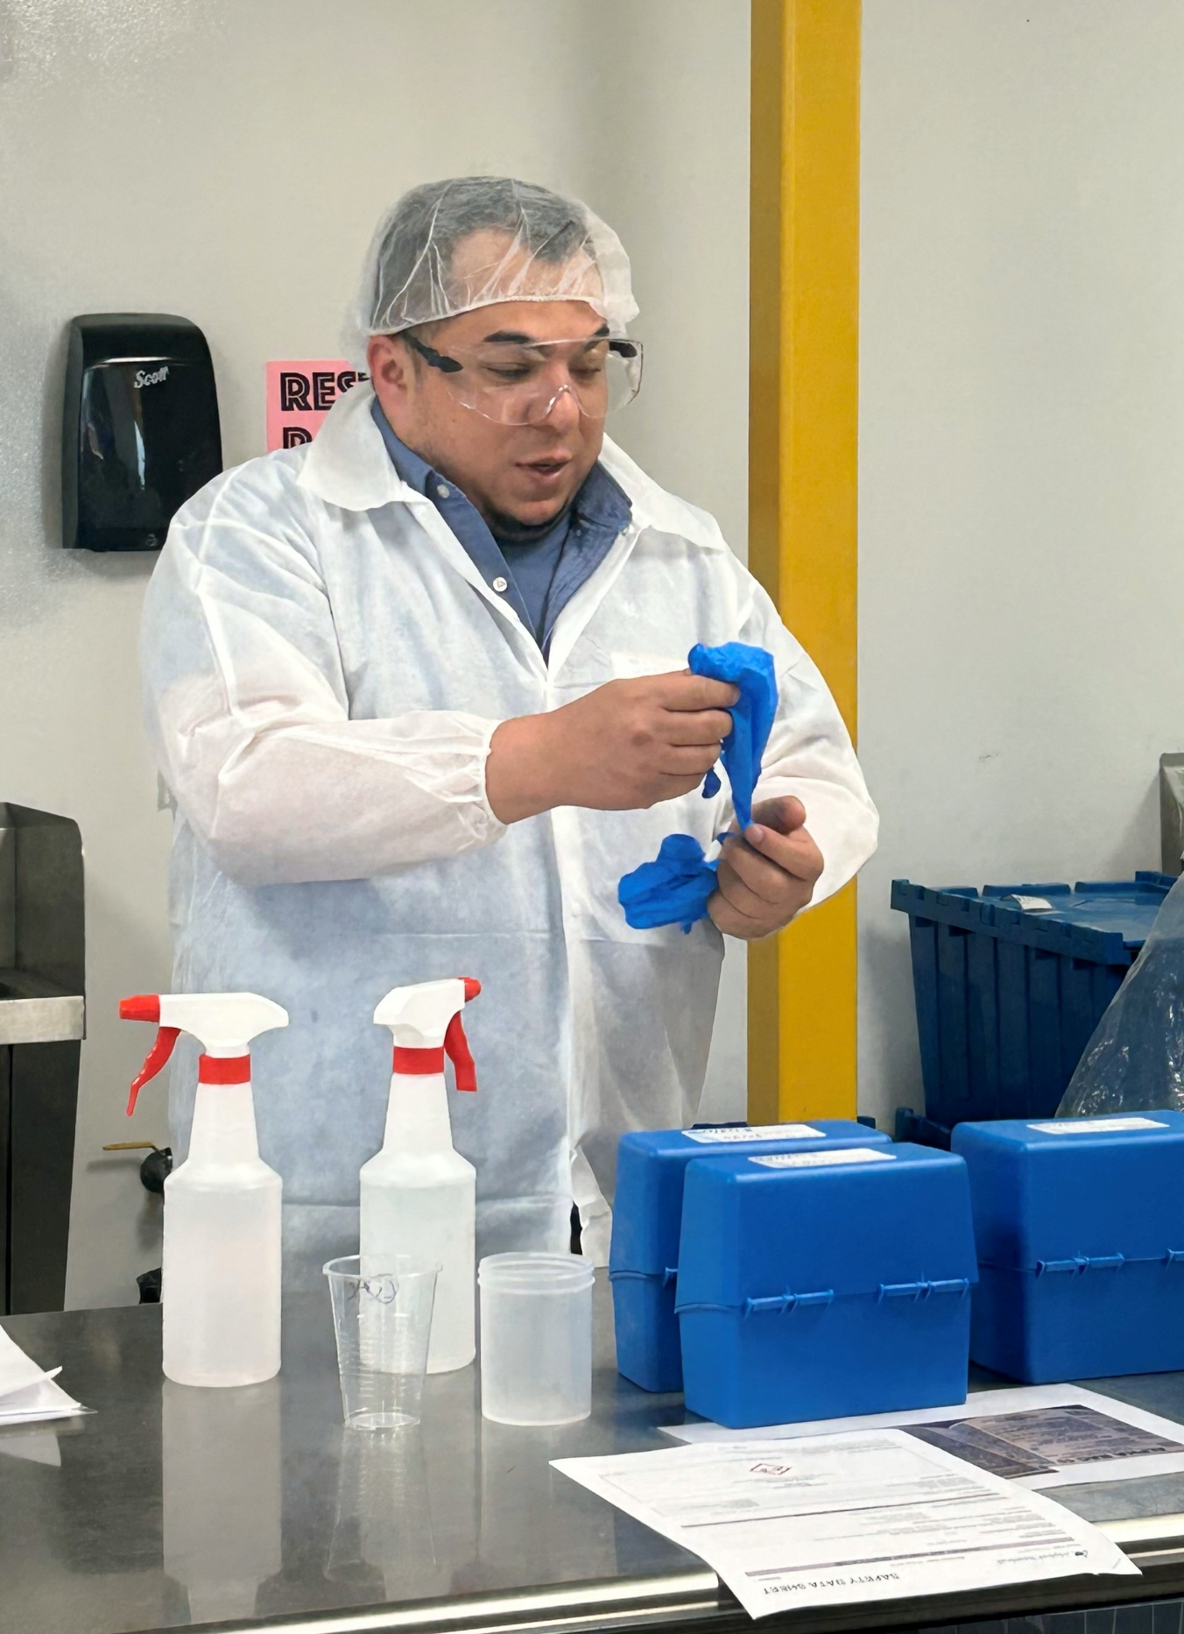
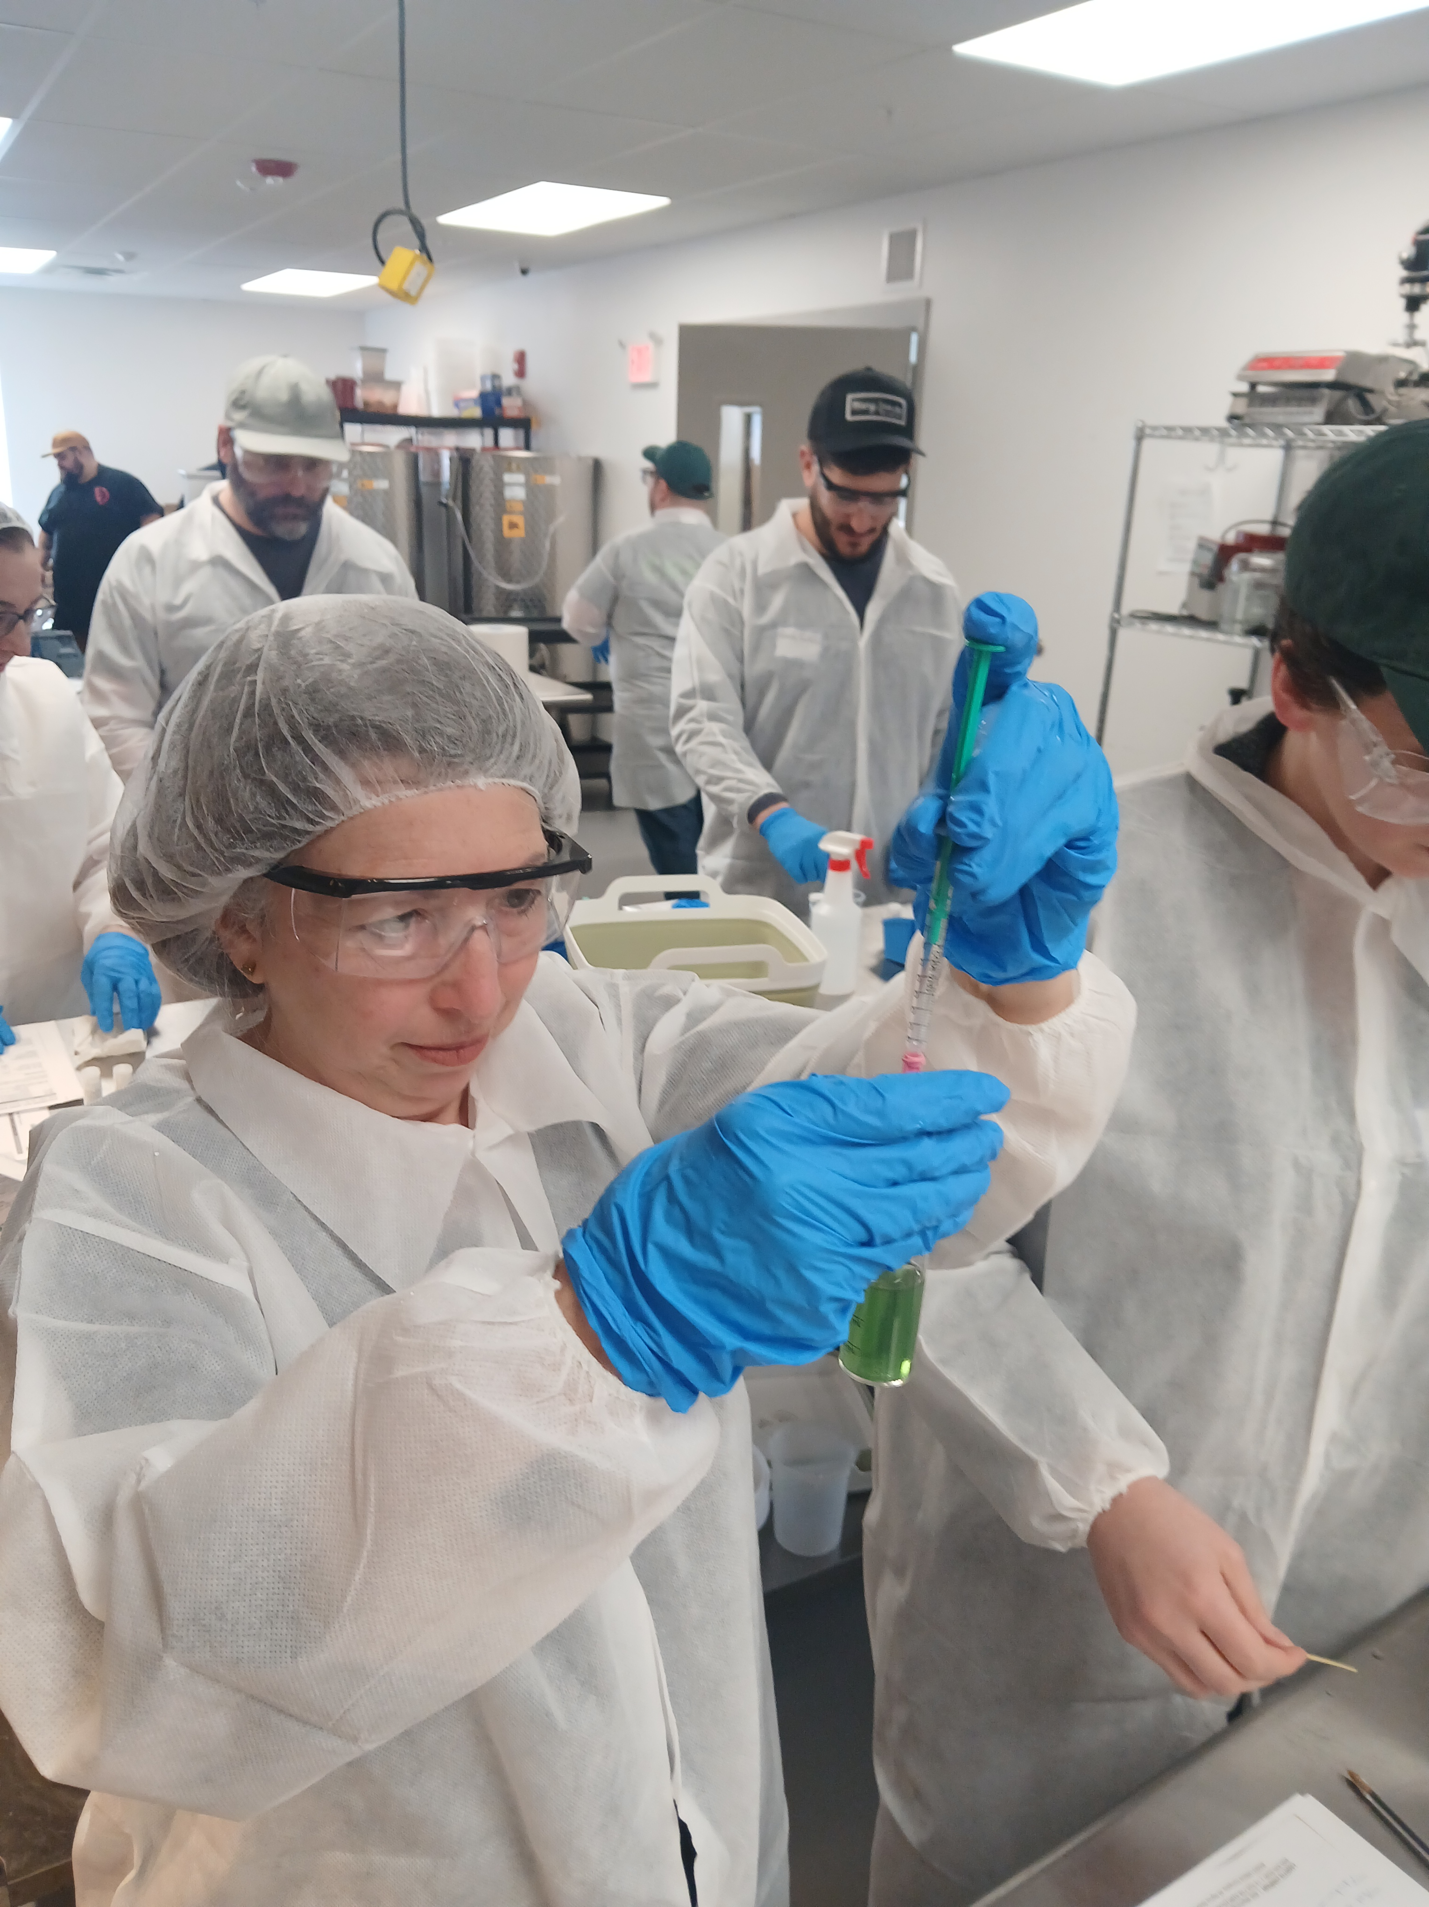
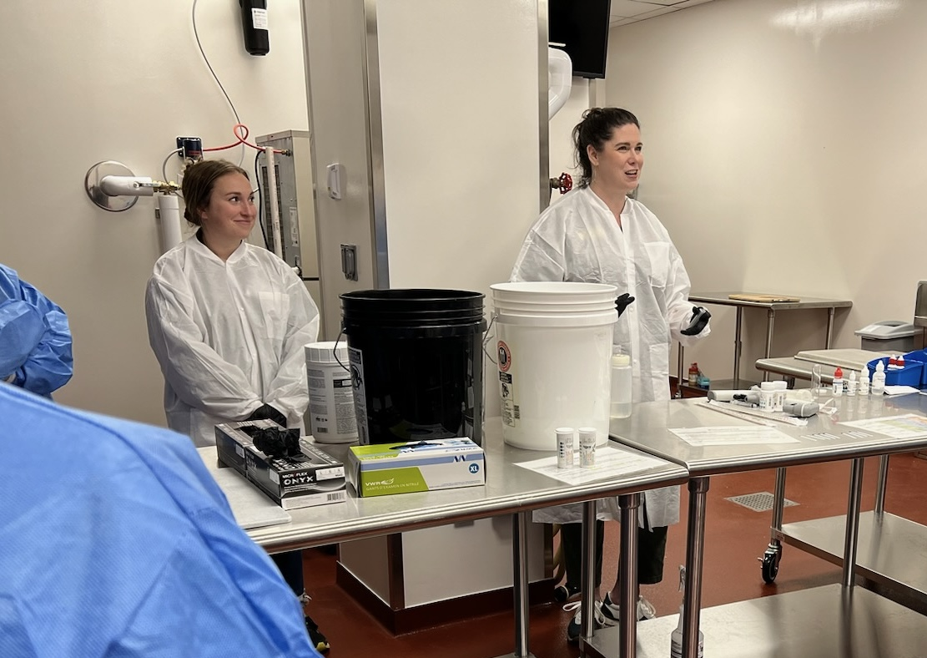
Sanitation Controls Practitioner Program (SCPP)
USDA FSOP, Project #2021-70020-35685
Results/Outcomes: Part 2: In-Person Workshop
Notes:
{Describe your project results / outcomes, either projected / planned or actual, depending on the project status.}

Slide 11
Results – Pre- to Post- In-Person Program Change in Preparedness
Notes:
Preparedness survey responses from SCPP participants by pilot program from pre-in-person (PRE: NC State n=11, Greenfield, MA n=17, Boston, MA n=12) program to post-in-person (POST: NC State n=11, Greenfield, MA n=11, Boston, MA n=11) program. Preparedness increased on average in almost all categories at for all sites. Scale was out of 5.

Slide 12
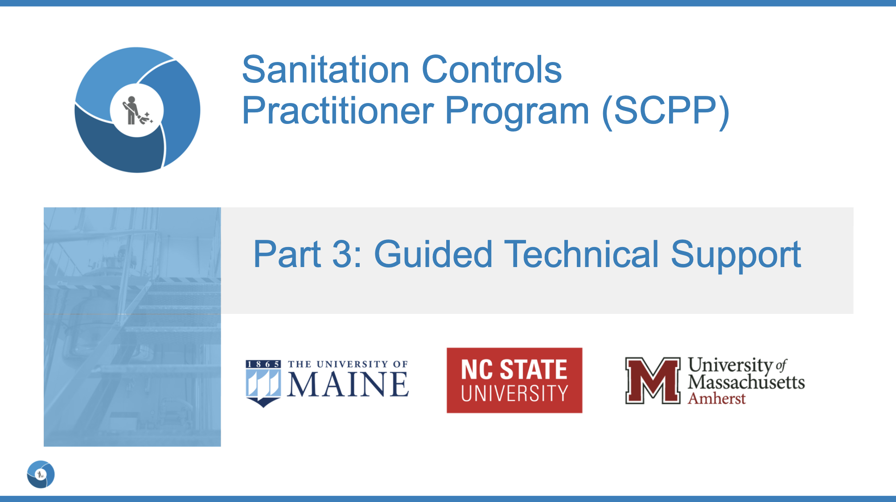
Sanitation Controls Practitioner Program (SCPP)
USDA FSOP, Project #2021-70020-35685
Results/Outcomes: Part 3 - Guided Technical Support Webinar Series
Webinar Topics
  Best practices for developing SSOPs
  Considerations for master sanitation schedules
  How to assess and resolve a cleaning or sanitation non-conformance
  Sanitation verification activities
  Dry Cleaning
  Disinfection
  ~3 hours of contact hours
Webinar includes a ~20 mini-lecture followed by a 40-minute open Q&A Discussion
Notes:
{Describe your project results / outcomes, either projected / planned or actual, depending on the project status.}

Slide 13
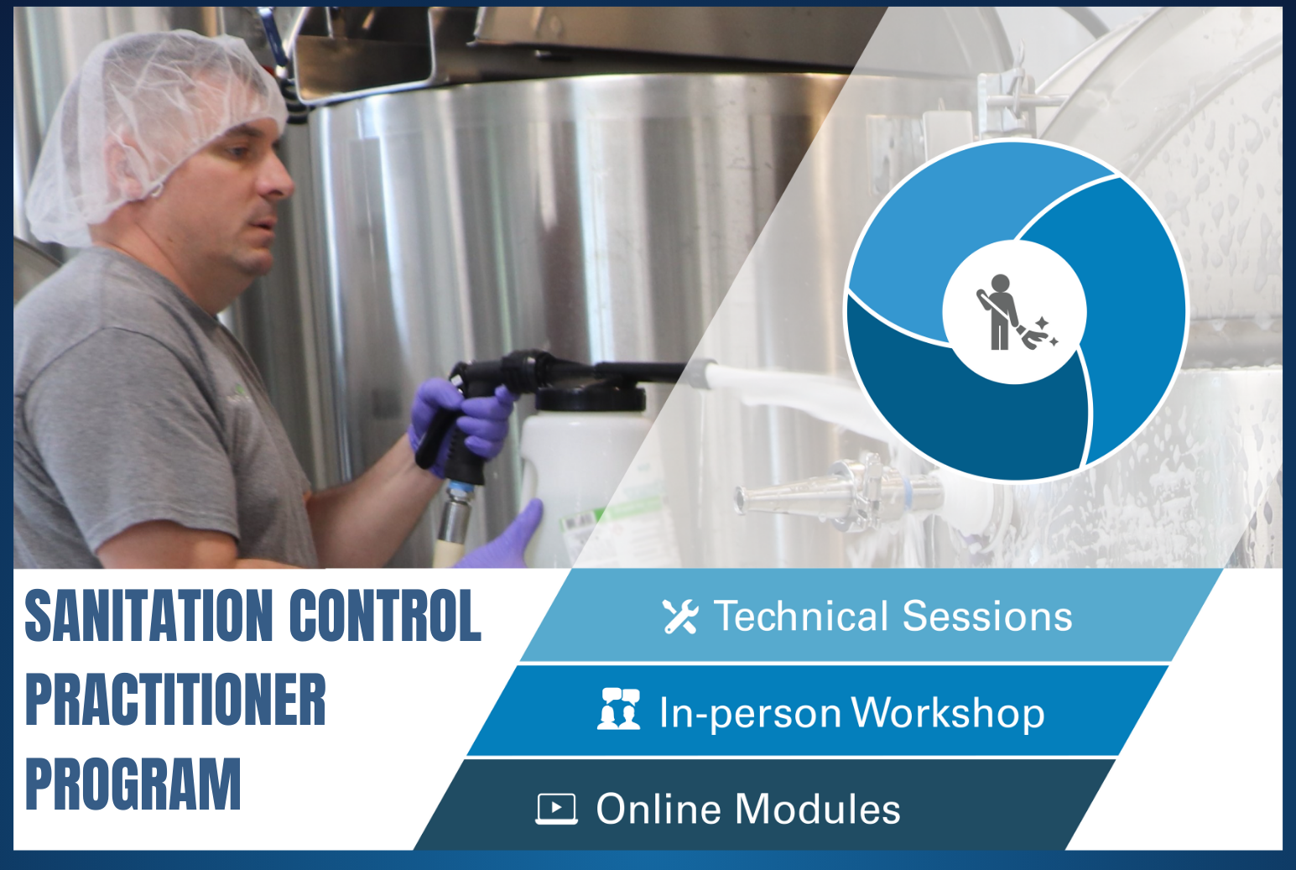

Sanitation Controls Practitioner Program (SCPP)
USDA FSOP, Project #2021-70020-35685
Project Outputs:
Industry engagement (focus groups, advisory board and evaluations)
Piloted programming (3 locations)
Hybrid Program
  Online Training: self-paced 6 modules
  1-Day In-person hands-on learning workshop
  3-part virtual technical support sessions (9 topics available)
  Practitioner workbook for building competencies
Instructor Guide
Spanish Translation – online training* (coming soon!)
Join us in New Hampshire in December!
Notes:
Delphi process for this work was just published in FPT

Slide 14

iTIPS: Interactive Tools to Improve the Practice of Food Safety

Slide 15

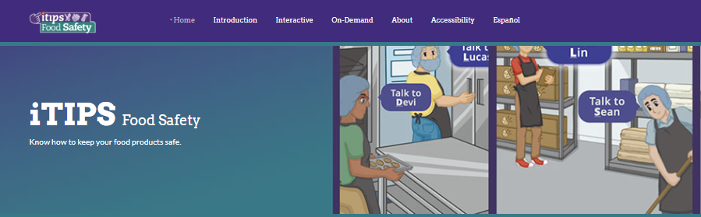
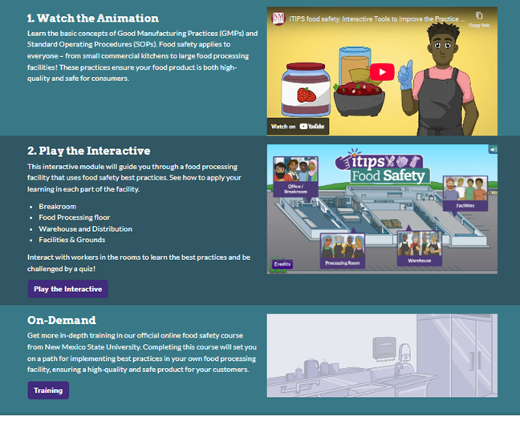
iTIPS: Interactive Tools to Improve the Practice of Food Safety
Main Goal: To improve food safety culture and reduce risk in small food processing establishments through accessible, bilingual, digital training tools that support FSMA compliance.
Relevance:
  Small processors face challenges: limited resources, potentially low English proficiency, and time constraints.
  FSMA compliance is critical but difficult to implement without support.
  iTIPS bridges the gap with interactive, practical, and culturally relevant training.
https://itipsfoodsafety.org/

Slide 16



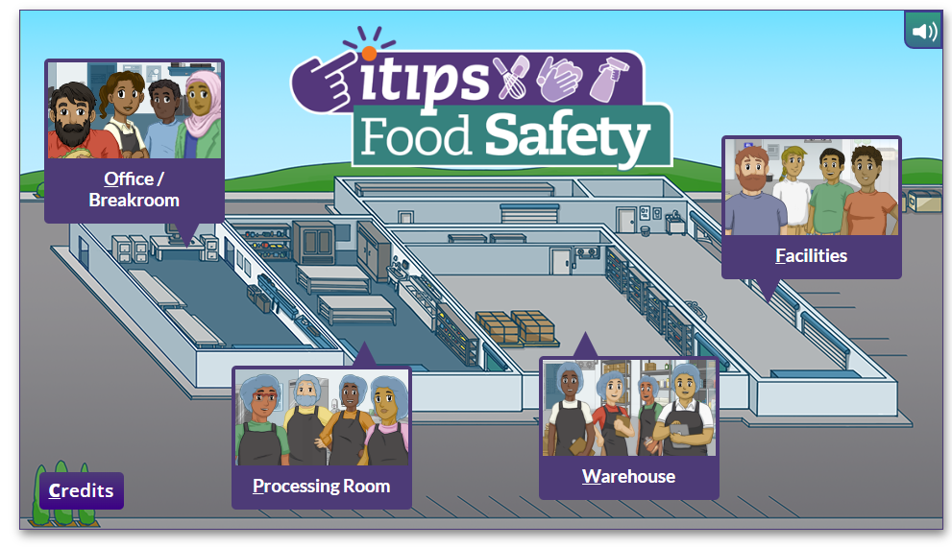
iTIPS: Interactive Tools to Improve the Practice of Food Safety
Key Program Objectives:
✅ Develop Interactive Digital Tools
  Bilingual, user-friendly modules tailored to
  small processors
  Accessible via mobile and desktop platforms
✅ Deliver Risk Management Training
  Focused on FSMA requirements
  Practical guidance for sanitation and food handling
✅ Strengthen Community Partnerships
  Collaborate with NGOs and community-based
  organizations
  Target support for socially disadvantaged and
  startup food businesses
✅ Expand Regional Impact
  Engage with WRCEFS, NECAFS, NRC FSMA
  Share resources across multi-state networks
https://itipsfoodsafety.org/

Slide 17
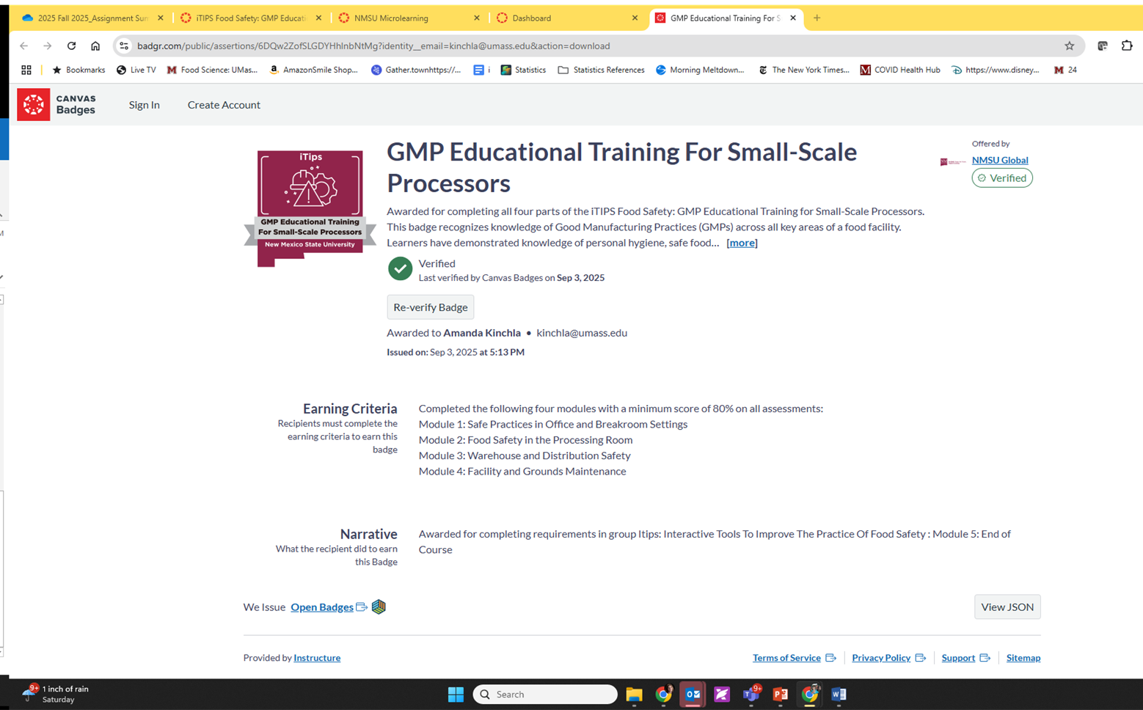

iTIPS: Interactive Tools to Improve the Practice of Food Safety
Complete the following modules with a minimum score 80% on all assessments:
Module 1: Safe Practices in Office and Breakroom Settings
Module 2: Food Safety in the Processing Room
Module 3: Warehouse and Distribution Safety
Module 4: Facility and Grounds Maintenance
https://itipsfoodsafety.org/

Slide 18
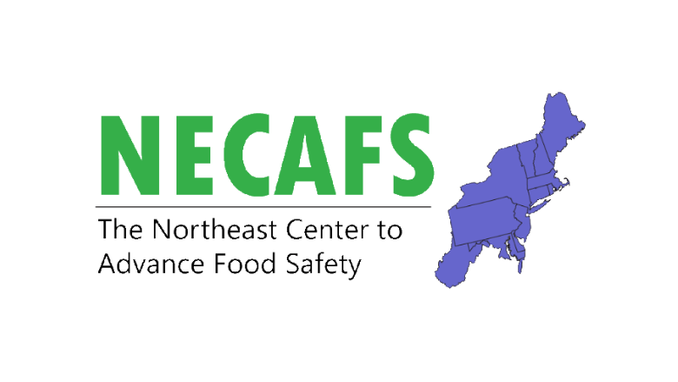
Northeast Center to Advance Food Safety Processors’ Toolkit

Slide 19
Northeast Center to Advance Food Safety
Northeast Center to Advance Food Safety (NECAFS) is one of four USDA funded regional centers tasked with coordinating training, education and outreach related to the FSMA Produce Safety Rule and the FSMA Preventive Controls for Human Foods Rule.
NECAFS focuses on coordination and facilitation of the Northeast regional network to support a national food safety training, education, extension, outreach, and technical assistance system among small and medium-sized producers and small processors.
About NECAFS | Northeast Center to Advance Food Safety | The University of Vermont

Slide 20
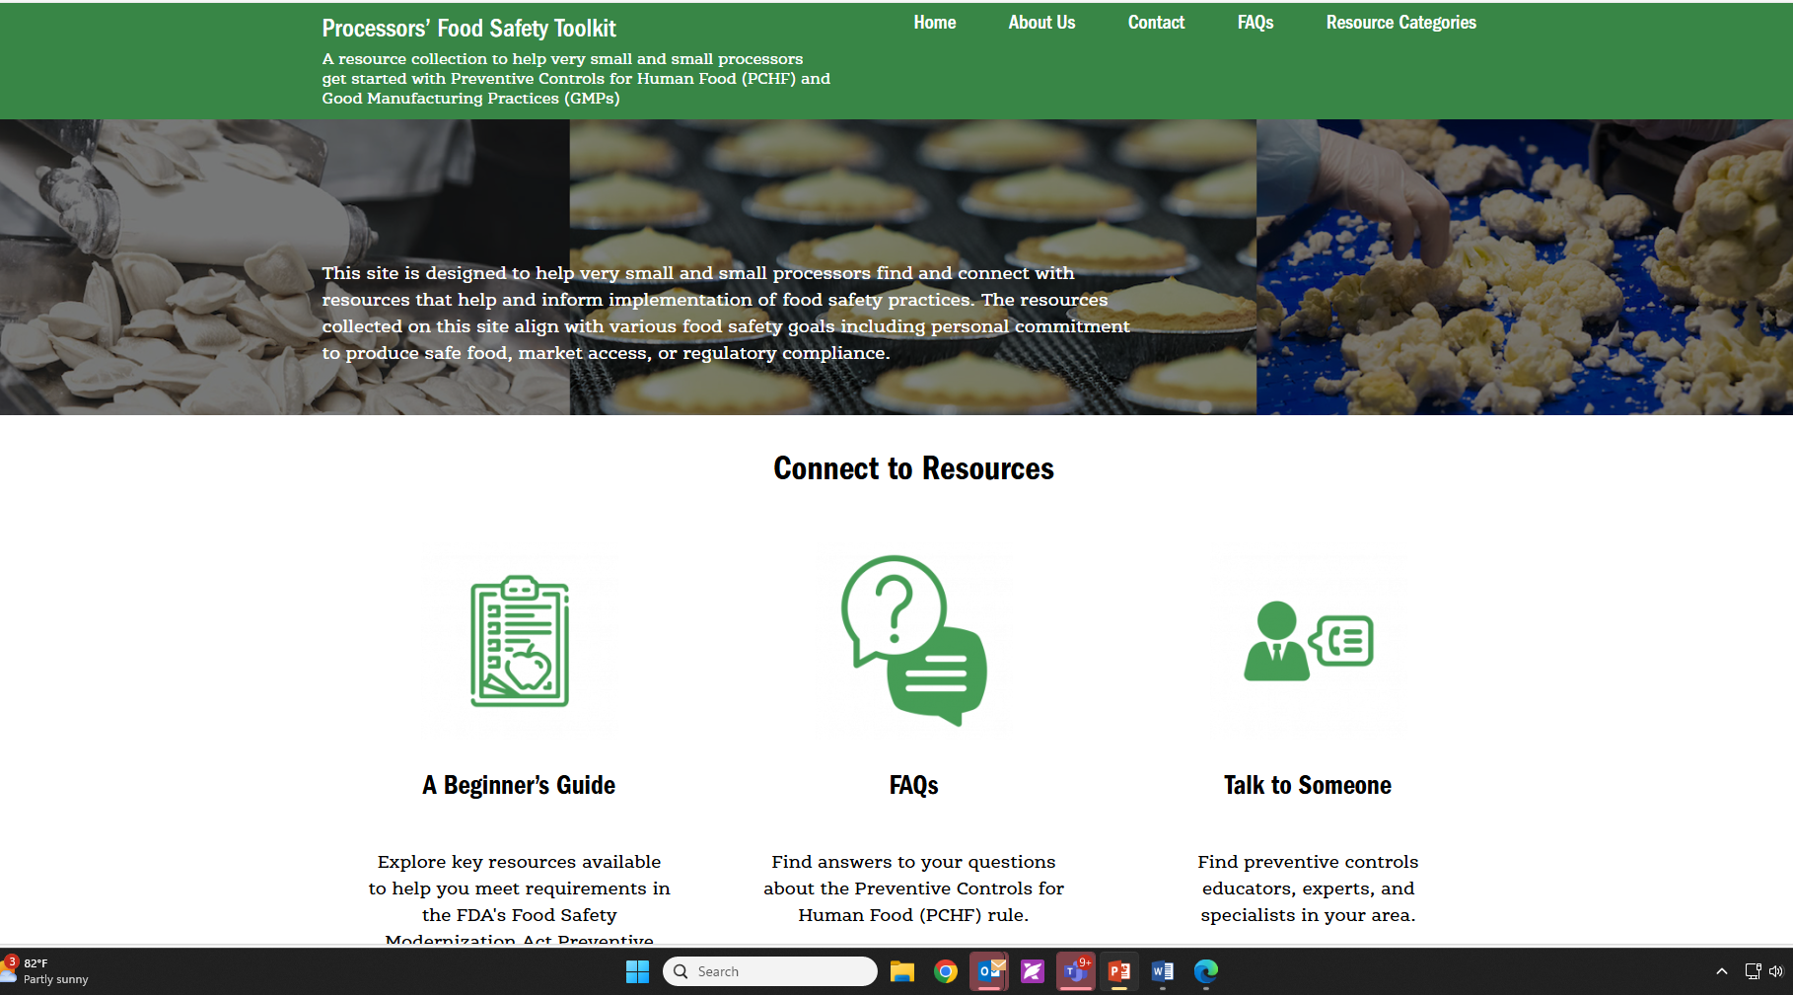
Processors’ Food Safety Toolkit
A resource collection to help very-small and small processors get started with Preventive Controls for Human Food (PCHF) and current Good Manufacturing Practices (cGMPs)
Home | Processors’ Food Safety Toolkit : https://pchf.necafs.org

Slide 21
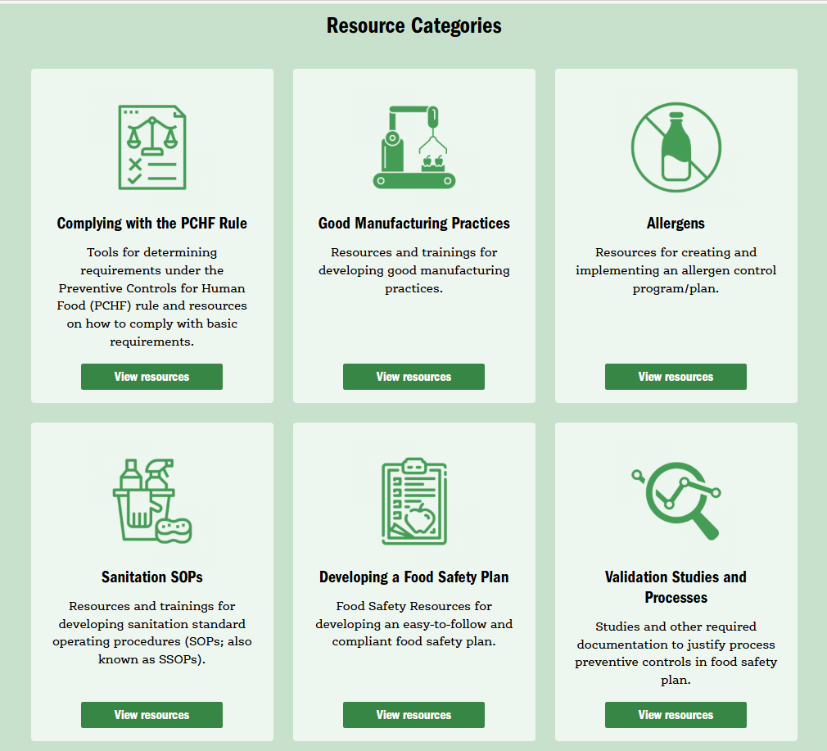
Processors’ Food Safety Toolkit
Complying with the PCHF Rule
Good Manufacturing Practices
Allergens
Sanitation SOPs
Developing a Food Safety Plan
Validation Studies and Processes
Production Specifications
Environmental Monitoring Program
State and Local Regulations
Extension and Consulting Services and Resources
Funding Opportunities
Talk to Someone
Home | Processors’ Food Safety Toolkit : https://pchf.necafs.org

Slide 22

Current Work: UMass Extension and CAFE

Slide 23

Conducting Concealed Observations to Investigate Variability in Sanitation Practices in Food Service Applications
Christina Allingham, Ph.D.
Postdoctoral Research Associate, Department of Food Science, University of Massachusetts Amherst

Slide 24
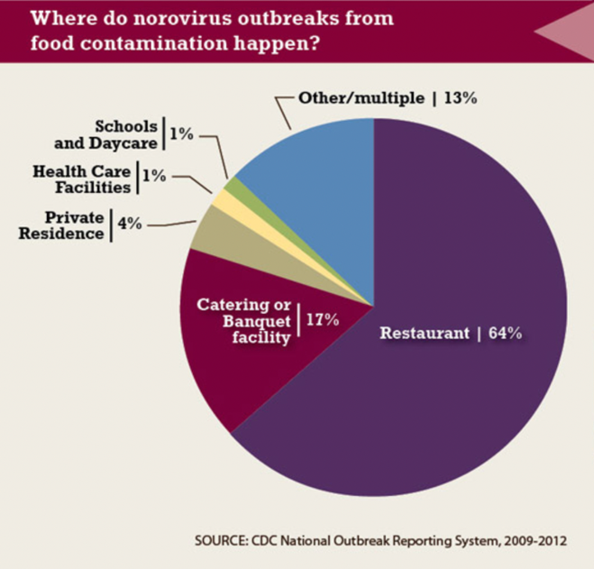
Noroviruses pose a burden in Food Service
  Over 81% of reported norovirus outbreaks in the United States are traced to food service.
35
Notes:
Human noroviruses (HuNoVs), which are non-enveloped viruses from the family caliciviradae, are a frequent cause of acute nonbacterial gastroenteritis outbreaks worldwide. Norovirus infection usually causes vomiting, diarrhea, body aches, fever and sometimes death in susceptible populations. Restaurants and other food service applications are responsible for over 81% of norovirus outbreaks in the United States, and that number is most likely higher than reported here. The virus has a low infectious dose (10-100 viral particles) and is shed in large amounts by infected individuals, which proves to be a significant issue in food service settings.

Slide 25
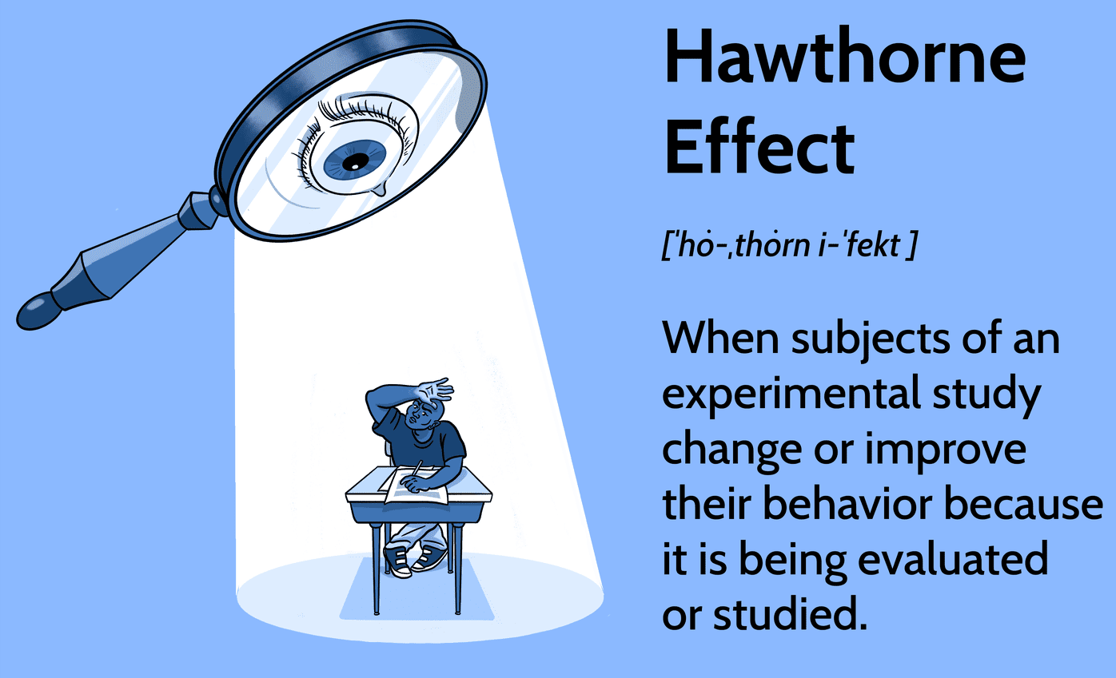

The Hawthorne Effect
To mitigate bias and obtain true reflections of sanitation practices, the research team must be concealed.
https://www.investopedia.com/terms/h/hawthorne-effect.asp
https://www.threads.com/@gordongram/post/DJ4Zkp7N7_E
36

Slide 26
Protocol Flow
Map site visit schedule on a weekly basis
Site visit
Concealed observations recorded
Transcription into encrypted software
Coding for themes in NVivo
No visits on “special” days
Equal number of days/shifts visited per site
Four different sites
Recorded on paper out of sight of other employees
Transcribed into Excel and paper copies destroyed.
Transcriptions uploaded into NVivo for coding.
37
Notes:
120 visits total, 30 per site, 10 per shift, 3 shifts

Slide 27
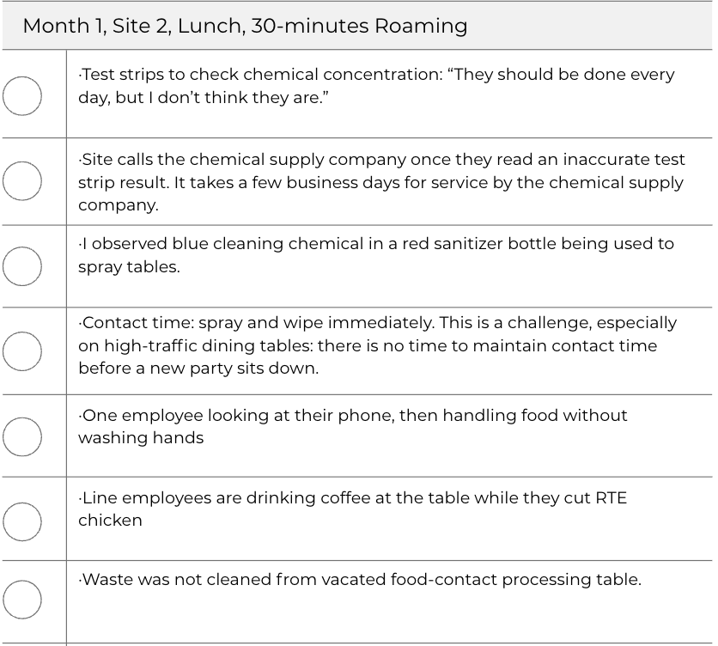

Sample Concealed Observation Data Entry
40

Slide 28
Preliminary Risk Model
Component 1: HuNoV contamination sources
Component 2: Food preparation
Component 3: HuNoV intervention measures
HuNoV hand contamination during restroom visit
Enhanced multilingual training interventions
Foods
Consistent, effective hand washing practices after restroom use
HuNoV asymptomatic carriers
Hands
HuNoV symptomatic carriers from prior exposure
Other workers
Surface disinfection: parameters TBD for quats and PAA
HuNoV resistance on surfaces
Working surfaces

Slide 29
Conclusions
Variable hand-washing times
Lack of sanitizer contact time
Language barriers
Through 120 site visits conducted across varied shifts, critical lapses in hand hygiene, sanitizer applications, and food safety communication were documented.
This works highlights the need for improved communication strategies and sanitization protocols that can effectively address norovirus risk in food service.
Notes:
In Conclusion:
Information regarding cost associations, time management and lack of resources are significant barriers to small processors. I was able to conclude this through testimonials from processors, knowledge interpretations from programming, personal statements during programming and further discussions with processors.
Providing a 4-part Extension intervention program increases awareness, improves food safety practices, and reduce food safety risks.
I was able to conclude this through testimonials from processors, knowledge interpretations from programming as previously mentioned, personal statements during programming and further discussions with processors.

Slide 30
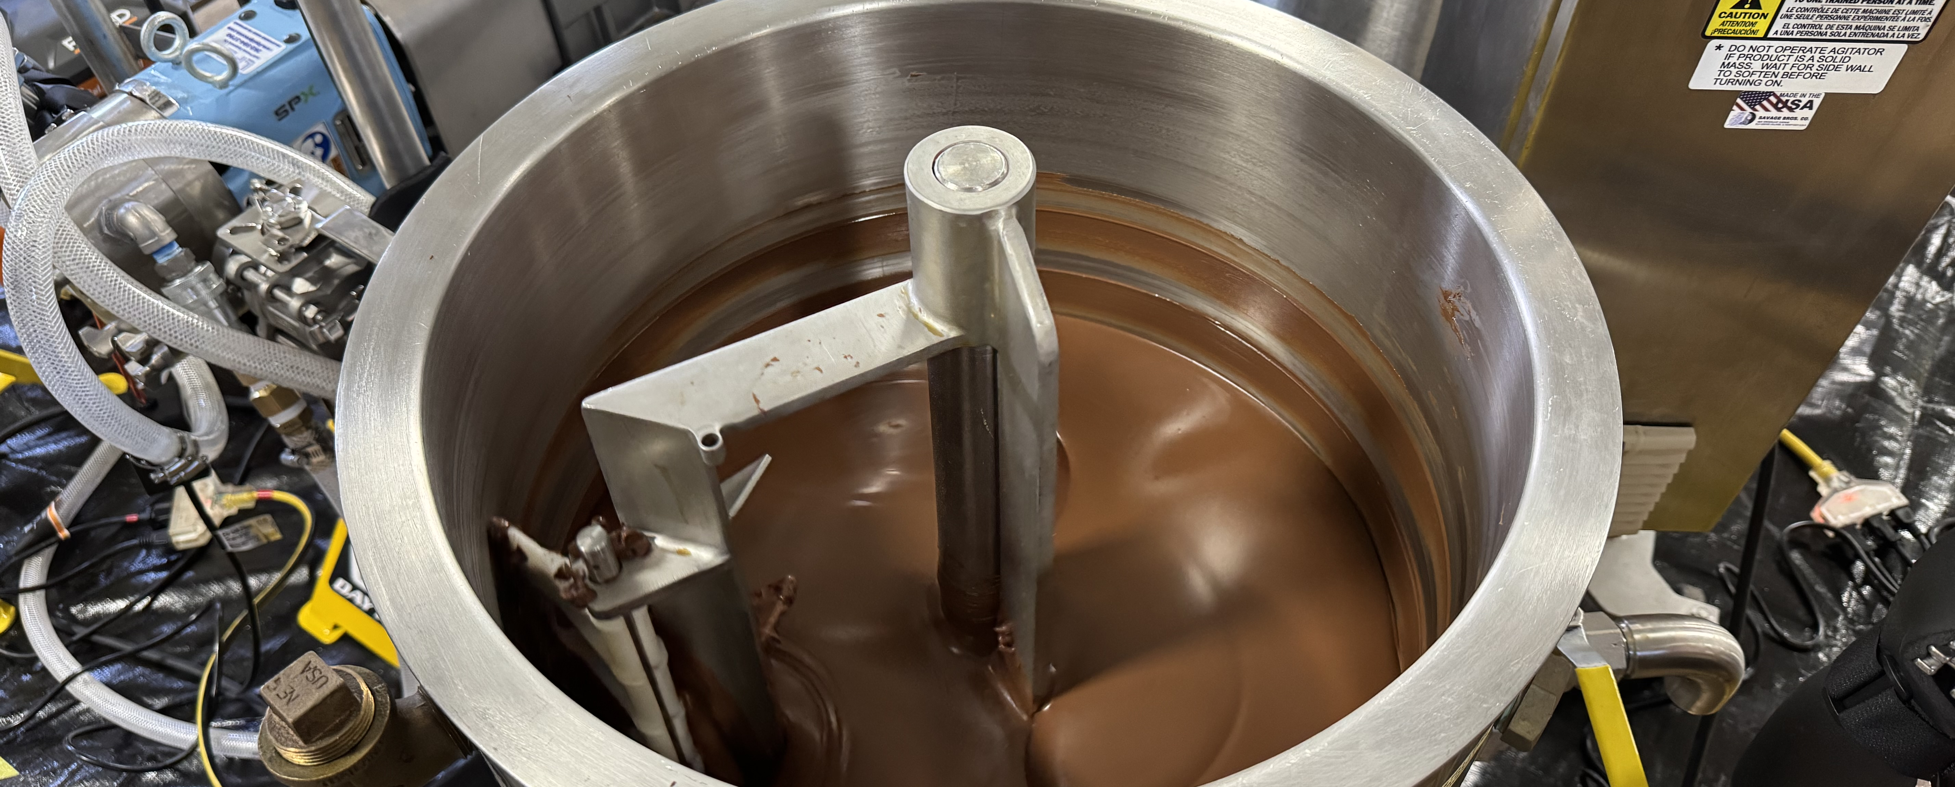
Dry sanitation of closed production lines by flushing with acidified oil emulsion
Shihyu Chuang, Ph.D.
Postdoctoral Research Associate, Department of Food Science, University of Massachusetts Amherst

Slide 31
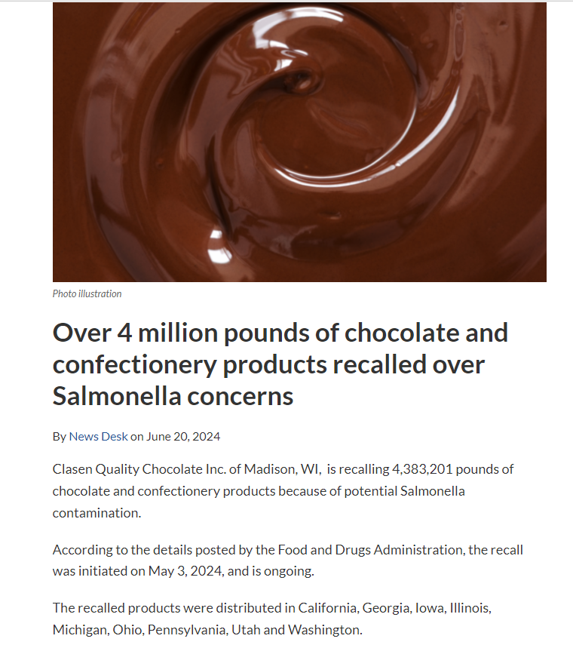
Cleaning Challenges for Dry Food Processing Environments
Manufacturers of dry foods have limited options when a bacterial pathogen is found in their food product.
Dry cleaning (scraping, vacuuming, product/oil flushing) is used for day-to-day cleaning of low-moisture food processing facilities but is not antimicrobial.
Wet cleaning of a dry processing facility can take over 1 month to complete, costing manufacturers millions of dollars.
Oil flushes remove food residues from processing lines (a.k.a. clean) without adding water but are not antimicrobial even with high heat.
Over 4 million pounds of chocolate and confectionery products recalled over Salmonella concerns | Food Safety News
Notes:
One of the biggest challenges of dry food manufacturers is creating a “clean break” in processing. A clean break is the point at which they know the equipment was truly clean. Without a clean break, recalls can encompass all product produced since last clean break
After an oil flush, can use currently available dry sanitizing agents utilize isopropanol or ethanol which are flamable

Slide 32
Dry Food Solutions: formulated oils for sanitizing food processing equipment
Highly antimicrobial formulated oil which is applied after an oil flush or pigging to remove food (patented)
Antimicrobial efficacy has been validated by two independent commercial laboratories. Ultimately, oil-based sanitizers may increase the frequency of sanitation in low-moisture food processing, improving food safety
Validated against peanut butter inoculated with Salmonella Enteritidis and non-pathogenic Enterococcus faecium in a benchtop system
Notes:
Water in oil emulsion
All foodgrade components (oil, surfactant, acid)
Controlled amount of water (3%), less than in an alcohol based sanitizer (30%)
We hare getting >6 log kill of salmonella, regardless of bacterial dryness, treatment temperature

Slide 33

Thank you
Dr. Christina Allingham, cwormald@umass.edu
Prof. Amanda Kinchla, M.S., kinchla@umass.edu

