Slide 1
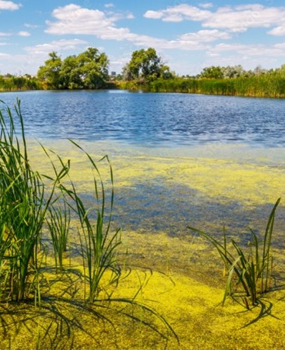

Harmful Agal Blooms​
HABS​
A local Challenge from Wayland Massachusetts
Ann Loree, MSPH, CHO, REHS/RS, CP-FS, SE, SI
September 10, 2025

Slide 2
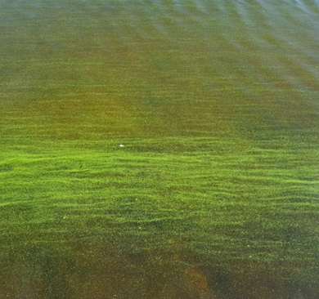
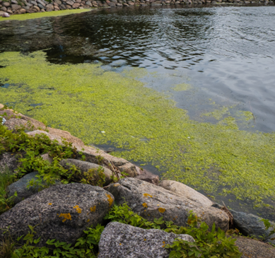
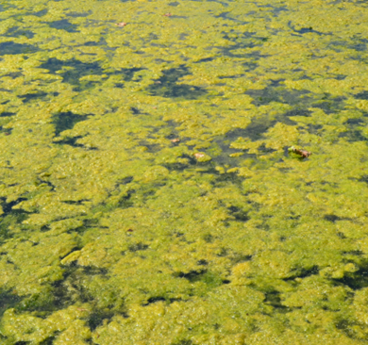
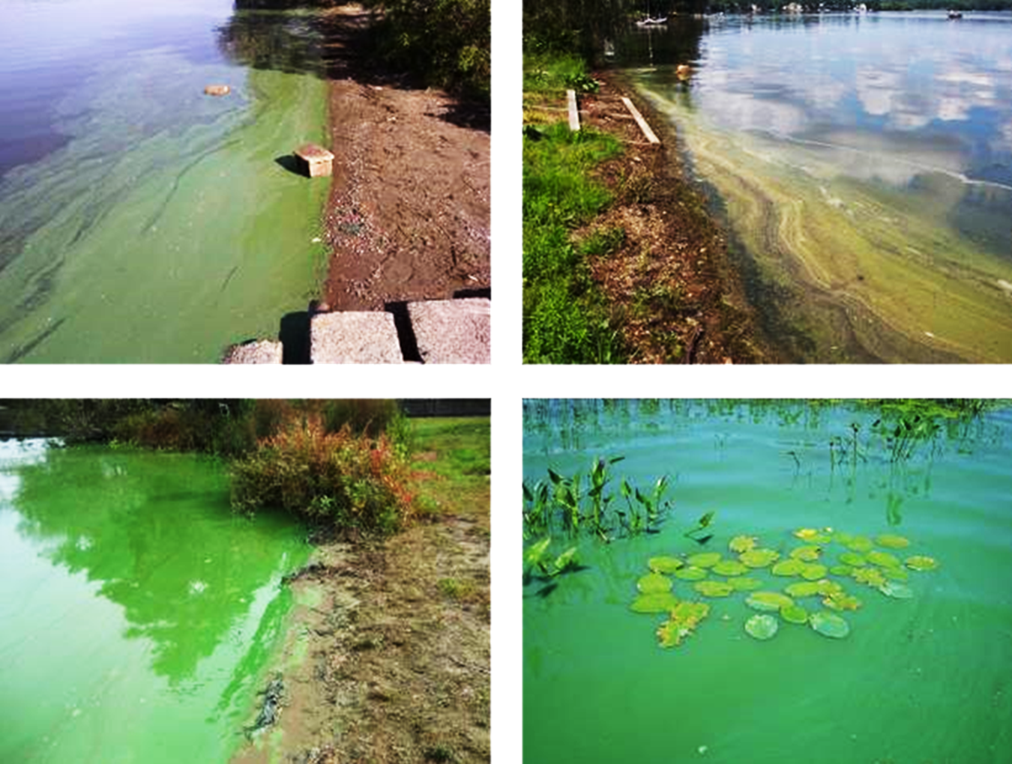
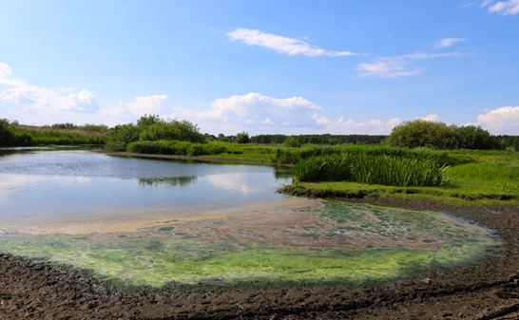
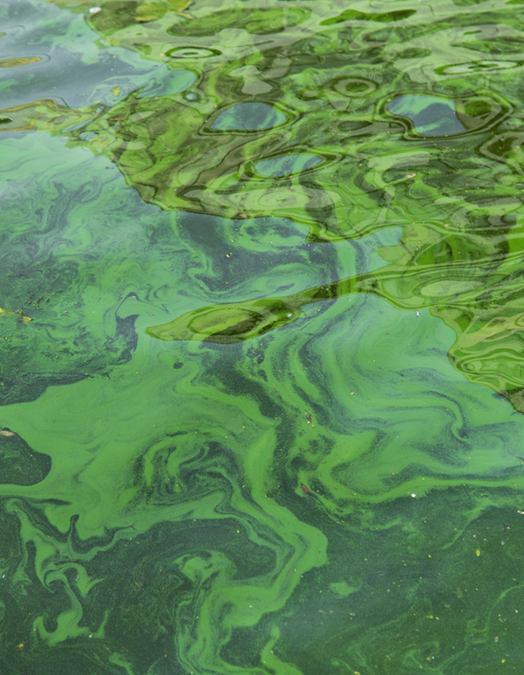
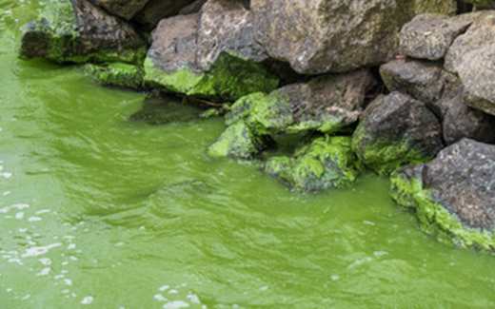
What are Harmful Algal Blooms (HABS)?

Slide 3
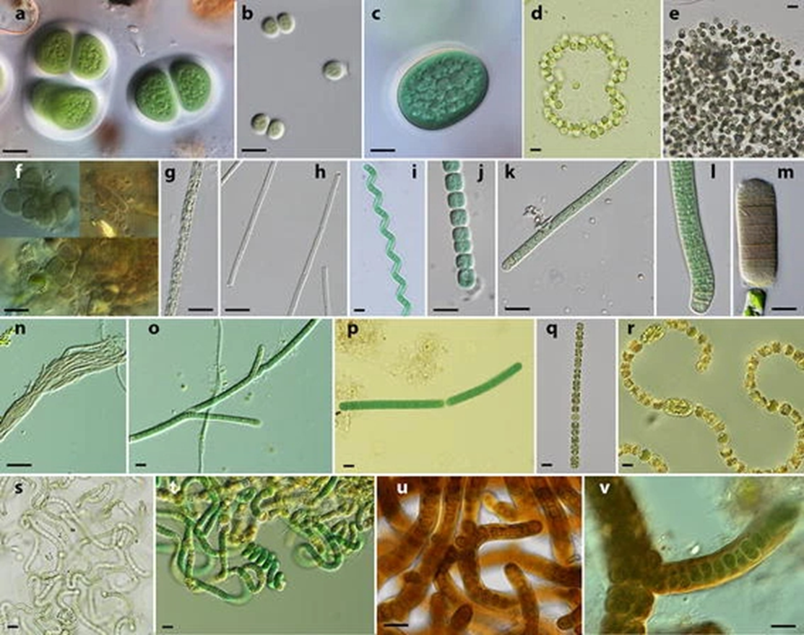
Various
Algae types

Slide 4

What Causes HABs to Grow?
Warm weather
  Sunlight
  Environmental Conditions:
  Sunlight
  Warm temperatures
  Warm water
  Stagnant or slow moving water
  Water fowl
  Excess Nutrients:
  Nitrogen and phosphorus
  Fertilizer
  Human and animal waste
  Failed Septic Systems
  sunlightnutrients
Sto
  Warm weather
  Sunlight
  Excess nutrients
  Stagnant/slow-moving waters
Specific factors behind each bloom vary because every waterbody is different.
Two most common factors: Phosphorus and Nitrogen, which are found in fertilizers and human/animal waste.
Septic system effluent leaks and geese, duck, and dog droppings are causative.
  moving waters
Specific factors behind each bloom vary because every waterbody is different.
Two most common factors: Phosphorus and Nitrogen, which are found in fertilizers and human/animal waste.
Septic system effluent leaks and geese, duck, and dog droppings are causative.
Notes:
When do they grow?
What influences their growth?
Certain environmental conditions, such as warm weather, sunlight, excess nutrients, and stagnant/slow-moving waters help cyanobacteria grow faster. Specific factors behind each bloom vary because every waterbody is different. However, two of the most common factors are phosphorus and nitrogen, which are found in fertilizers and human/animal waste.
Septic system effluent leaks and geese, duck and dog droppings are causative.

Slide 5

Hydrogeology of Wayland, Massachusetts
2 ponds in neighboring towns cascade in series into North Pond, Lake Cochicuate.
HABs bloom flow in the same direction from one pond into the other.
In 2023 Wayland Board of Health chose to test the water before closing the bathing beach.
Notes:
Lake Cochicuate Image Link: https://live.staticflickr.com/8661/28376826640_30bc4d93bb_b.jpg

Slide 6
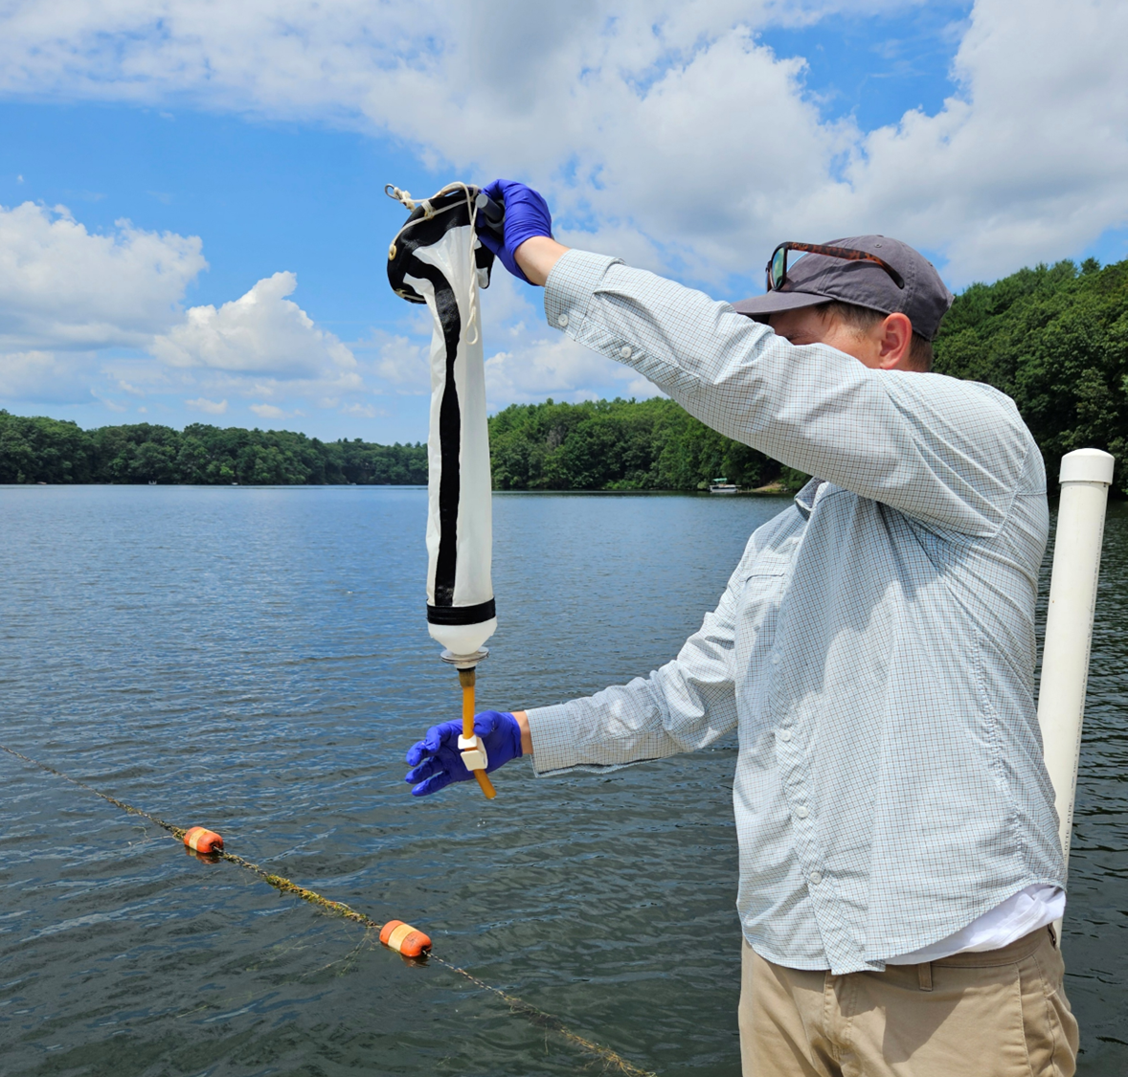
Massachusetts
Environmental Protection
Agency
Notes:
Massachusetts Department of Environmental Protection
Demonstrates proper sampling

Slide 7


Testing for Microcystins
Abraxis Microcystins Test Strip Method
8 step bench assay test
Test strip
AbraScan Reader
Notes:
Method we chose to use for Testi
Abraxis Microcystins Test Strip Method
6 step bench assay test
Test strip
Abrascan Readerng for Microcystin

Slide 8
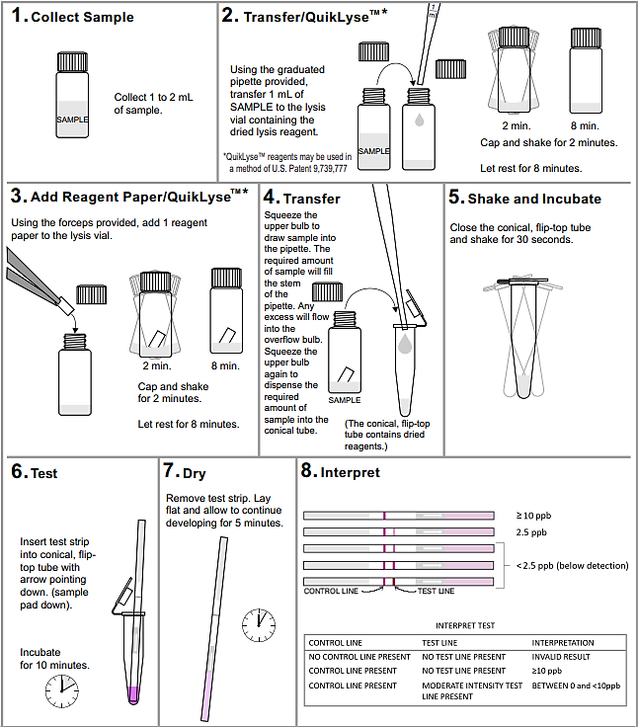
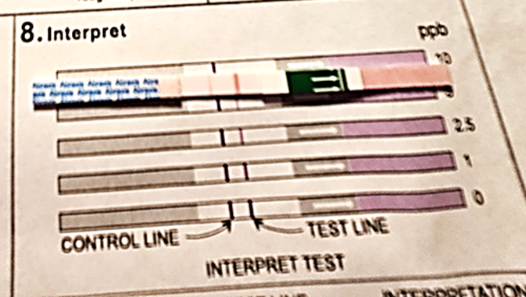
Abraxis Microcystins
Test Strip Method

Slide 9
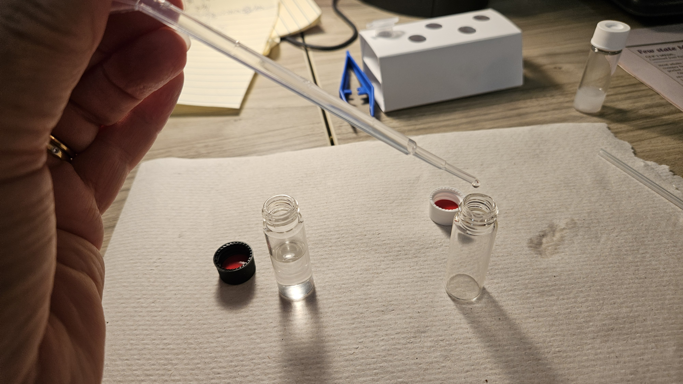
Pipette 1 ml of sample into lyse vial

Slide 10
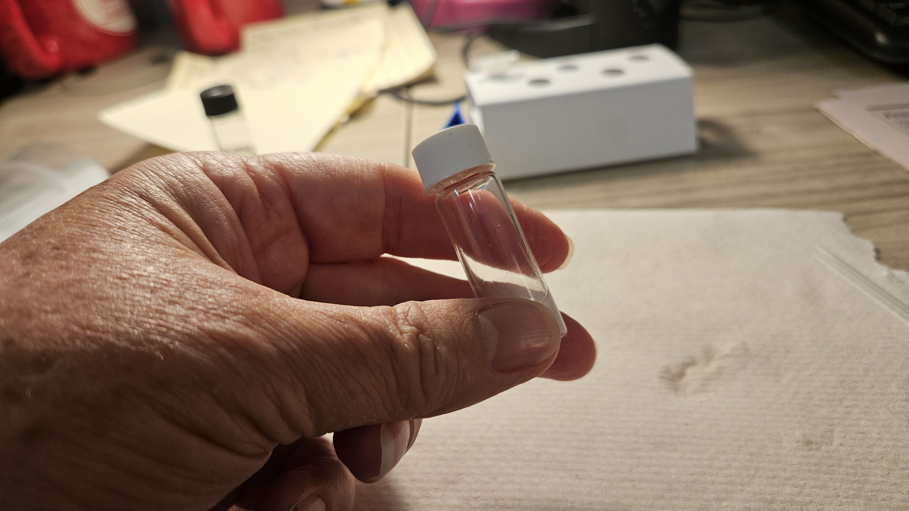
Shake the vial for two minutes, let stand for 8 minutes

Slide 11
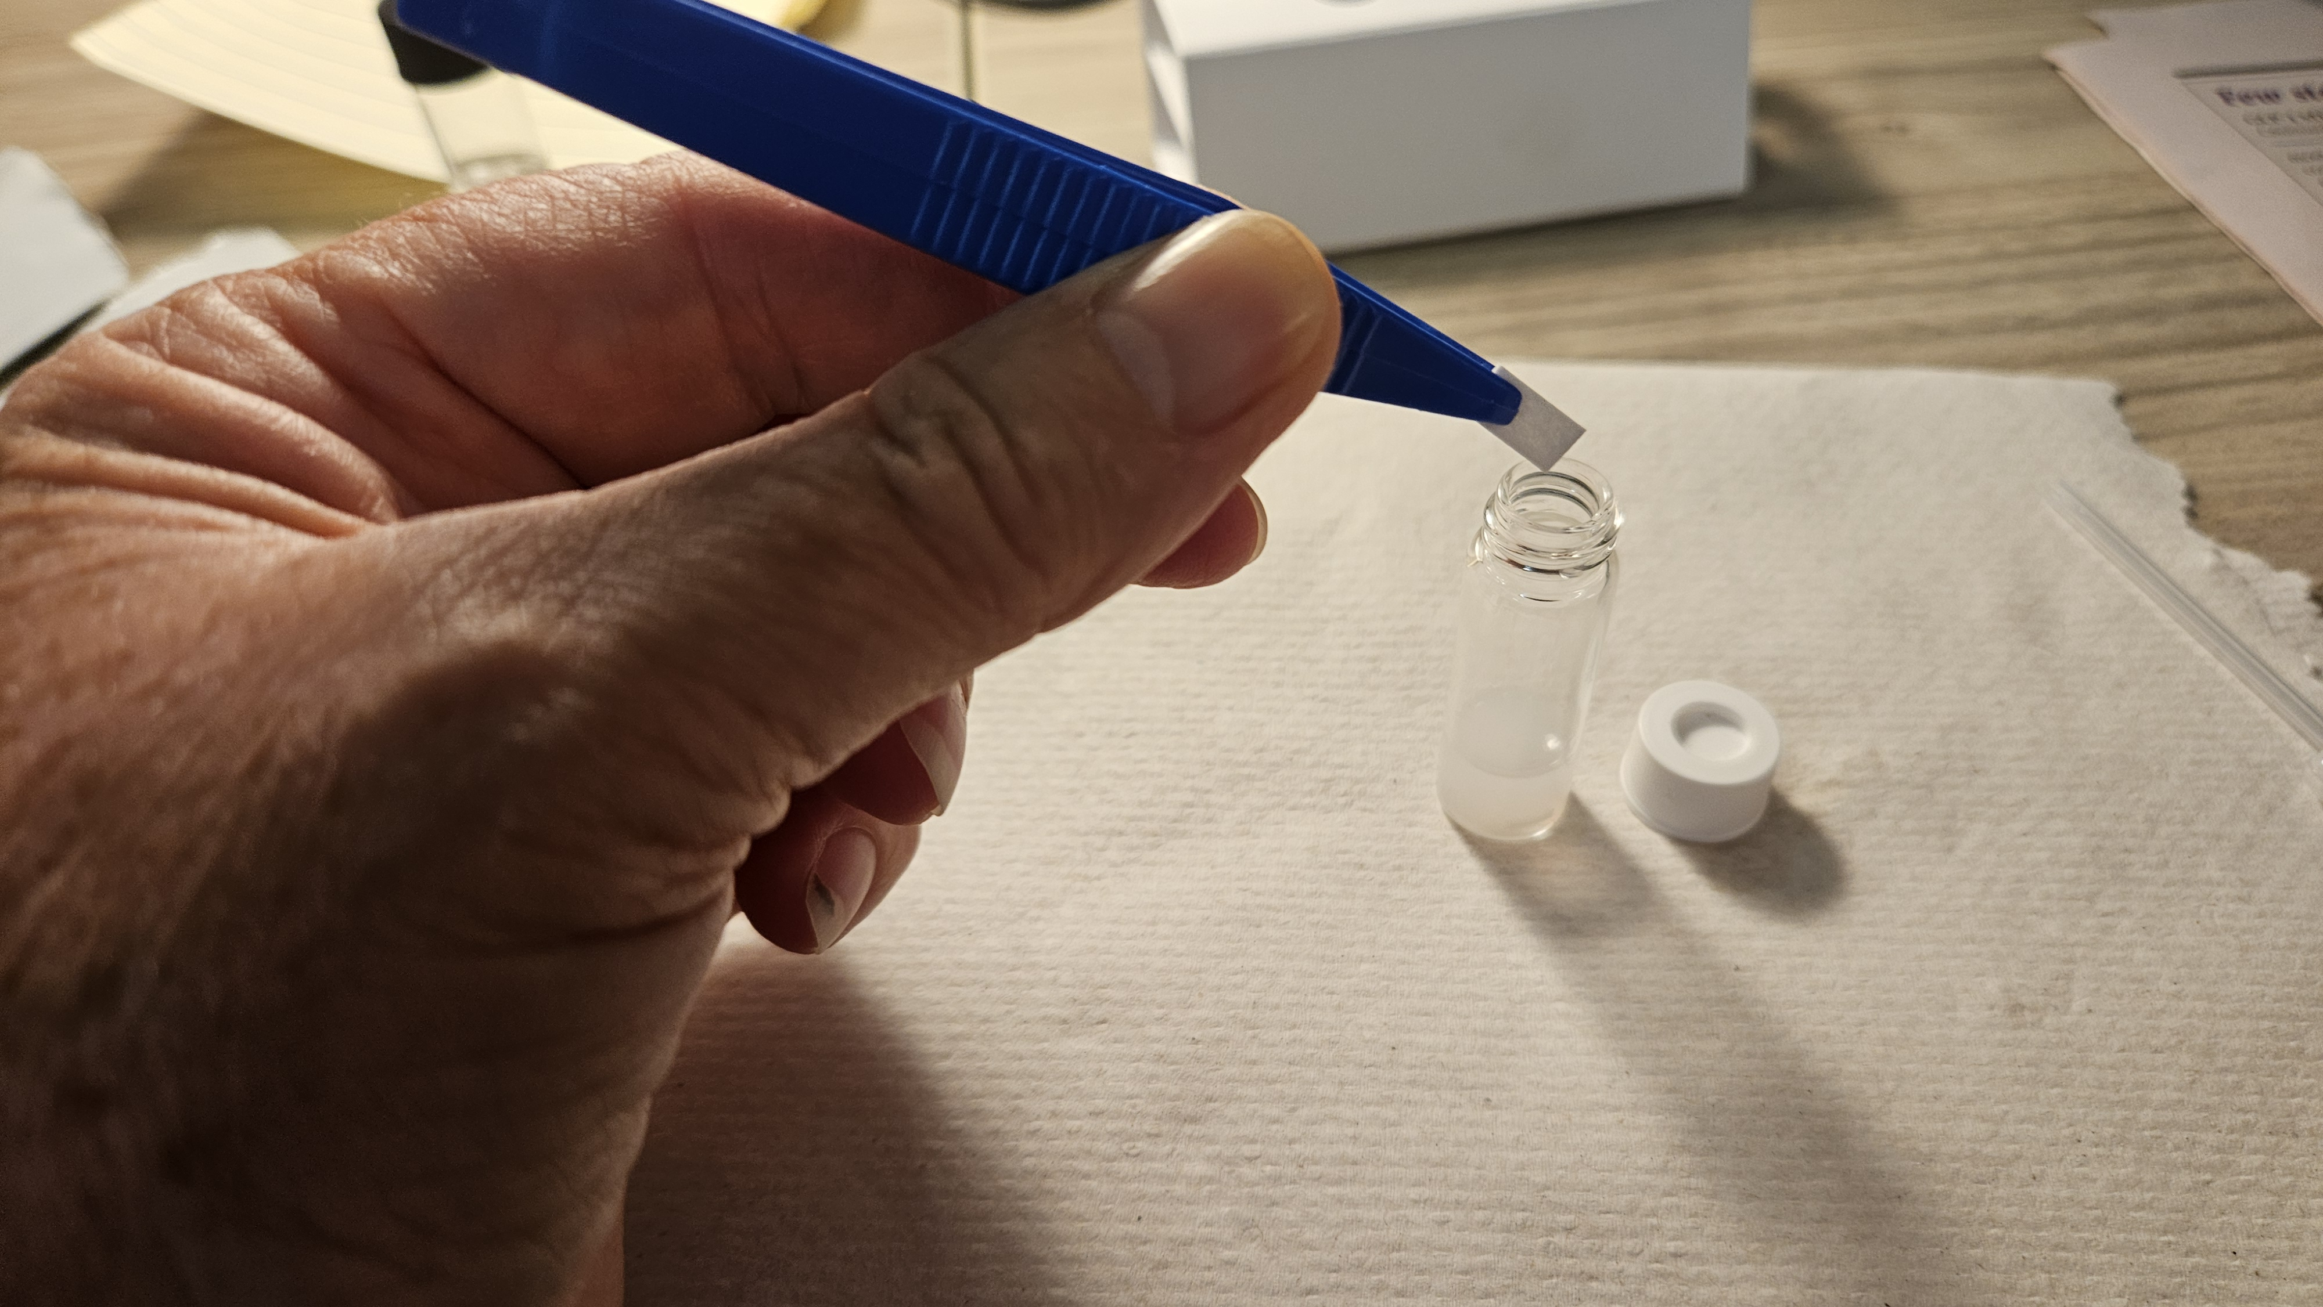
Add reagent paper

Slide 12
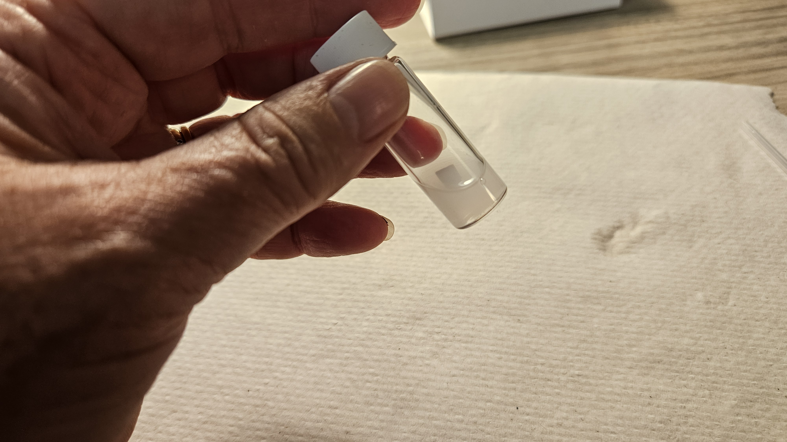
Shake for two minutes

Slide 13
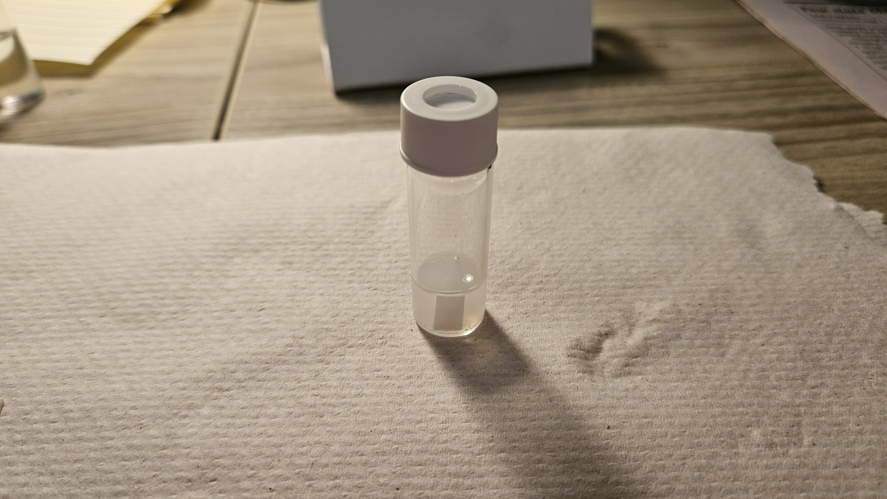
Let vial stand and cook for 8 minutes

Slide 14
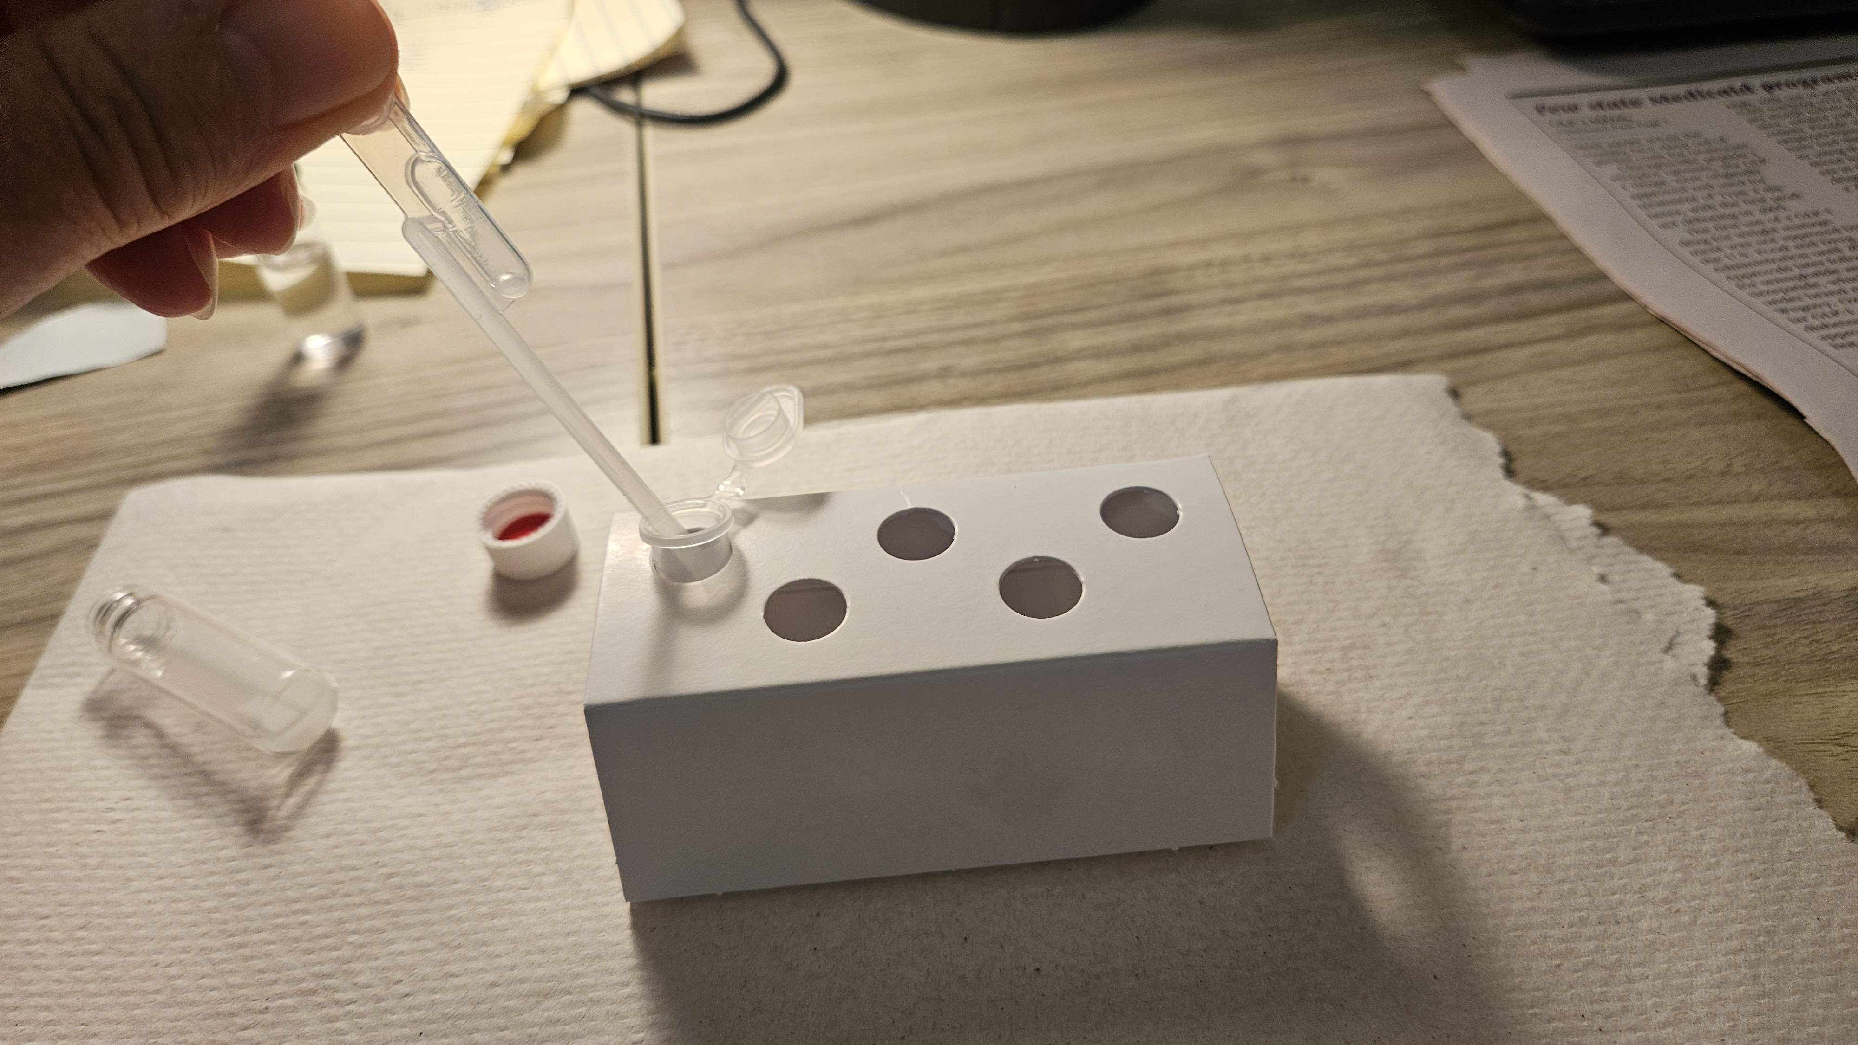
Remove .1 ml with the micro pipette to a microcentrifuge tube

Slide 15
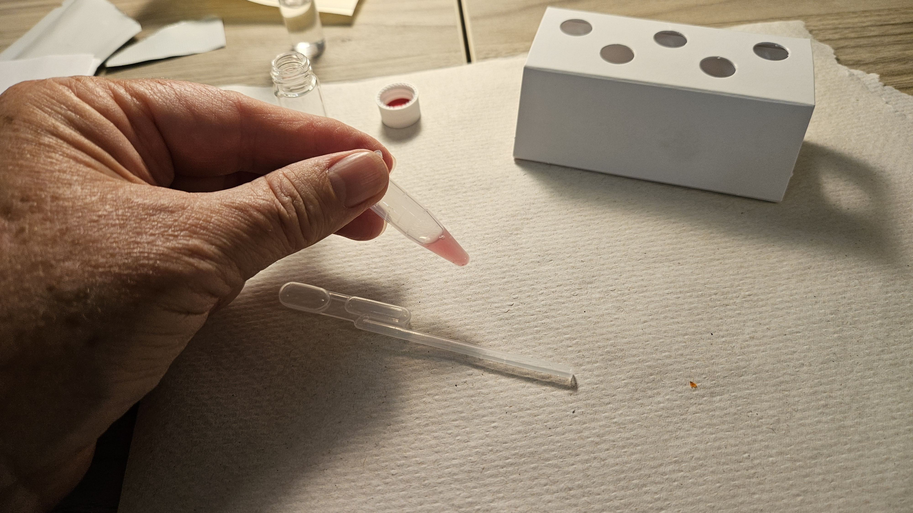
Swirl the microcentrifuge tube for 30 seconds

Slide 16
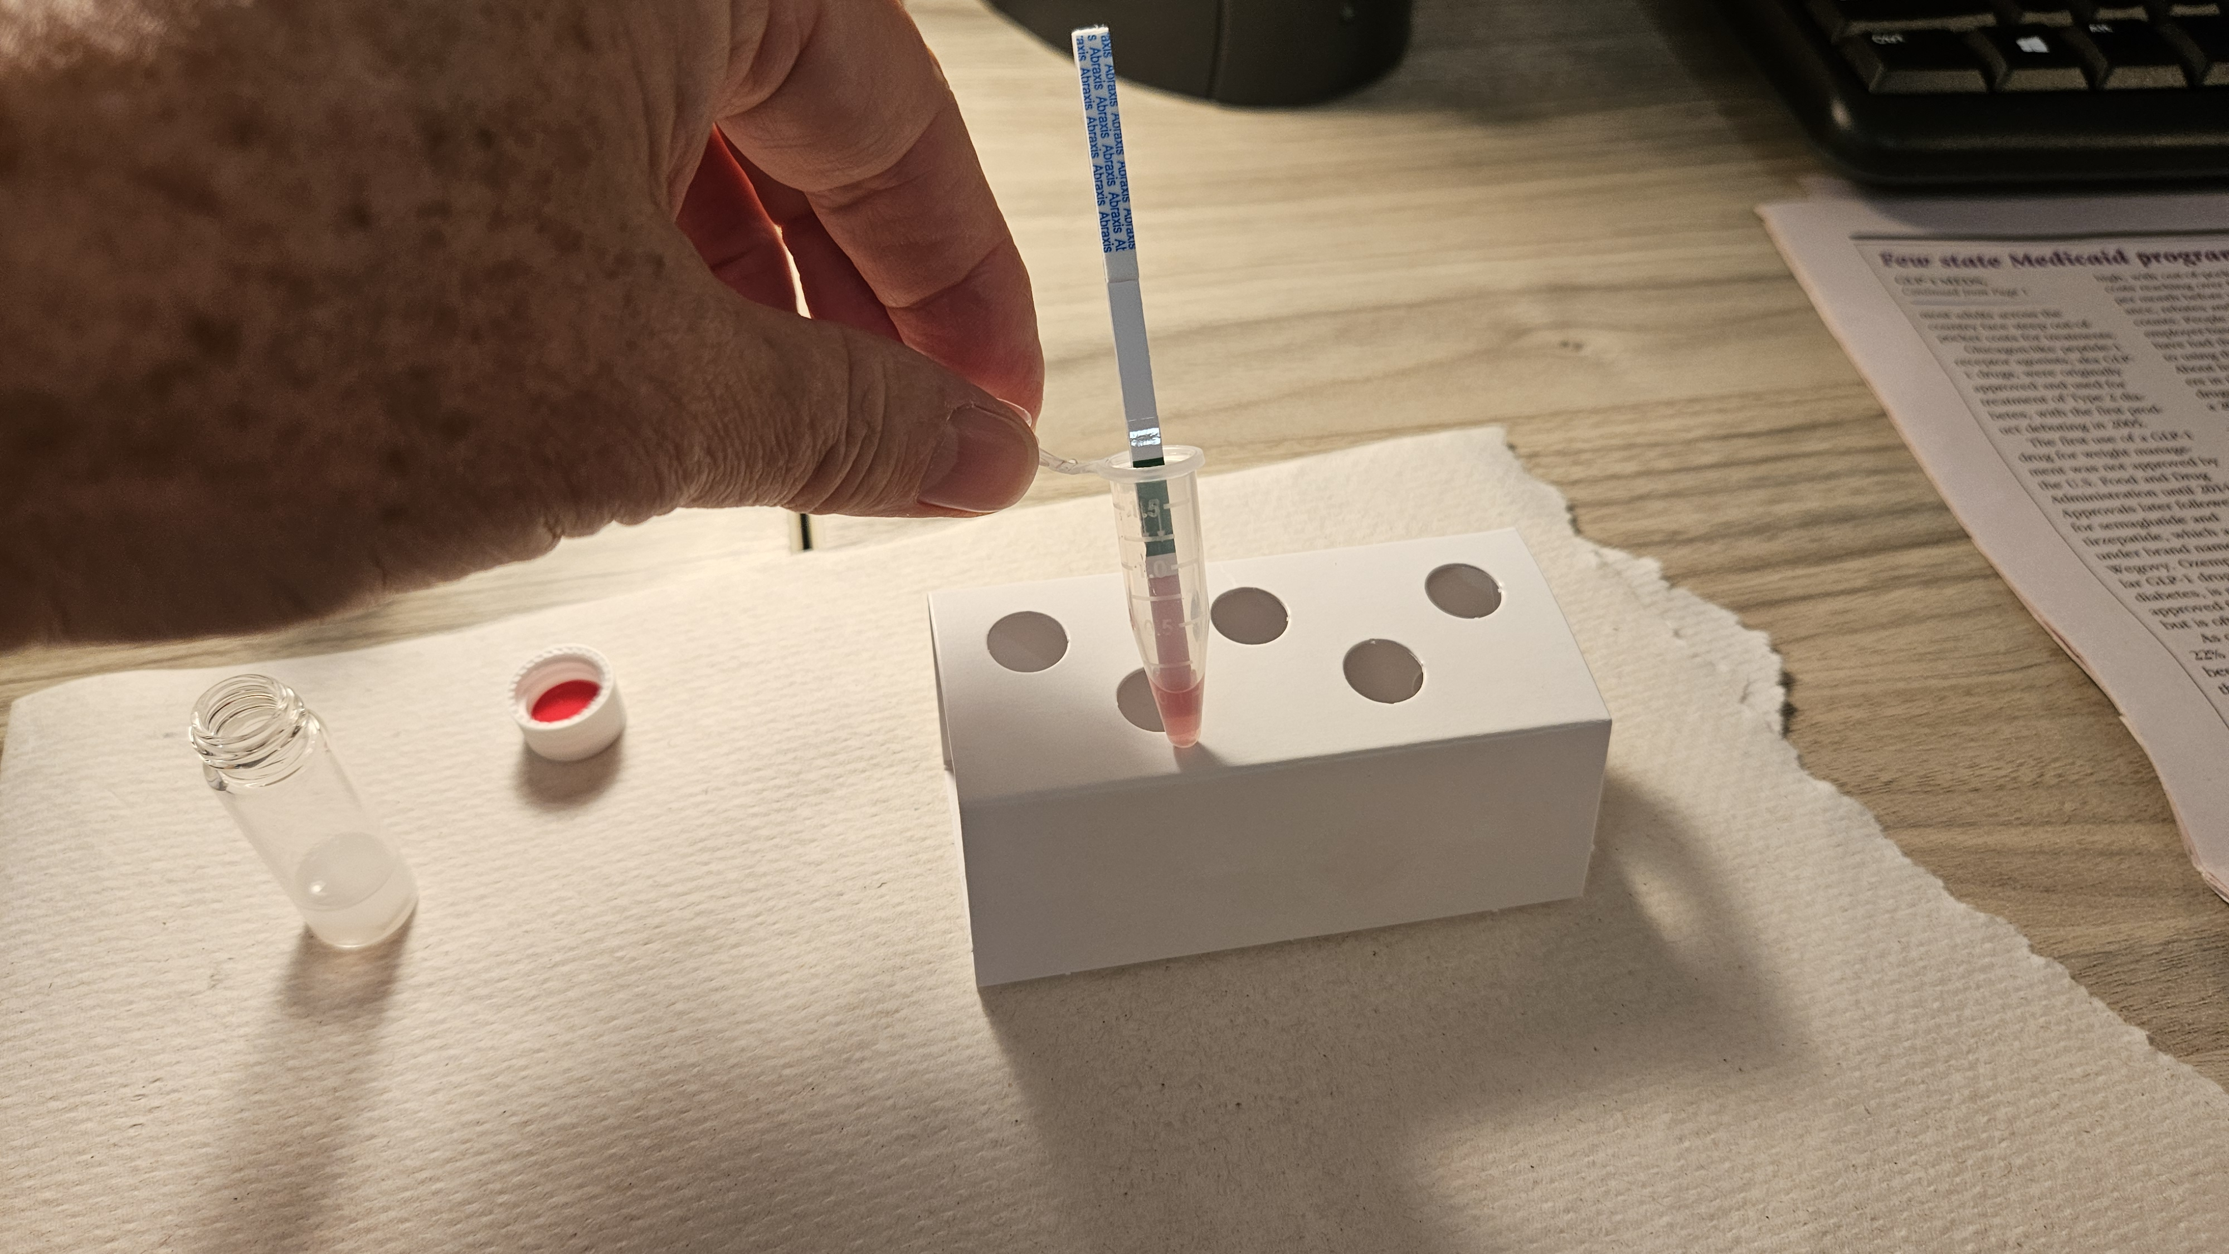
Test strip is placed into microcentrifuge tube arrows down for 10 minutes

Slide 17
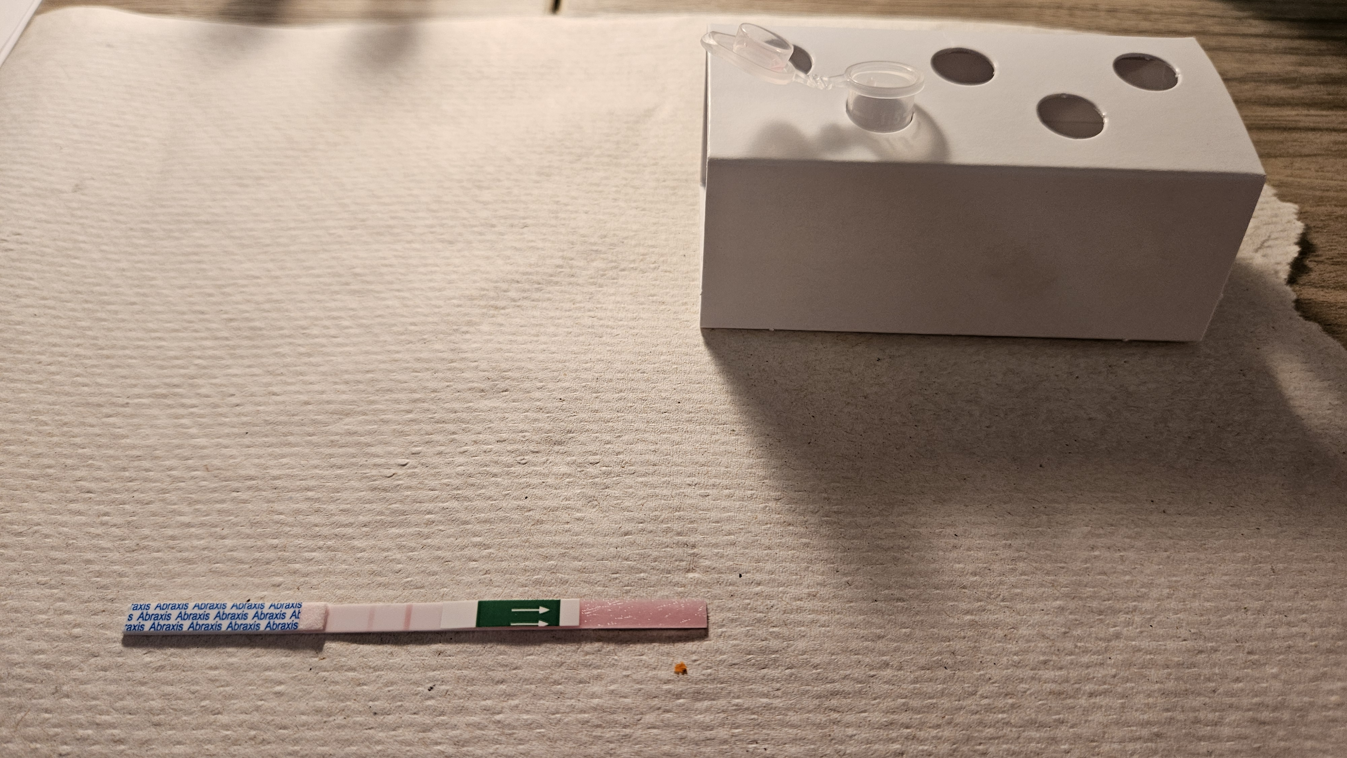
Remove test strip and let sit for 5 minutes

Slide 18
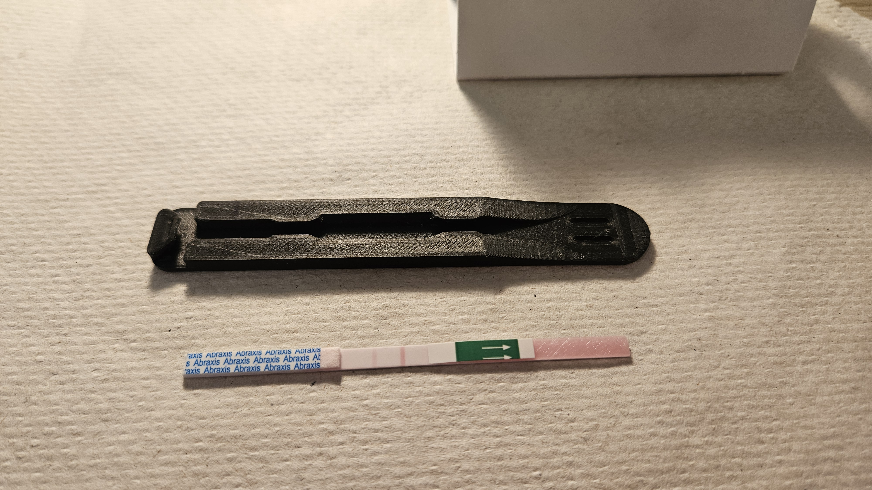
Strip goes into the black jacket

Slide 19
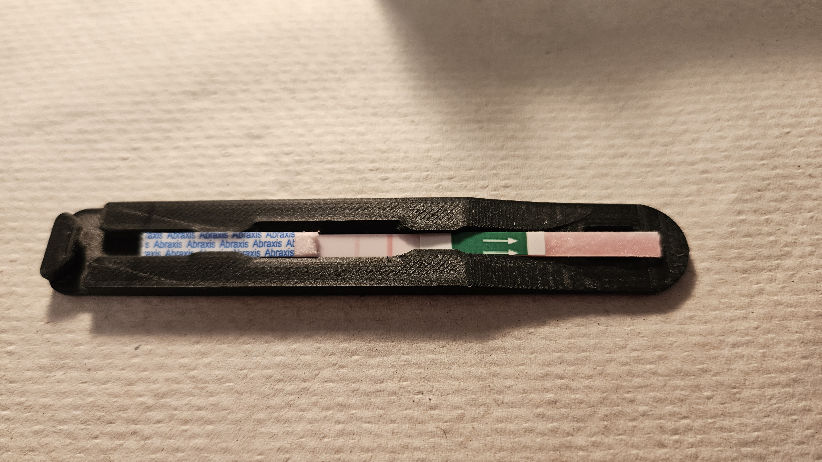
Position the test strip so test line is next to indents on the black jacket

Slide 20
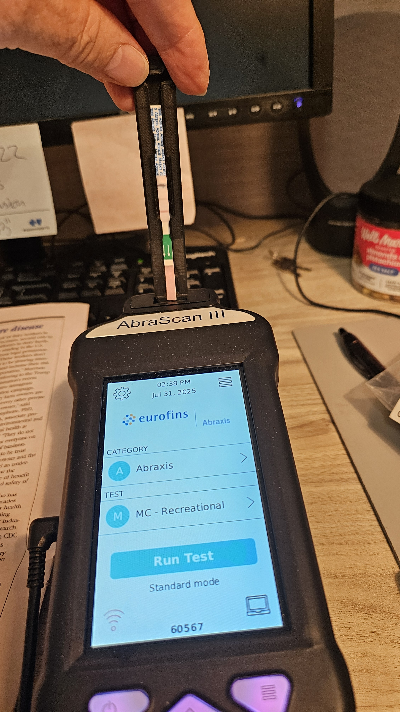
Insert the black jacket and test strip arrows down

Slide 21

Enter sample ID number into AbraScan

Slide 22
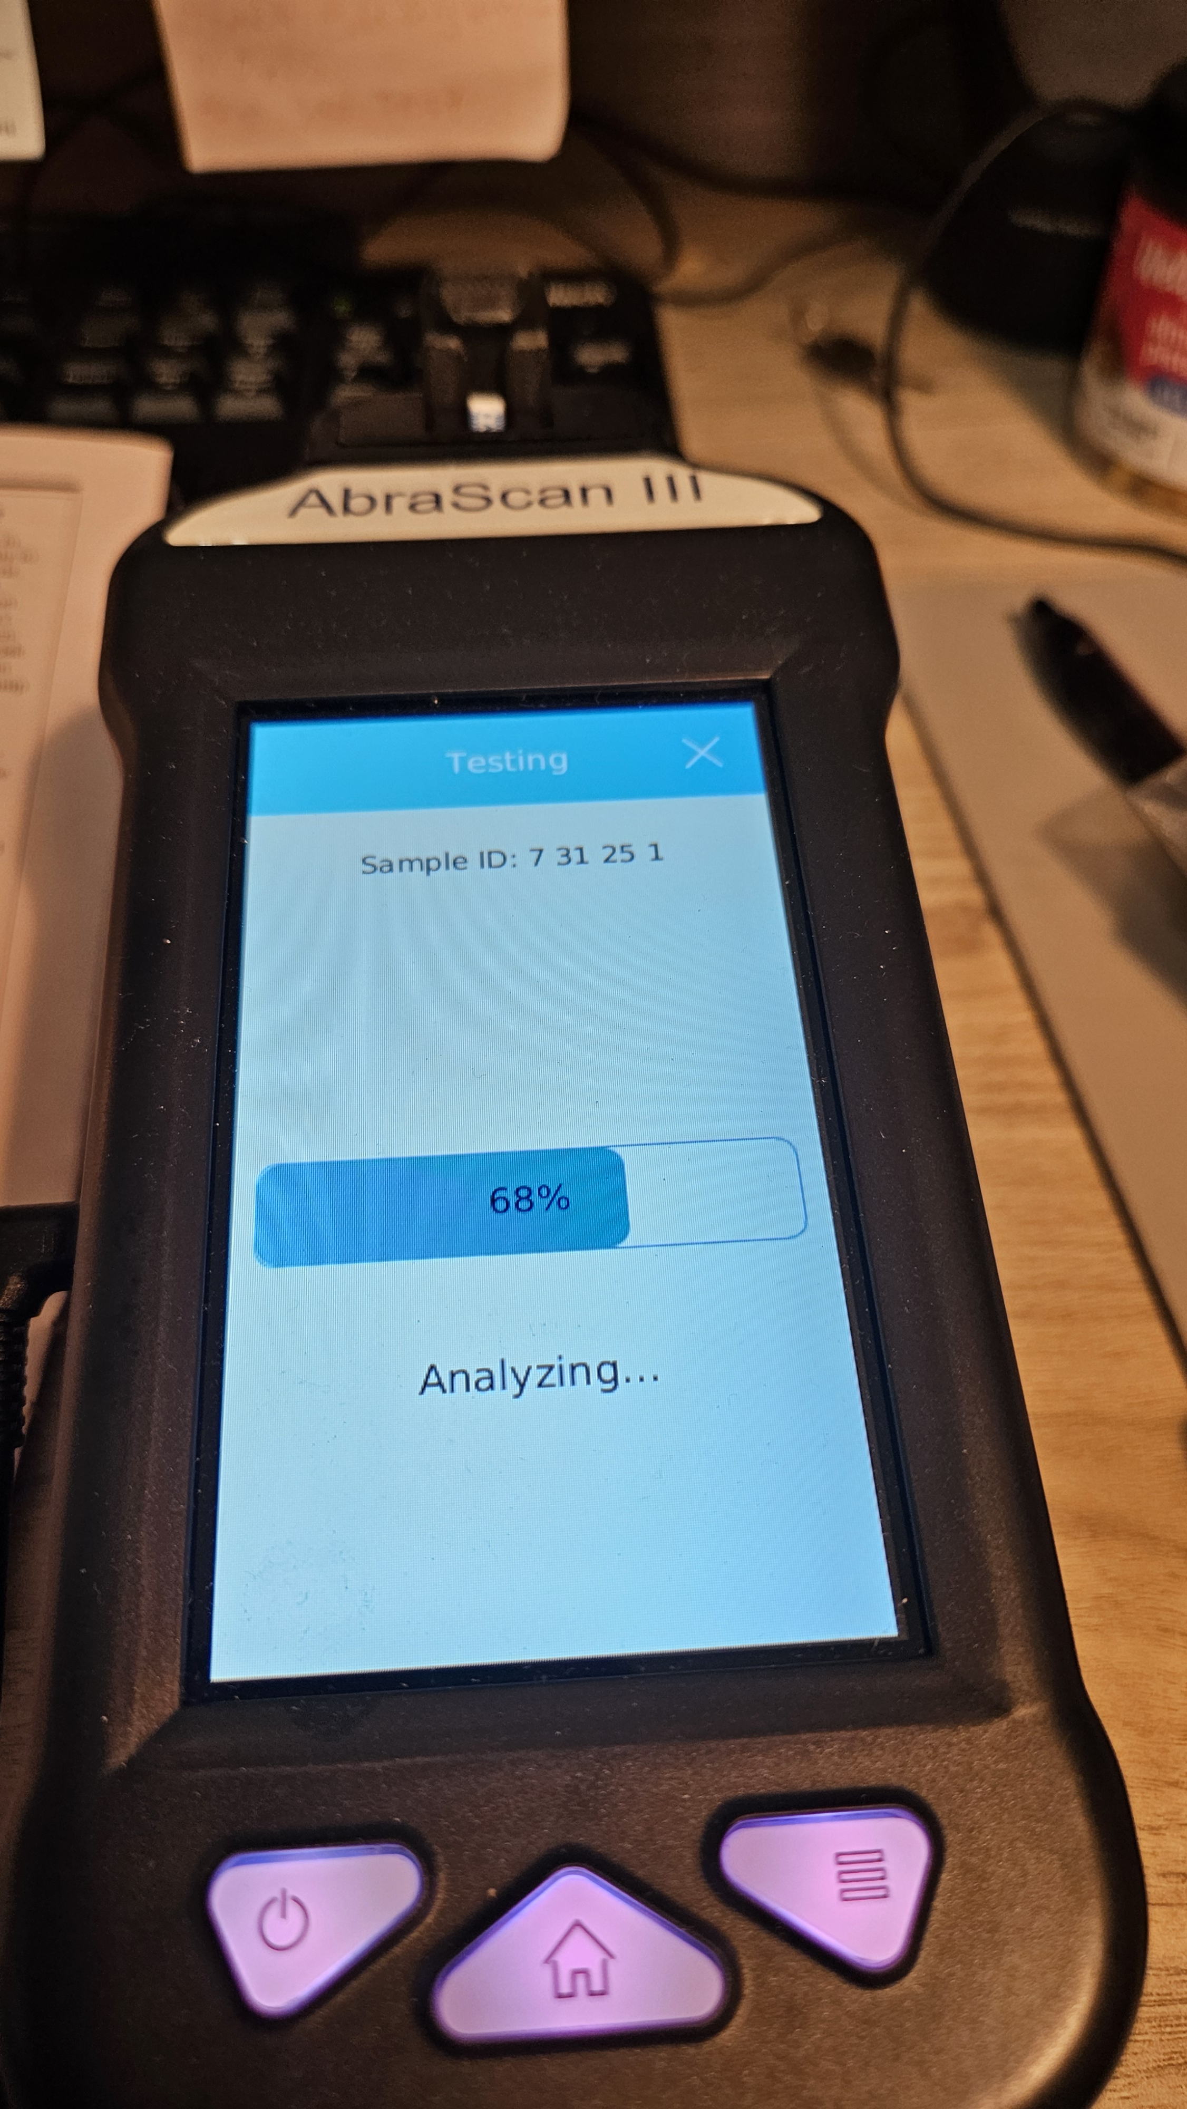
Processing sample

Slide 23
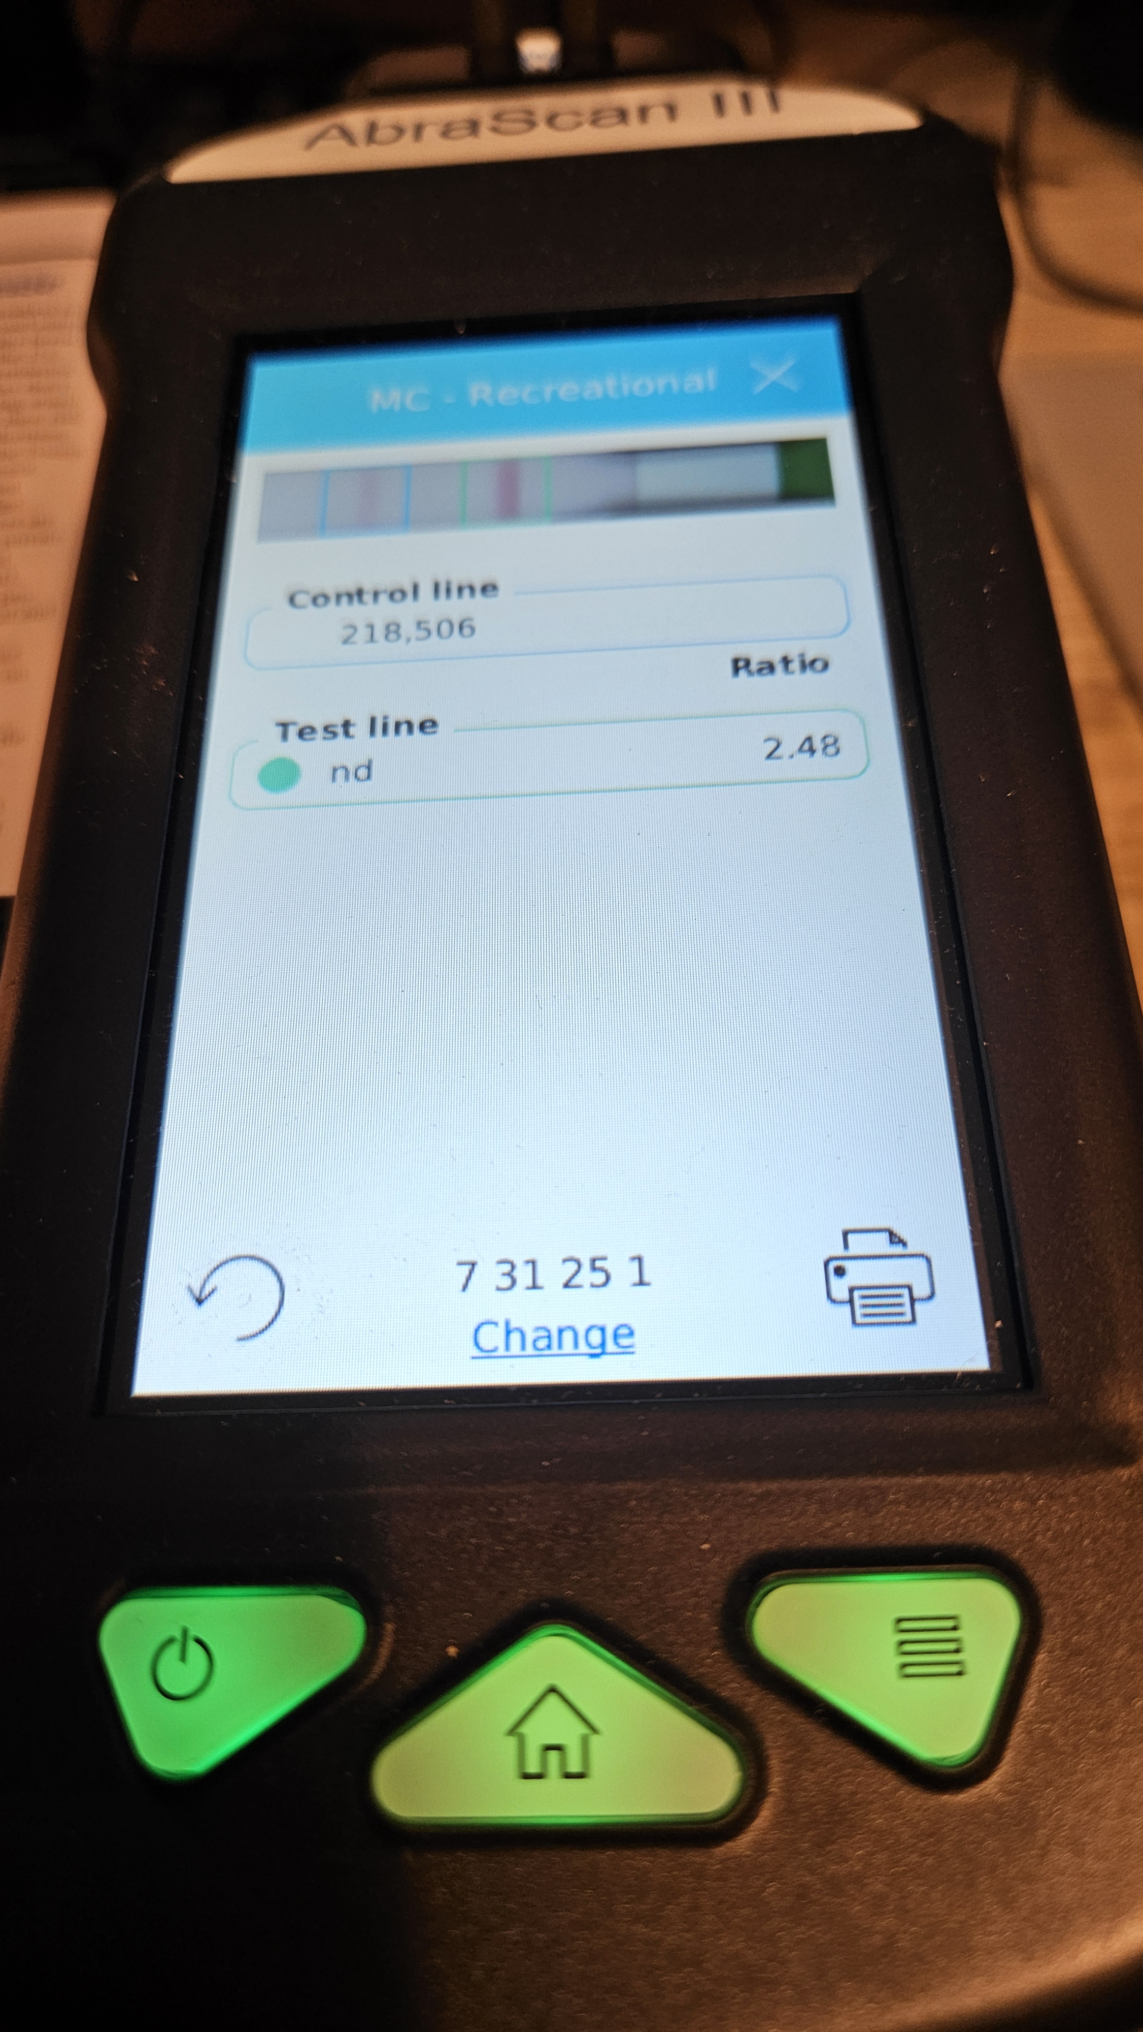
Microcystins Not Detected

Slide 24
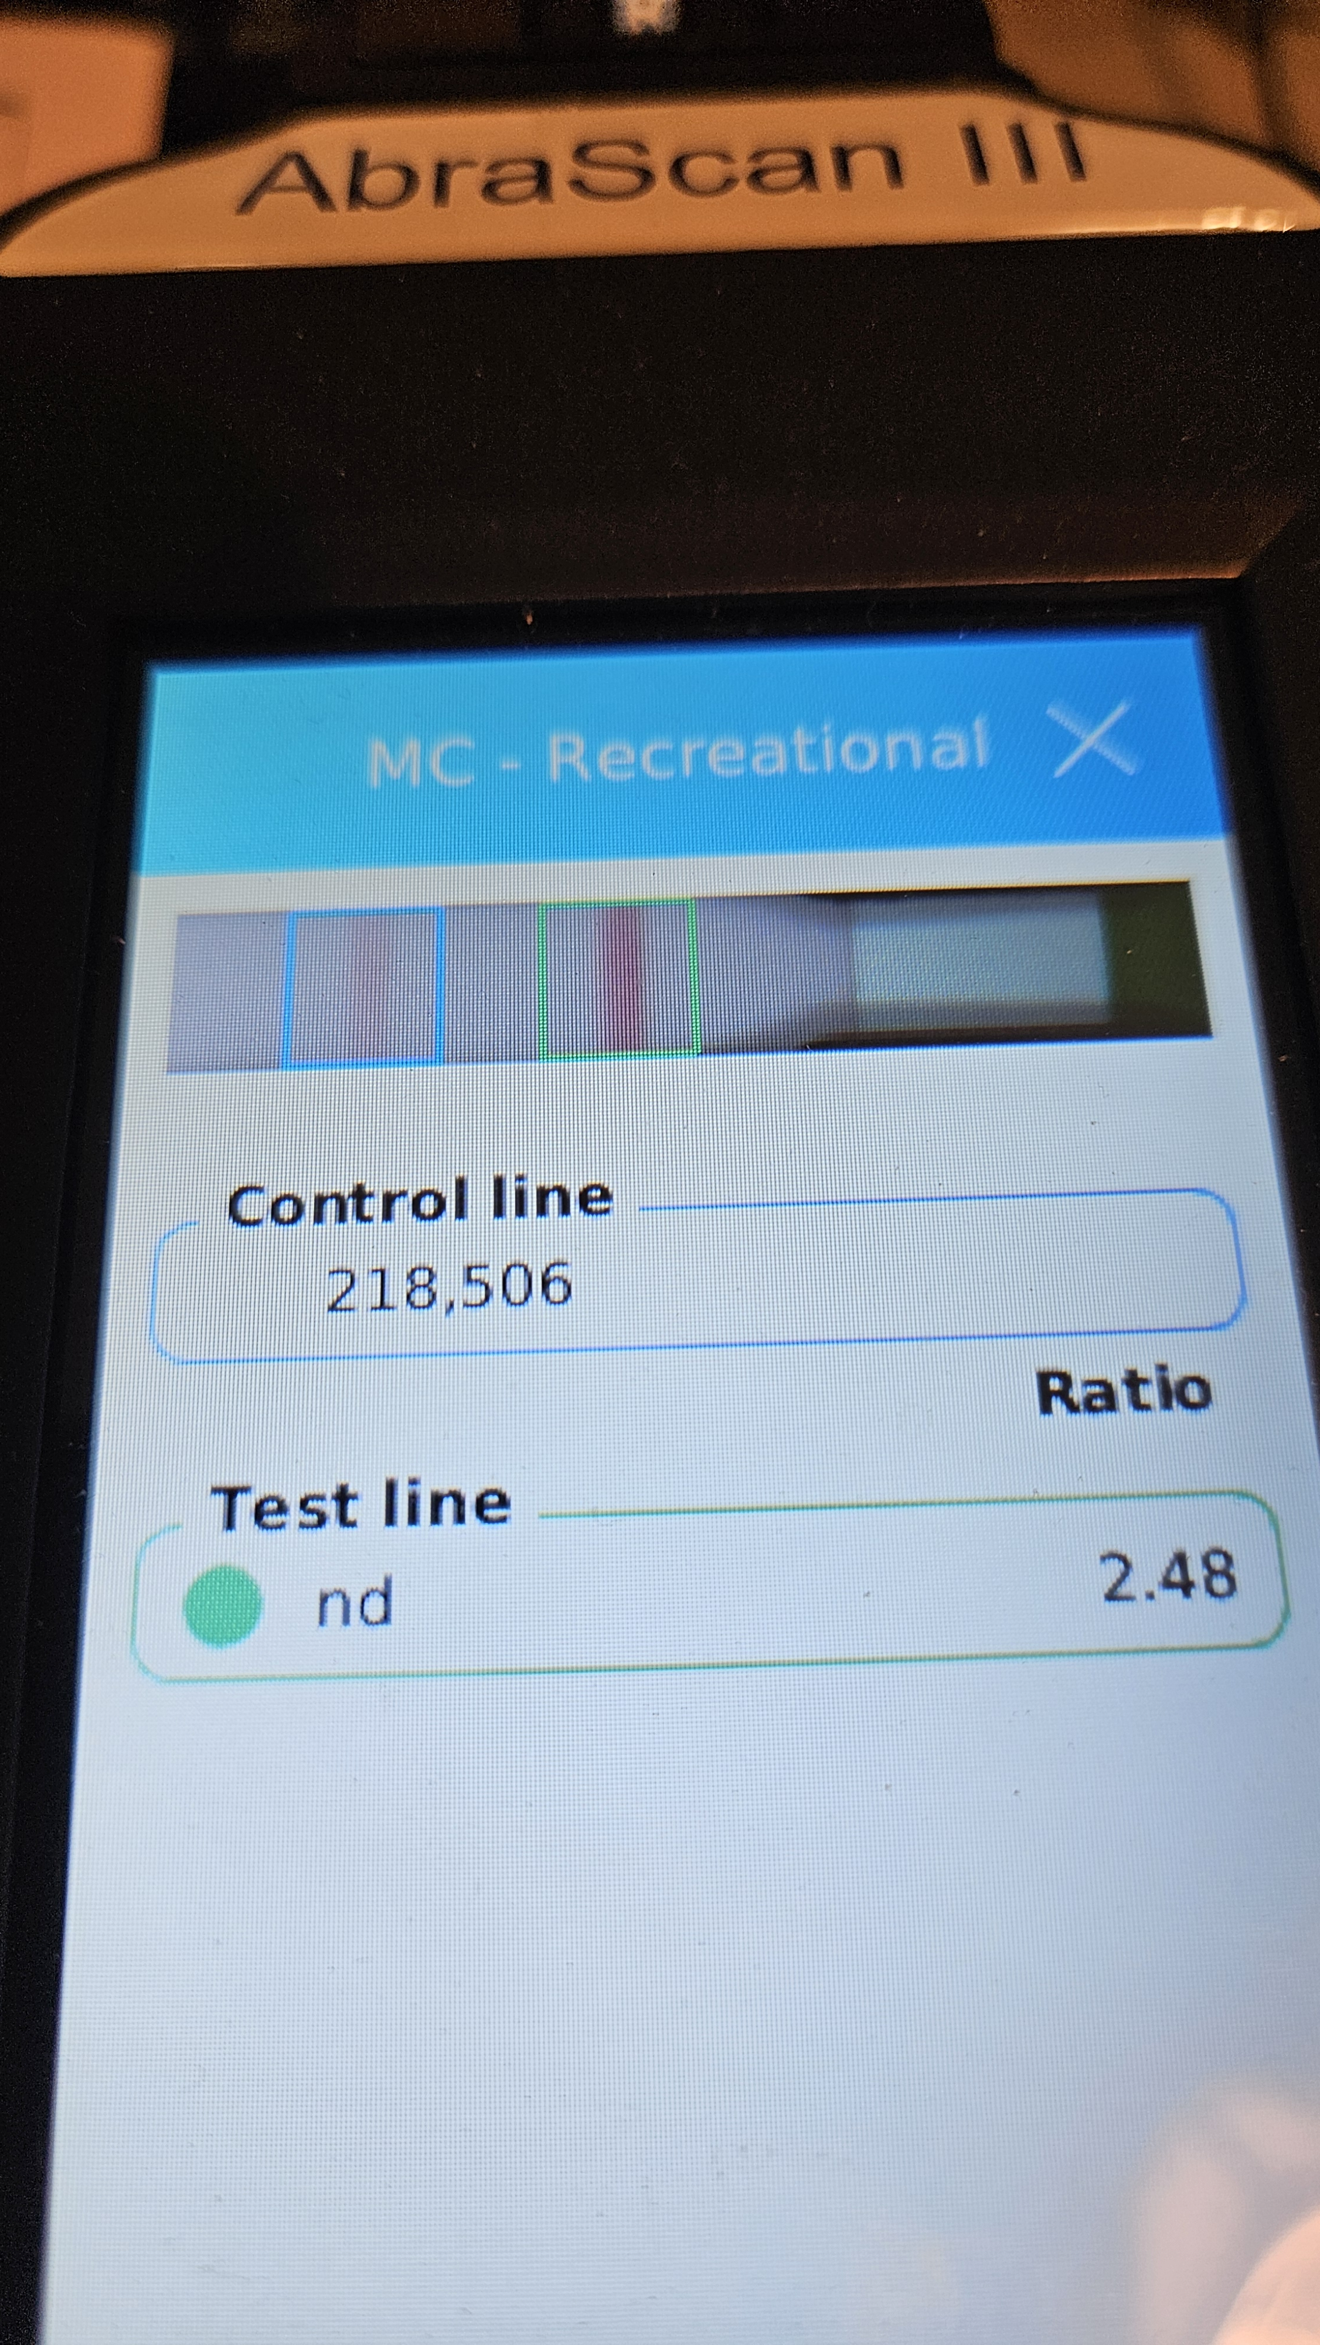
Blue bracket is control line
Green bracket is test line
Both Lines must be in respective brackets to be valid

Slide 25
Testing is Key
Know if you have a rising toxin situation in your recreation waters
Fresh water situation can change overnight
If you rely solely on visual, risk missing it!

Slide 26
Lessons Learned
You cannot always tell by looking at it!
Find a method that goes beyond observation.
Plan for time to work out the technology.

Slide 27
Thank you!
Ann Loree MSPH, CHO, REHS/RS, CP-FS, SE, SI
Regional Health Agent
Great Meadows Public Health Collaborative
loreea@sudbury.ma.us

